Slide 1
How to create a digital family policy?
WHAT CAN PARENTS DO FOR DIGITAL SAFETY AT HOME?
FÜLÖP HAJNALKA
DIGITALLY AWARE PARENT

Slide 2
Tuning:)
-The digital space is infinite, parenthood is an eternal relationship.
We are the first generation to grow up offline and raise children in the online space.
The two pillars of knowledge:
1. knowledge of technology, digital tools, algorithms, content and business models.
2.Self-awareness, recognition of emotions, importance of connection, self-regulation

Slide 3
Kids online - generation alpha - Touch screens
Today's children are all born in the 21st century
And today's teachers and parents grew up in the 20th century
Every schoolchild is now younger than Google!
The alpha generation has never lived a minute without digital devices
Internet by default, everywhere
Inactivity: NOT AN OPTION.
Consuming content online anywhere, anytime is also basic
Consumers of content, content producers (!), subjects of content

Slide 4
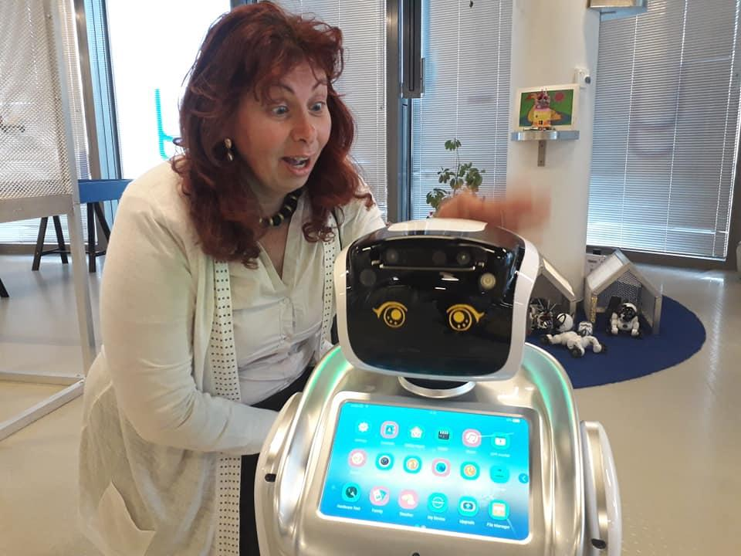
THE WORKS OF THE FUTURE do not yet exist
We set the patterns for the children
Machine learning
Augmented Reality- AR
Virtual Reality - VR
Artificial Intelligence - AI, AI
Internet of things
Blockchain
Robotics
Drones

Slide 5
A solution for online presence
Strategy: your why! The purpose of your online presence? What is the ideal response?
Tactics: self-regulation (parent, teacher, child), connection! , empowerment, peer support, discharge, detox.
Technique: setting limits, children's time, listening to crying- Related education- trauma-informed tools
Pair audition

Slide 6
3 M principles as parents in the digital age
0-6 years: we are models
6-14 years: we are managers
14 to 18 years: monitoring
Mental maturity , biological age, role in the family, family dynamics, digital transformation period
ld. Covid generation, Tik-Tok generation, etc.

Slide 7
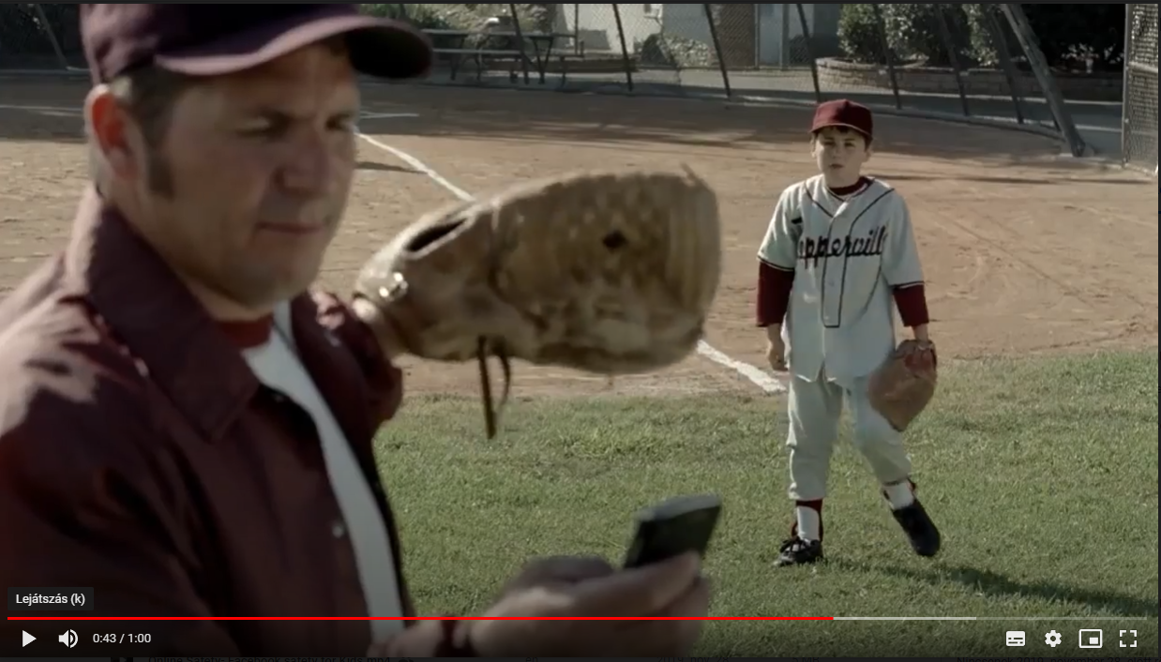
Why set limits?
Their beliefs about the digital space, their first strong impressions, their opinions, the attitudes that shape their lives are formed now, in childhood.
Connection is more important than control!!
These will become the patterns of thinking that can influence their success in the 21st century.
Notes:
Klaus, Really, WHERE do you live?

Slide 8
Digital detox
reduces stress
memory and attention improvement
Balance
positive future (news stop)
reduces the feeling of FOMO

Slide 9
SETTING LIMITS!! (RELATED EDUCATION TOOLKIT, E.G. CHILDREN'S TIME, LISTENING TO CRYING)
PERIOD: EVERY FAMILY IS DIFFERENT!
Screen-free sites
screen-free periods
Shared screen time
meaningful digital activities

Slide 10
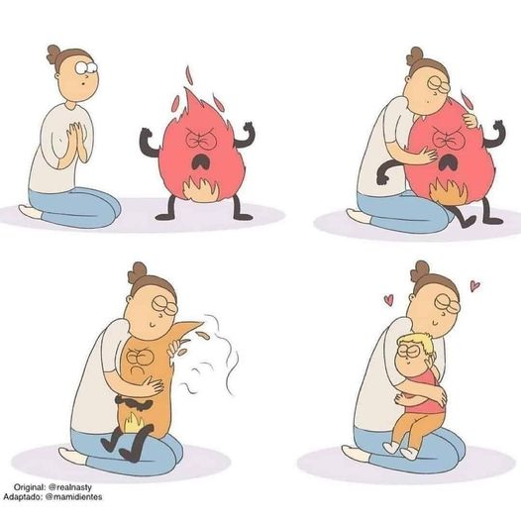
Listening to crying- Related education

Slide 11
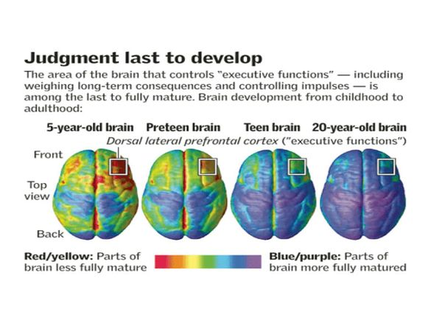
Brain development - maturation of the lobe responsible for emotion regulation
Source:
PMID: 15148381
Image: National Institute of Mental Health; Paul Thompson, Ph.D., UCLA Laboratory of Neuro Imaging
Bonded from the beginning (Facebook page)

Slide 12
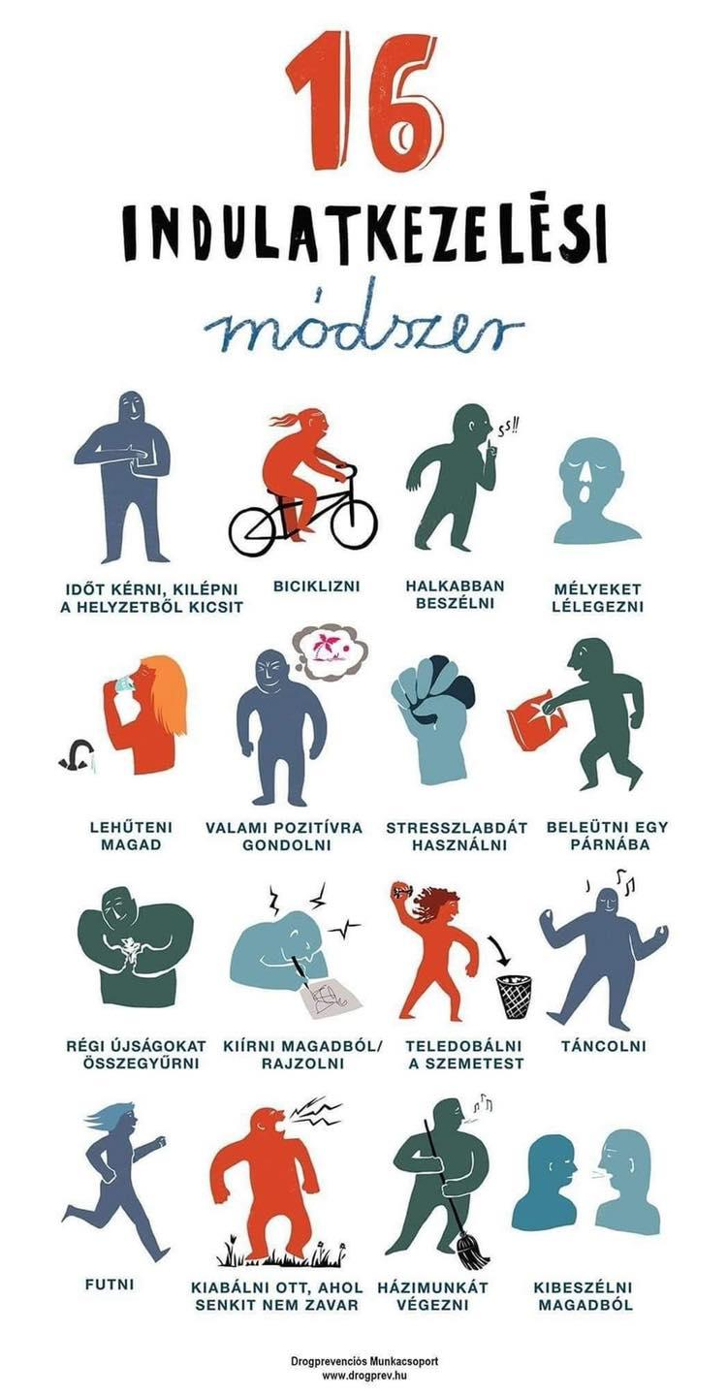
you can hang them on the wall, on your fridge, even your own photo!

Slide 13
DIGITAL AND ANALOGUE ZONES
DISCUSS WITH THE CHILD WHERE IN THE HOME THERE IS A SCREEN-FREE AREA AND TIME.

Slide 14
Hajnalka Fülöp
Mobile: +36 70 77 28 261
hfulop@gmail.com
Follow me on Facebook: digitally aware parent
Online Home Education founder

