Slide 1
Evaluation in a digital environment

Slide 2
About the project: Digitmarket
Marketplace of Knowledge for Digital Education Methodology (DIGIMARKET)
You can read and learn about Erasmus Plus at these two links:
https://ec.europa.eu/programmes/erasmus-plus/resources/coronavirus-impact_en
https://ec.europa.eu/programmes/erasmus-plus/resources/coronavirus-impact_en

Slide 3
Hi, I am Hajnalka Fulop, digital andragogist,
internet security specialist. I teach parents, teachers and students how to use digital tools safely and improve their lives online.
I have 5 children, school, school evaluation is an important phenomenon in education for me too.
What does the word "screenager" mean? What do you think?

Slide 4
Why do we need digital assessment methods?
Alpha Generations and COVID learning
-touchscreen digital devices
-digital content consumers
-visuality
interactivity
int

Slide 5
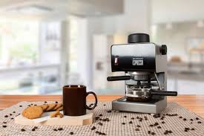
Content consumption habits of the Alpha generation
surfaces that can be quickly abandoned
competitive platforms, e.g. video games, social media platforms
peer -process communication spaces
social and cognitive skills
compliance
virtual reality

Slide 6
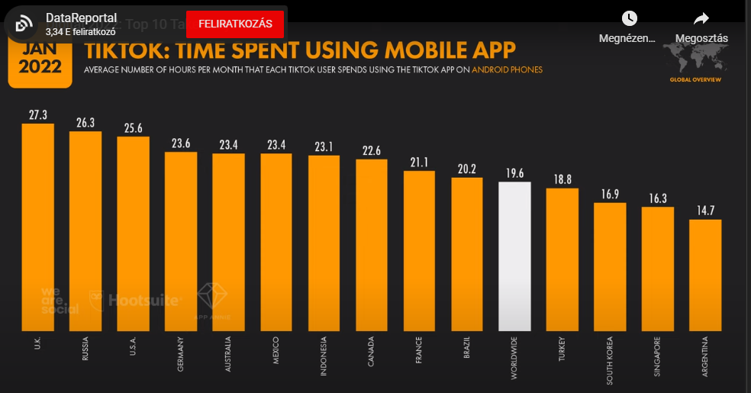
A generation (also) living on TikTok

Slide 7
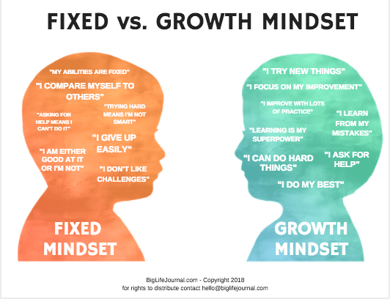
How do we develop their mindset?
Evaluation principles that also work online
An evolving mindset
we commend the effort
help you discover your own resources
be emotionally available (too)
making mistakes is part of the action, not a punishment
let him try
help your self-reflection

Slide 8
What is motivation?
"The word motivation means
motivation (noun)
Motivation is an inducement to act, which increases a person's willingness and becomes a rational reason for him to take an expected action or obey an order. This willingness trigger is placed as successive steps on a scale."
Source: Gyermekneveles.hu

Slide 9
How is school different?
Online education "kicked down the door"
Digital education:
Ideal: parallel knowledge acquisition, teacher and student partner, communication more equal (?)
Reality: a hierarchical system in a more flexible environment
Which platforms do we use?
Zoom, Google Meet, Classroom, MS Teams: software-superseding communication spaces
Evaluation is a function of communication

Slide 10
Online interfaces VS. face-to-face school education
touchscreen spinning content- vs.
dialogues, finger gestures vs.
more static content
complex stimuli, vs.
immediate feedback vs.
home, relaxed environment, comfort vs. cooperative and/or competitive atmosphere - !
virtual reality vs.
slower visualisation
cognitive load (attention, memory, thinking)
cognitive load (attention, memory, thinking)
slower or no feedback
stone walls, stricter order, school -educational environment
everyday reality

Slide 11
Assessment, grading in crisis
Since when?
A study on gamification by Márta Barbarics, an educator writing her doctoral dissertation in education at ELTE:
1912- Dr. Gábor Kemény wrote an article and gave a lecture on "The Abolition of Classification" (October 5, 1912), the reactions to which can be read in the 1912 issue of The Child, issues 9-10
awe-inspiring
unfair
does not measure real work performance
be abolished (1912!)
.

Slide 12
Scoring instead of ranking, cups, challenges: gamification
"gamification is the incorporation of elements from games into everyday situations that are not games at all, such as work or education."
Deterding

Slide 13
How to get started?
pedagogical objective
rethinking the pedagogical role
survey
Design
small change at a time
feedback,, feedback request-add
documentation
existing good practices
in partnership with the student
need consistency and flexibility similar to algorithms
.
-

Slide 14
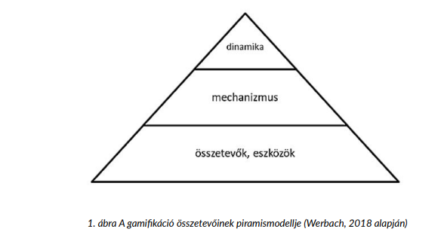
How do we design the gamified assessment?
structural
content
Elemei:
Points
coupons
levels
badges
feedback
colour codes
the possibility to make your own choice
cooperation

Slide 15
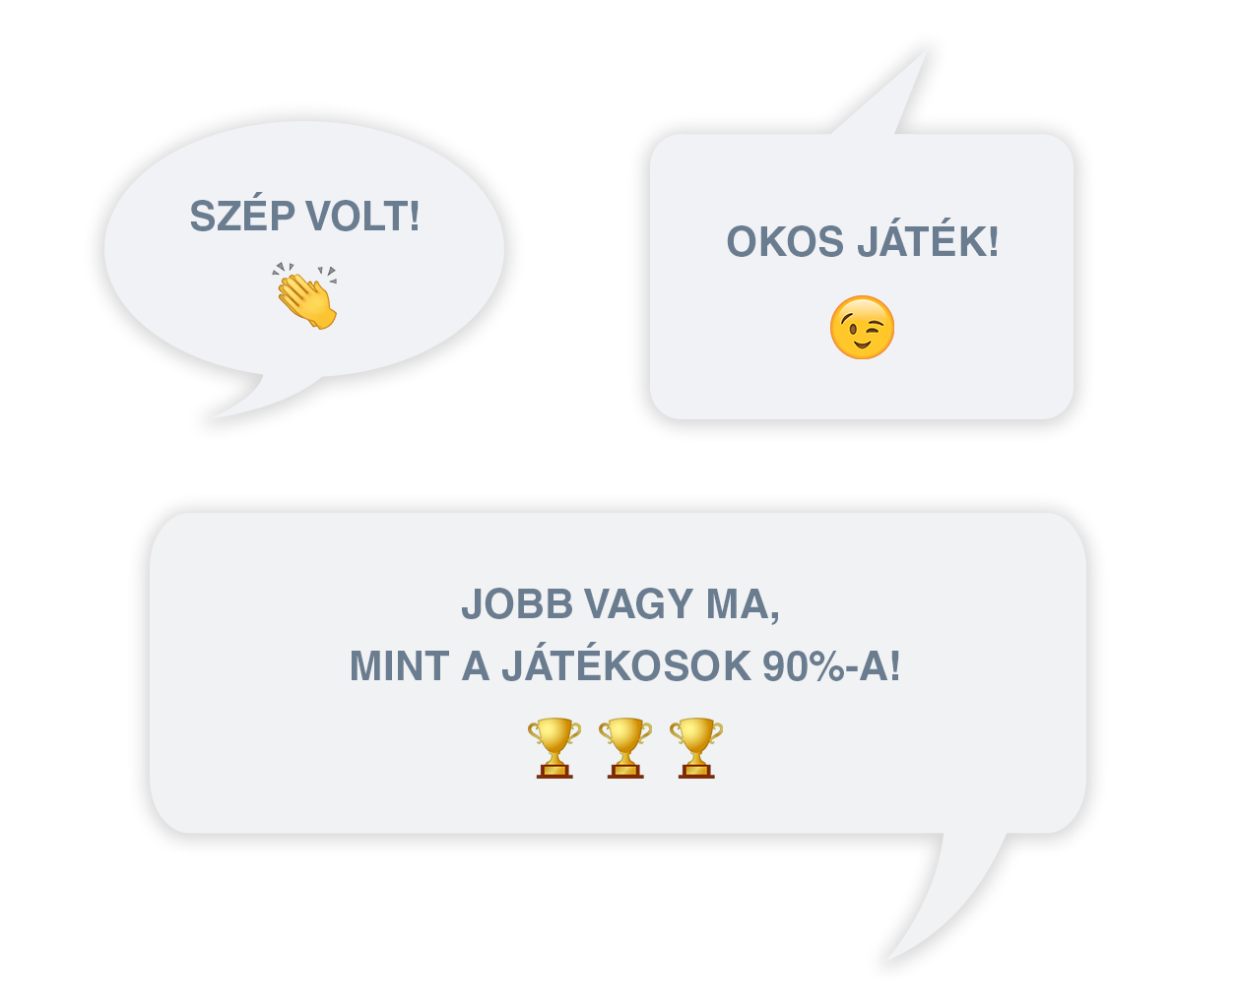
The result of gamification:
liberated, you can get into the flow
develops a creative attitude, which is a resource
incorporates the way games work
motivation even in case of failure

Slide 16
What to look out for?
what happens, what does it do and what does it feel?
protection from overload (teacher, student)
positive feedback, continuous interaction
requires more autonomy
- helps develop intrinsic motivation

Slide 17
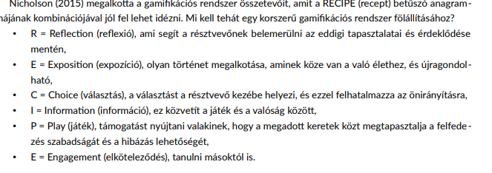
The recipe for gamification: RECIPE

Slide 18
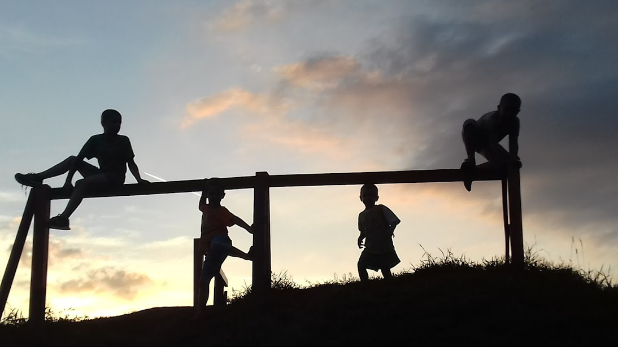
"You have to look for what you have, not what you think you should have." - Albert Einstein German-American theoretical physicist 1879 - 1955

