Slide 1
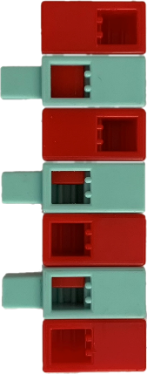
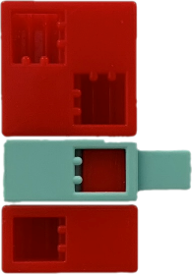
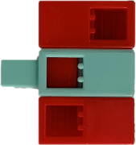
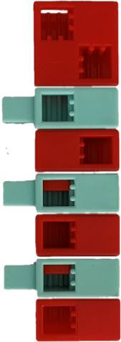
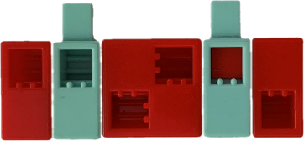
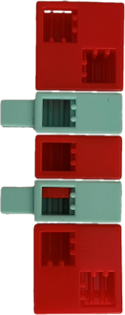
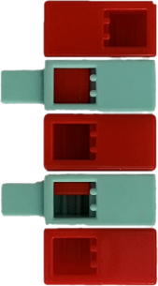
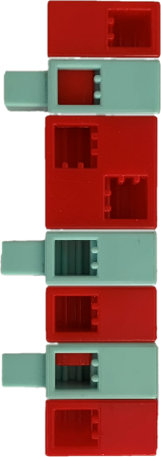
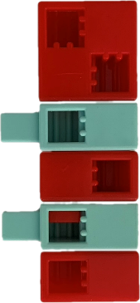
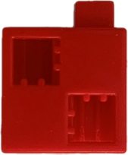
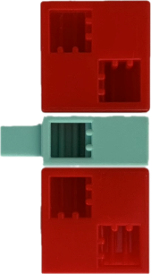
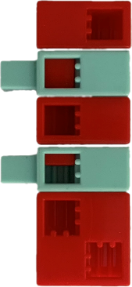
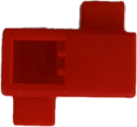
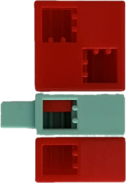
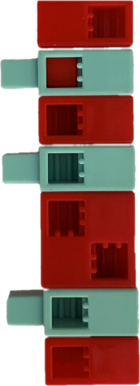
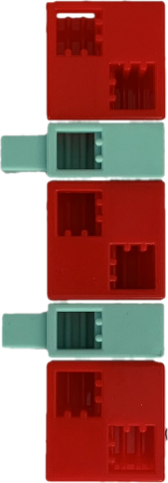
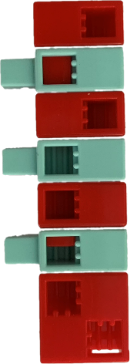
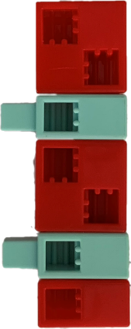
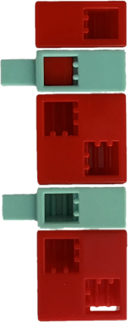
Morse code table
A |  | H |  | P
Á |  | I |  | Q
B |  | J |  | R
C |  | K |  | S
D |  | L |  | T
E |  | M |  | U
É |  | N |  | Ü
F |  | O |  | V
G |  | Ö |  | W

Slide 2
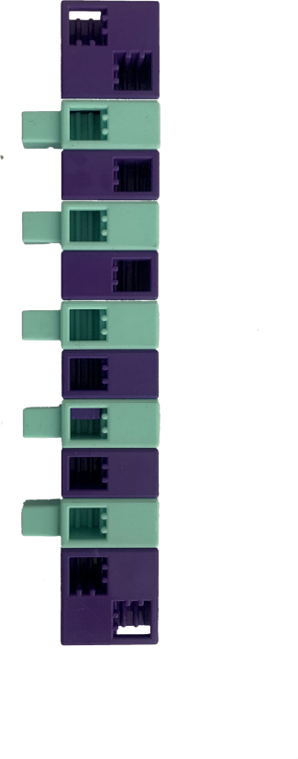
Morse code table
X |  | 7 |  | Dz
Y |  | 8 |  | Dzs
Z |  | 9 |  | Gy
1 |  | 0 |  | Ly
2 |  | - |  | Ny
3 |  | ? |  | Sz
4 |  | ! |  | Ty
5 |  | . |  | Zs
6 |  | :

Slide 3
Morse code decoding 1.
Using the Morse code board, solve the puzzles and write the answer on the line. Where you find a description of the solution, colour it according to the Morse code table!
What to look out for: Choose a colour for the short and long symbols that make up the letters. Choose a colour for the pauses between words.
Short: Long: Break between letters: Break between words:
The title of the novel
The author of the novel: Joseph Rudyard Kipling
Main characters: lost boy, animals of the forest
The name of the fire in the novel
Which jungle is the novel set in?

Slide 4
Morse code decoding 1. - solution
The title of the novel
The title of the novel: The Jungle Book
The author of the novel: Joseph Rudyard Kipling
Main characters: lost boy, animals of the forest
The name of the fire in the novel
Red flower
Which jungle is the novel set in?
Indian

Slide 5
Morse code decoding 2.
Using the Morse code board, solve the puzzles and write the answer on the line. Where you find a description of the solution, colour it according to the Morse code table!
What to look out for: Choose a colour for the short and long symbols that make up the letters. Choose a colour for the pauses between words.
Short: Long: Break between letters: Break between words:
The title of the novel
The author of the novel: Joanne Kathleen Rowling (her pen name J. K. Rowling)
Main characters: the wizarding world, wizards and witches, magical creatures…etc.
The most important ball game in the magic world
What is Ron most afraid of?

Slide 6
Morse code decoding 2. - solution
The title of the novel
The title of the novel: Harry Potter
The author of the novel: Joanne Kathleen Rowling (her pen name J. K. Rowling)
Main characters: the wizarding world, wizards and witches, magical creatures…etc.
The most important ball game in the magic world
Quidditch
What is Ron most afraid of?
Spider

Slide 7
Morse code decoding 3.
Using the Morse code board, solve the puzzles and write the answer on the line. Where you find a description of the solution, colour it according to the Morse code table!
What to look out for: Choose a colour for the short and long symbols that make up the letters. Choose a colour for the pauses between words.
Short: Long: Break between letters: Break between words:
In how many days does Phileas Fogg circumvent Jules Gabriel Verne in his novel?
What does Wilbur Fix suspect the main character of?
What did Phileas Fogg gain from the trip?

Slide 8
Morse code decoding 3. - solution
In how many days does Phileas Fogg circumvent Jules Gabriel Verne in his novel?
80
What does Wilbur Fix suspect the main character of?
Bank robbery
What did Phileas Fogg gain from the trip?
Wife

Slide 9
Morze-kód fejtés 4.
Using the Morse code board, solve the puzzles and write the answer on the line. Where you find a description of the solution, colour it according to the Morse code table!
What to look out for: Choose a colour for the short and long symbols that make up the letters. Choose a colour for the pauses between words.
Short: Long: Break between letters: Break between words:
Title of the novel
The author of the novel: Antoine Marie Jean-Baptiste Roger, comte de Saint-Exupéry (his pen name Antoine de Saint-Exupéry)
Main characters: the child with a pure soul, the pilot, the rose, the fox, the snake...etc.
The main character has tamed
Type of flower watered

Slide 10
Morse code decoding 4. - solution
Title of the novel
Title of the novel: The Little Prince
The author of the novel: Antoine Marie Jean-Baptiste Roger, comte de Saint-Exupéry (his pen name Antoine de Saint-Exupéry)
Main characters: the child with a pure soul, the pilot, the rose, the fox, the snake...etc.
The main character has tamed
Fox
Type of flower watered
Rose

Slide 11
Morse code decoding 5.
Using the Morse code board, solve the puzzles and write the answer on the line. Where you find a description of the solution, colour it according to the Morse code table!
What to look out for: Choose a colour for the short and long symbols that make up the letters. Choose a colour for the pauses between words.
Short: Long: Break between letters: Break between words:
The title of the novel
The author of the novel: Charles Lutwidge Dodgson (his pen name Lewis Carroll)
Main characters: Alice, The White Rabbit, The Caterpillar, The Cheshire Cat, The Queen anf The King of Hearts...etc
The Queen of Heart favourite racquet game
Alice bit into this to change its size

Slide 12
Morse code decoding 5. - solution
The title of the novel
The author of the novel: Charles Lutwidge Dodgson (his pen name Lewis Carroll)
Main characters: Alice, The White Rabbit, The Caterpillar, The Cheshire Cat, The Queen anf The King of Hearts...etc
The Queen of Heart favourite racquet game
Croquet
Alice bit into this to change its size
Mushroom

