Slide 1
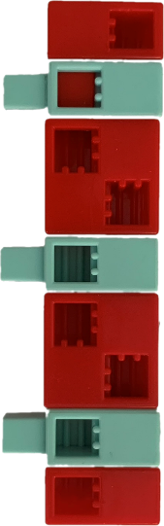
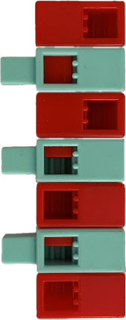
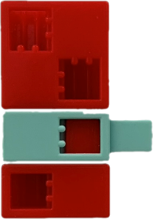
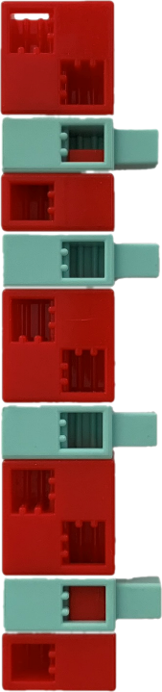
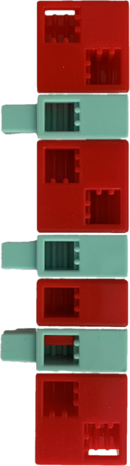
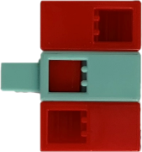
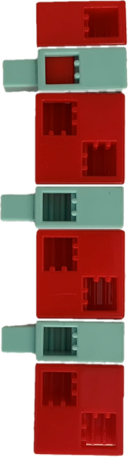
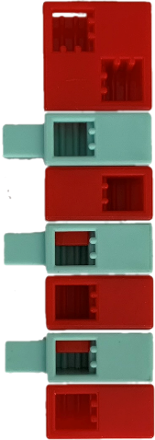
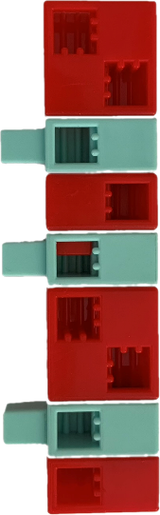
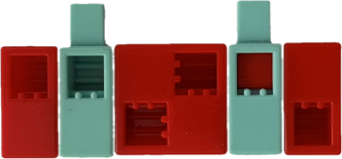
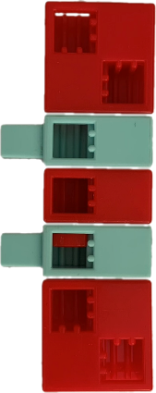
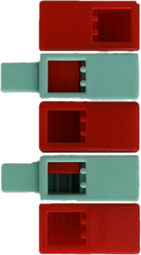
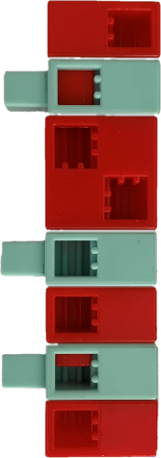
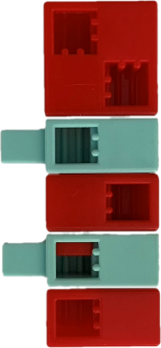
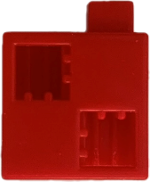
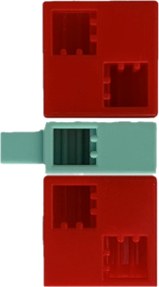
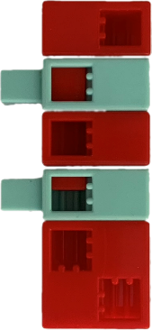
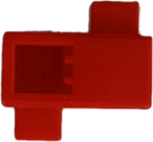
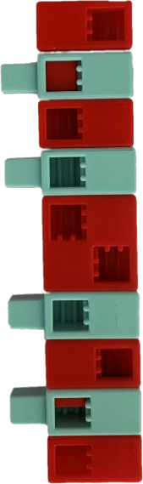
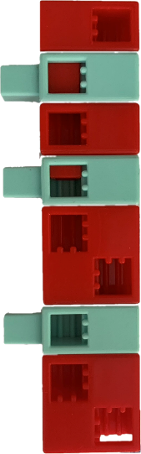
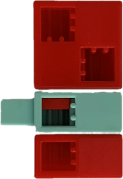
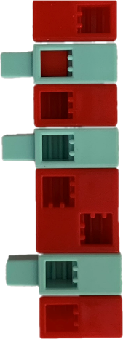
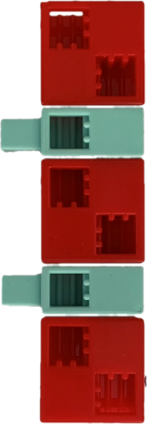
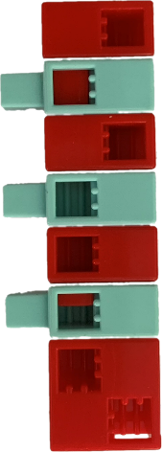
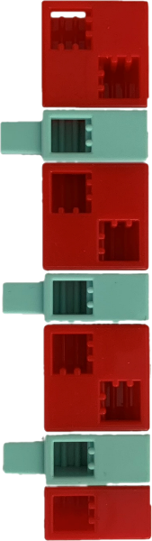
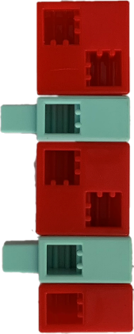
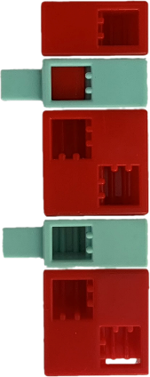



Morse code table
A |  | H |  | P
Á |  | I |  | Q
B |  | J |  | R
C |  | K |  | S
D |  | L |  | T
E |  | M |  | U
É |  | N |  | Ü
F |  | O |  | V
G |  | Ö |  | W

Slide 2
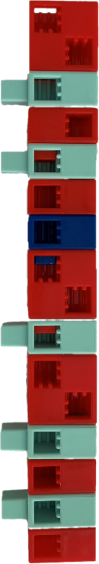
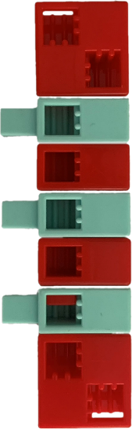
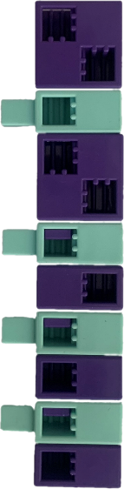
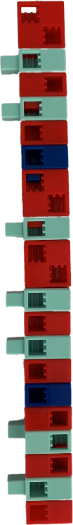
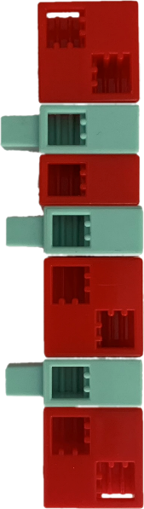
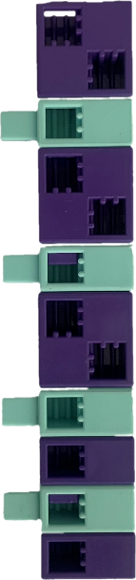
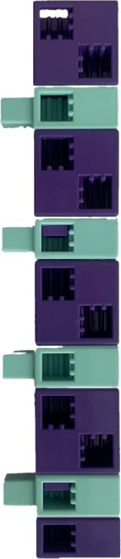
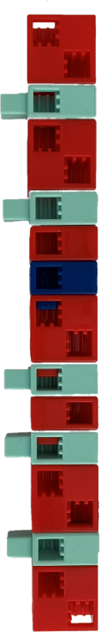
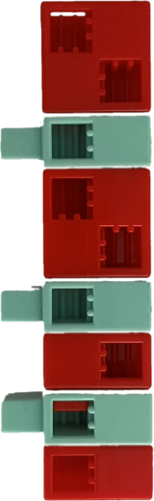
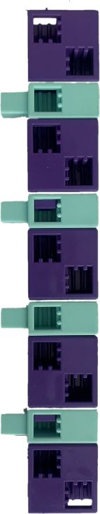
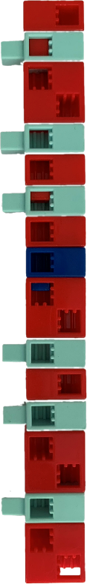
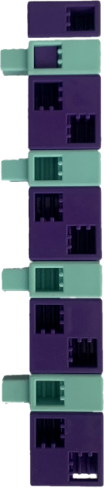
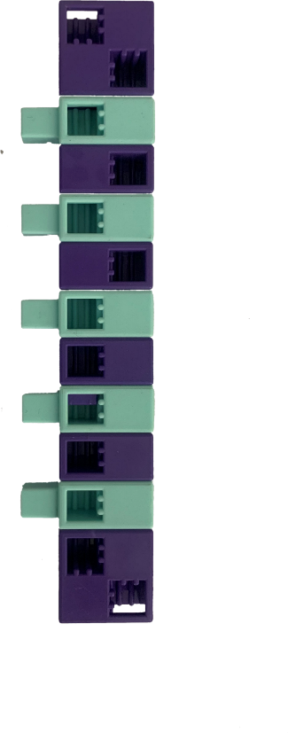
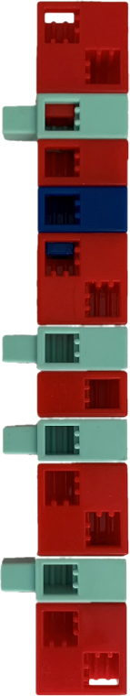
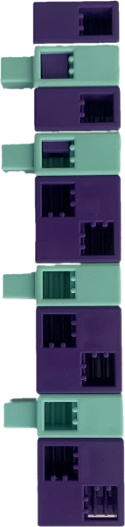
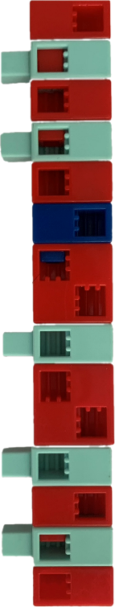
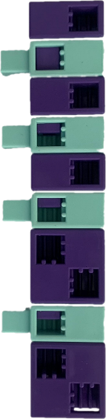
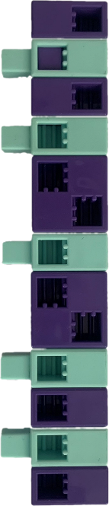
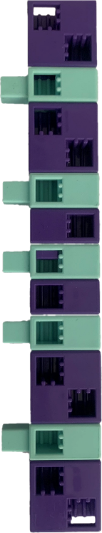
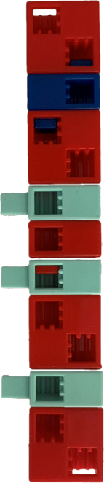
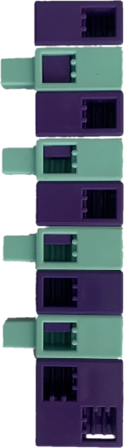
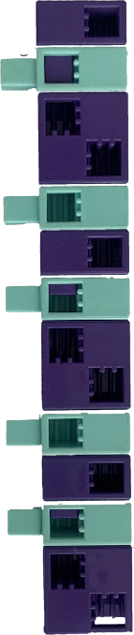
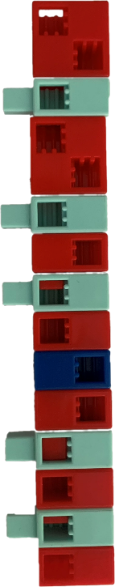



Morse code table
X |  | 7 |  | Dz
Y |  | 8 |  | Dzs
Z |  | 9 |  | Gy
1 |  | 0 |  | Ly
2 |  | - |  | Ny
3 |  | ? |  | Sz
4 |  | ! |  | Ty
5 |  | . |  | Zs
6 |  | :

Slide 3


Morse code decoding 1. a.)
Using the Morse code board, solve the puzzles and write the answer on the line.
Note:
The breaks between the short and long symbols that make up the letters are indicated by the water blue half elements.
The breaks between the letters are indicated by the pale orange whole cubes.
Shape of the traffic board
Base colour of the traffic board
Colour of the line in the middle of the traffic board

Slide 4
Morse code decoding 1. b.)
Use the Morse code table to code the puzzles.
What to look out for: Choose a colour for the short and long symbols that make up the letters. Choose a colour for the pauses between words.
Short: Long: Break between letters: Break between words:
Shape of the traffic board
Circle
Base colour of the traffic board
Red
Colour of the line in the middle of the traffic board
White

Slide 5

Morse code decoding 1. - solution
Shape of the traffic board
Cirkle
Base colour of the traffic board
Red
Colour of the line in the middle of the traffic board
White
Name of the table
Do not enter

Slide 6

Morse code decoding 2. a.)
Using the Morse code board, solve the puzzles and write the answer on the line.
Note:
The breaks between the short and long symbols that make up the letters are indicated by the water blue half elements.
The breaks between the letters are indicated by the pale orange whole cubes.
Shape of the traffic board
Base colour of the traffic board
The drawing in the middle of the traffic board

Slide 7
Morse code decoding 2. b.)
Use the Morse code table to code the puzzles.
What to look out for: Choose a colour for the short and long symbols that make up the letters. Choose a colour for the pauses between words.
Short: Long: Break between letters: Break between words:
Shape of the traffic board
Circle
Base colour of the traffic board
Blue
The drawing in the middle of the traffic board
Bicycle

Slide 8

Morse code decoding 2. - solution
Shape of the traffic board
Circle
Base colour of the traffic board
Blue
The drawing in the middle of the traffic board
Bicycle
Name of the table
Route to be used for pedal cycles only

Slide 9



Morse code decoding 3. a.)
Using the Morse code board, solve the puzzles and write the answer on the line.
Note:
The breaks between the short and long symbols that make up the letters are indicated by the water blue half elements.
The breaks between the letters are indicated by the pale orange whole cubes.
Shape of the traffic board
Base colour of the traffic board
The drawing in the middle of the traffic board

Slide 10
Morse code decoding 3. b.)
Use the Morse code table to code the puzzles.
What to look out for: Choose a colour for the short and long symbols that make up the letters. Choose a colour for the pauses between words.
Short: Long: Break between letters: Break between words:
Shape of the table
Circle
Base colour of the table
Blue
The drawing in the middle of the table
White arrow

Slide 11

Morse code decoding 3. - solution
Shape of the table
Circle
Base colour of the table
Blue
The drawing in the middle of the table
White arrow
Name of the table
Mandatory direction of travel

Slide 12



Morse code decoding 4. a.)
Using the Morse code board, solve the puzzles and write the answer on the line.
Note:
The breaks between the short and long symbols that make up the letters are indicated by the water blue half elements.
The breaks between the letters are indicated by the pale orange whole cubes.
Shape of the traffic board
Base colour of the traffic board
Text in the middle of the traffic board

Slide 13
Morse code decoding 4. b.)
Use the Morse code table to code the puzzles.
What to look out for: Choose a colour for the short and long symbols that make up the letters. Choose a colour for the pauses between words.
Short: Long: Break between letters: Break between words:
Shape of the table
8 angle
Base colour of the table
Red
Text in the middle of the traffic board
STOP

Slide 14

Morse code decoding 4. - solution
Shape of the table
8 angle
Base colour of the table
Red
Text in the middle of the traffic board
STOP
Name of the table
STOP

Slide 15

Morse code decoding 5. a.)
Using the Morse code board, solve the puzzles and write the answer on the line.
Note:
The breaks between the short and long symbols that make up the letters are indicated by the water blue half elements.
The breaks between the letters are indicated by the pale orange whole cubes.
The shape of the traffic board set at its apex
Base colour of the table
Colour of the border of the traffic board

Slide 16
Morse code decoding 5. b.)
Use the Morse code table to code the puzzles.
What to look out for: Choose a colour for the short and long symbols that make up the letters. Choose a colour for the pauses between words.
Short: Long: Break between letters: Break between words:
The shape of the traffic board set at its apex
3 angle
Base colour of the table
White
Colour of the border of the traffic board
Red

Slide 17

Morse code decoding 5. - solution
The shape of the traffic board set at its apex
3 angle
Base colour of the table
White
Colour of the border of the traffic board
Red
Name of the table
Right of way signs

