Slide 1
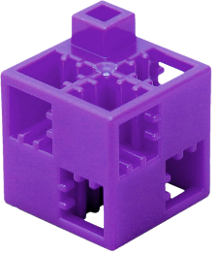
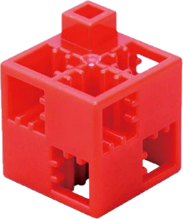
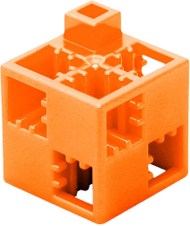
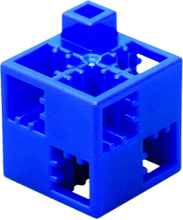
Construction process 1.
Labyrinth
The task:
Get from the START box to the GOAL box following the four directions (up, down, right, left), but you cannot move diagonally. Each direction is represented by a different coloured ArTeC Blocks element. You can use these to find the solution, or you can use arrows in the squares at the bottom of the page to indicate the correct path. Pass through each marked square and collect the elements associated with the path title.
Watch:
- Avoid the field(s) containing the wrong element!
- In the case of tracks which show some kind of process, correct order is important!
- In other cases there are several good solutions!
Primer,
insulation
Walls,
slab
Start
Planning
Roof
Up
Windows and doors
Public utilities,
cladding
Down
Excavation
Landscaping,
handover of keys
Goal
Right
Left

Slide 2
Construction process 1. solution
Primer,
insulation
Walls,
slab
Up
Start
Planning
Roof
Down
Windows and doors
Right
Public
utilities,
cladding
Left
Excavation
Landscaping,
handover of keys
Goal

Slide 3
Life in the village 2.
Labyrinth
The task:
Get from the START box to the GOAL box following the four directions (up, down, right, left), but you cannot move diagonally. Each direction is represented by a different coloured ArTeC Blocks element. You can use these to find the solution, or you can use arrows in the squares at the bottom of the page to indicate the correct path. Pass through each marked square and collect the elements associated with the path title.
Watch:
- Avoid the field(s) containing the wrong element!
- In the case of tracks which show some kind of process, correct order is important!
- In other cases there are several good solutions!
Start
Larger plot sizes
Lower population density
A more
job opportunities
Up
A more active lifestyle
Down
A more cohesive community
Fewer services
Goal
Right
Left

Slide 4
Life in the village 2. with error - solution
Start
Larger plot sizes
Lower population density
Up
A more
job opportunities
Down
A more
active
lifestyle
Right
A more cohesive community
Left
Fewer
services
Goal

Slide 5
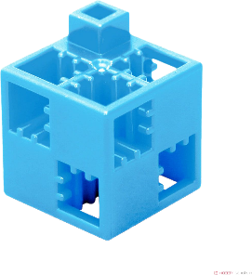
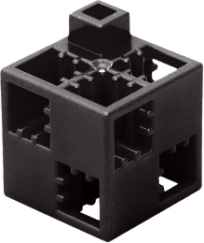
Public buildings 3.
Labyrinth
The task:
Get from the START box to the GOAL box following the four directions (up, down, right, left), but you cannot move diagonally. Each direction is represented by a different coloured ArTeC Blocks element. You can use these to find the solution, or you can use arrows in the squares at the bottom of the page to indicate the correct path. Pass through each marked square and collect the elements associated with the path title.
Watch:
- Avoid the field(s) containing the wrong element!
- In the case of tracks which show some kind of process, correct order is important!
- In other cases there are several good solutions!
Hospital
Townhouse
Shopping centre
Police
station
Start
Mayor's office
Up
Fire brigade
Down
School
Right
Goal
Housing estate
Kindergarden
Left

Slide 6
Public buildings 3. with error - solution
Hospital
Townhouse
Shopping centre
Police
station
Up
Start
Mayor’s
office
Down
Fire
brigade
Right
School
Left
Goal
Housing estate
Kindergarden

Slide 7
Tower house construction process 4.
Labyrinth
The task:
Get from the START box to the GOAL box following the four directions (up, down, right, left), but you cannot move diagonally. Each direction is represented by a different coloured ArTeC Blocks element. You can use these to find the solution, or you can use arrows in the squares at the bottom of the page to indicate the correct path. Pass through each marked square and collect the elements associated with the path title.
Watch:
- Avoid the field(s) containing the wrong element!
- In the case of tracks which show some kind of process, correct order is important!
- In other cases there are several good solutions!
Start
Deep foundation
Vertical reinforced concrete structure
Mesh elements
Up
Goal
Shutters,
insulation,
plastering,
painting
Horizontal
reinforced concrete structure
Down
Right
Left

Slide 8
Tower house construction process 4. - solution
Start
Vertical reinforced concrete structure
Deep foundation
Up
Mesh elements
Down
Goal
Right
Shutters,
insulation,
plastering,
painting
Horizontal
reinforced concrete structure
Left

Slide 9
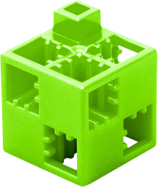
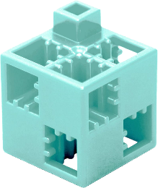
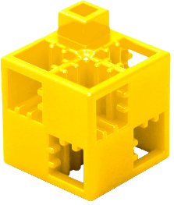
Features of a city 5.
Labyrinth
The task:
Get from the START box to the GOAL box following the four directions (up, down, right, left), but you cannot move diagonally. Each direction is represented by a different coloured ArTeC Blocks element. You can use these to find the solution, or you can use arrows in the squares at the bottom of the page to indicate the correct path. Pass through each marked square and collect the elements associated with the path title.
Watch:
- Avoid the field(s) containing the wrong element!
- In the case of tracks which show some kind of process, correct order is important!
- In other cases there are several good solutions!
A more cohesive community
Higher land prices
Start
A more job opportunies
Higher population density
Up
A more active lifestile
Down
Smaller plot size
Fewer services
Cultural, industrial and commercial centre
Right
Goal
Left

Slide 10
Features of a city 5. with error - solution
A more cohesive community
Higher land prices
Up
Start
A more job opportunies
Higher population density
Down
more active lifestile
Right
Smaller plot size
Fewer
services
Left
Cultural, industrial and commercial centre
Goal

Slide 11
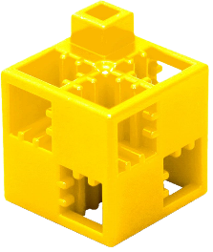
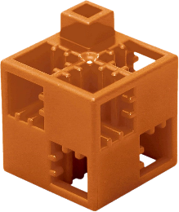
Vegetable garden 6.
Labyrinth
The task:
Get from the START box to the GOAL box following the four directions (up, down, right, left), but you cannot move diagonally. Each direction is represented by a different coloured ArTeC Blocks element. You can use these to find the solution, or you can use arrows in the squares at the bottom of the page to indicate the correct path. Pass through each marked square and collect the elements associated with the path title.
Watch:
- Avoid the field(s) containing the wrong element!
- In the case of tracks which show some kind of process, correct order is important!
- In other cases there are several good solutions!
The taxonomic classification of
the family is
taken into
account when planting
Soft-stemmed plants
Typically undemanding plant
species
Up
Require intensive
care
Important nutrient
sources
Start
When planting, attention is paid to the taxonomic classification of the trunk
Down
Goal
Right
Left

Slide 12
Vegetable garden 6. with error - solution
The taxonomic classification
of the family is taken into
account when planting
Soft-stemmed plants
Up
Typically undemanding plant species
Down
Require intensive
care
Important nutrient
sources
Start
Right
When planting, attention is
paid to the taxonomic classification
of the trunk
Goal
Left

Slide 13
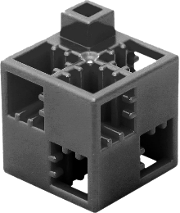
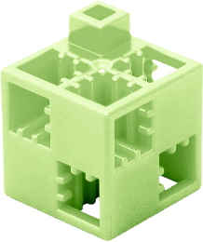
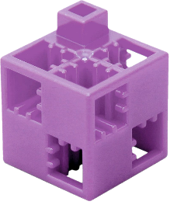
The paper 7.
Labyrinth
The task:
Get from the START box to the GOAL box following the four directions (up, down, right, left), but you cannot move diagonally. Each direction is represented by a different coloured ArTeC Blocks element. You can use these to find the solution, or you can use arrows in the squares at the bottom of the page to indicate the correct path. Pass through each marked square and collect the elements associated with the path title.
Watch:
- Avoid the field(s) containing the wrong element!
- In the case of tracks which show some kind of process, correct order is important!
- In other cases there are several good solutions!
Made only
from natural vegetable fibres
Start
Artificial material
The white colour is achieved by colouring
Production is highly polluting
Cellulose is the main
raw material
Tipically the size is signed by “A” +
a number
Up
The fillers improve
the quality
Down
Paper and rags can be made into repaper
Right
Goal
Left

Slide 14
The paper 7. with error - solution
Made only
from natural vegetable
fibres
Start
Artificial
material
Up
The white colour is achieved by colouring
production is highly polluting
Down
Cellulose is the main
raw material
Tipically the size is signed by “A” +
a number
Right
The fillers improve the quality
Left
Paper and rags can be made into repape
Goal

Slide 15
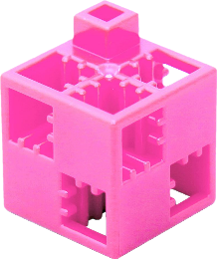
Materials in nature 8.
Labyrinth
The task:
Get from the START box to the GOAL box following the four directions (up, down, right, left), but you cannot move diagonally. Each direction is represented by a different coloured ArTeC Blocks element. You can use these to find the solution, or you can use arrows in the squares at the bottom of the page to indicate the correct path. Pass through each marked square and collect the elements associated with the path title.
Watch:
- Avoid the field(s) containing the wrong element!
- In the case of tracks which show some kind of process, correct order is important!
- In other cases there are several good solutions!
Wood
Start
Iron
Clay
Bauxite
Up
Gravel
Down
Alumínium
Right
Sand
Goal
Left

Slide 16
Materials in nature 8. with error - solution
wood
Start
iron
Up
Down
clay
Bauxite
gravel
Right
Alumínium
Left
sand
Goal

Slide 17
Features of the orchard 9.
Labyrinth
The task:
Get from the START box to the GOAL box following the four directions (up, down, right, left), but you cannot move diagonally. Each direction is represented by a different coloured ArTeC Blocks element. You can use these to find the solution, or you can use arrows in the squares at the bottom of the page to indicate the correct path. Pass through each marked square and collect the elements associated with the path title.
Watch:
- Avoid the field(s) containing the wrong element!
- In the case of tracks which show some kind of process, correct order is important!
- In other cases there are several good solutions!
Produce a bountiful harvest all year round
Start
Goal
The fruit of the apple tree has a real crop
Mature from summer
to late autumn
Typically have a sweet taste
Up
Down
Fruits to be eaten raw
Cigar- blanket- petal- and cup sheets
We eat fake and real crops
Right
Left

Slide 18
Features of the orchard 9. with error - solution
Produce a bountiful harvest all year round
Start
Goal
The fruit of the apple
tree has a real crop
Up
Mature from summer to late
autumn
Typically have a sweet taste
Down
Right
Fruits to be eaten raw
Left
Cigar-
blanket-
petal- and
cup sheets
We eat fake and real crops

Slide 19
Autumn-winter gardening with 10.
Labyrinth
The task:
Get from the START box to the GOAL box following the four directions (up, down, right, left), but you cannot move diagonally. Each direction is represented by a different coloured ArTeC Blocks element. You can use these to find the solution, or you can use arrows in the squares at the bottom of the page to indicate the correct path. Pass through each marked square and collect the elements associated with the path title.
Watch:
- Avoid the field(s) containing the wrong element!
- In the case of tracks which show some kind of process, correct order is important!
- In other cases there are several good solutions!
Late
autumn
tree planting
Winter sowing between
0 – 5 C°
Seedling growing
Thinning
of pests
Mulching
Up
Collecting grafting
plants
Not
planting trees
Down
Goal
Sorting of seeds
Start
Right
Left

Slide 20
Autumn-winter gardening with 10. with error - solution
Late
autumn
tree planting
Winter
sowing between
0 – 5 C°
Seedling growing
Thinning of pests
Up
Mulching
Down
Right
Collecting grafting
plants
Goal
Not planting trees
Left
Sorting of seeds
Start

