Slide 1
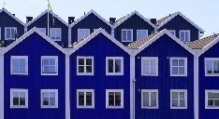
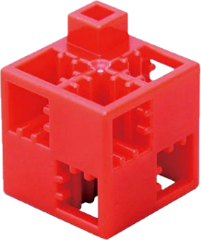
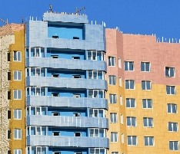
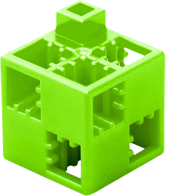
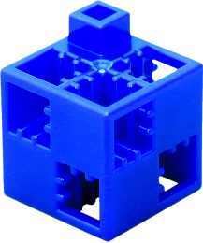
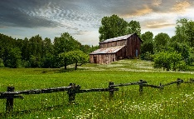
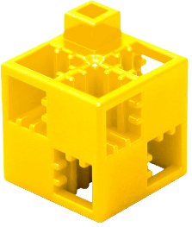
Residential buildings 1. a.)
Start |  |  |  | Goal
Labyrinth
The task:
Get from the START box to the GOAL box following the four directions (up, down, right, left), but you cannot move diagonally. Each direction is represented by a different coloured ArTeC Blocks element. You can use these to find the solution, or you can use arrows in the squares at the bottom of the page to indicate the correct path. Pass through each marked square and collect the elements associated with the path title.
Watch:
- Avoid the field(s) containing the wrong element!
- In the case of tracks which show some kind of process, correct order is important!
- In other cases there are several good solutions!
Up
Down
Right
Left

Slide 2
Residential buildings 1. b.)
Start |  |  |  | Goal
Terraced house
Labyrinth
The task:
Get from the START box to the GOAL box following the four directions (up, down, right, left), but you cannot move diagonally. Each direction is represented by a different coloured ArTeC Blocks element. You can use these to find the solution, or you can use arrows in the squares at the bottom of the page to indicate the correct path. Pass through each marked square and collect the elements associated with the path title.
Watch:
- Avoid the field(s) containing the wrong element!
- In the case of tracks which show some kind of process, correct order is important!
- In other cases there are several good solutions!
Up
Housing estate
Down
Family house
Right
Farmhouse
Left

Slide 3
Residential buildings 1. - solution
 |  |  |  | Goal
Labyrinth
The task:
Get from the START box to the GOAL box following the four directions (up, down, right, left), but you cannot move diagonally. Each direction is represented by a different coloured ArTeC Blocks element. You can use these to find the solution, or you can use arrows in the squares at the bottom of the page to indicate the correct path. Pass through each marked square and collect the elements associated with the path title.
Watch:
- Avoid the field(s) containing the wrong element!
- In the case of tracks which show some kind of process, correct order is important!
- In other cases there are several good solutions!
Up
Down
Right
Left
Start

Slide 4
Residential buildings 2. a.)
Start
Labyrinth
The task:
Get from the START box to the GOAL box following the four directions (up, down, right, left), but you cannot move diagonally. Each direction is represented by a different coloured ArTeC Blocks element. You can use these to find the solution, or you can use arrows in the squares at the bottom of the page to indicate the correct path. Pass through each marked square and collect the elements associated with the path title.
Watch:
- Avoid the field(s) containing the wrong element!
- In the case of tracks which show some kind of process, correct order is important!
- In other cases there are several good solutions!
Up
Down
Right
Goal
Left

Slide 5
Residential buildings 2. b.)
Start
Housing estate
Labyrinth
The task:
Get from the START box to the GOAL box following the four directions (up, down, right, left), but you cannot move diagonally. Each direction is represented by a different coloured ArTeC Blocks element. You can use these to find the solution, or you can use arrows in the squares at the bottom of the page to indicate the correct path. Pass through each marked square and collect the elements associated with the path title.
Watch:
- Avoid the field(s) containing the wrong element!
- In the case of tracks which show some kind of process, correct order is important!
- In other cases there are several good solutions!
Up
Farmhouse
Barn
Down
Right
Goal
Terraced house
Left
Family house

Slide 6
Residential buildings 2. with error - solution
Start
Labyrinth
The task:
Get from the START box to the GOAL box following the four directions (up, down, right, left), but you cannot move diagonally. Each direction is represented by a different coloured ArTeC Blocks element. You can use these to find the solution, or you can use arrows in the squares at the bottom of the page to indicate the correct path. Pass through each marked square and collect the elements associated with the path title.
Watch:
- Avoid the field(s) containing the wrong element!
- In the case of tracks which show some kind of process, correct order is important!
- In other cases there are several good solutions!
Up
Down
Right
Goal
Left

Slide 7
Construction of the tower block 3.
Start
Windows, insulation
Labyrinth
The task:
Get from the START box to the GOAL box following the four directions (up, down, right, left), but you cannot move diagonally. Each direction is represented by a different coloured ArTeC Blocks element. You can use these to find the solution, or you can use arrows in the squares at the bottom of the page to indicate the correct path. Pass through each marked square and collect the elements associated with the path title.
Watch:
- Avoid the field(s) containing the wrong element!
- In the case of tracks which show some kind of process, correct order is important!
- In other cases there are several good solutions!
Up
Vertical reinforced concrete structure
Down
Square mesh elements (walls)
Right
Goal
Left
Horizontal reinforced concrete structure

Slide 8
Construction of the tower block 3. - solution
Windows, insulation
Labyrinth
The task:
Get from the START box to the GOAL box following the four directions (up, down, right, left), but you cannot move diagonally. Each direction is represented by a different coloured ArTeC Blocks element. You can use these to find the solution, or you can use arrows in the squares at the bottom of the page to indicate the correct path. Pass through each marked square and collect the elements associated with the path title.
Watch:
- Avoid the field(s) containing the wrong element!
- In the case of tracks which show some kind of process, correct order is important!
- In other cases there are several good solutions!
Up
Vertical reinforced concrete
structure
Down
Square mesh elements (walls)
Right
Mély-
garázs
Goal
Left
Horizontal reinforced concrete structure
Start

Slide 9
Life in the village 4. a.)
Labyrinth
The task:
Get from the START box to the GOAL box following the four directions (up, down, right, left), but you cannot move diagonally. Each direction is represented by a different coloured ArTeC Blocks element. You can use these to find the solution, or you can use arrows in the squares at the bottom of the page to indicate the correct path. Pass through each marked square and collect the elements associated with the path title.
Watch:
- Avoid the field(s) containing the wrong element!
- In the case of tracks which show some kind of process, correct order is important!
- In other cases there are several good solutions!
Up
Start
Goal
Down
Right
Left

Slide 10
Life in the village 4 b.)
Larger plot sizes
More cohesive community
Labyrinth
The task:
Get from the START box to the GOAL box following the four directions (up, down, right, left), but you cannot move diagonally. Each direction is represented by a different coloured ArTeC Blocks element. You can use these to find the solution, or you can use arrows in the squares at the bottom of the page to indicate the correct path. Pass through each marked square and collect the elements associated with the path title.
Watch:
- Avoid the field(s) containing the wrong element!
- In the case of tracks which show some kind of process, correct order is important!
- In other cases there are several good solutions!
Up
Start
Cél
Down
Less work opportunities
Right
Left
More relaxed lifestyle
Cheaperland price

Slide 11
Life in the village 4. - solution
Labyrinth
The task:
Get from the START box to the GOAL box following the four directions (up, down, right, left), but you cannot move diagonally. Each direction is represented by a different coloured ArTeC Blocks element. You can use these to find the solution, or you can use arrows in the squares at the bottom of the page to indicate the correct path. Pass through each marked square and collect the elements associated with the path title.
Watch:
- Avoid the field(s) containing the wrong element!
- In the case of tracks which show some kind of process, correct order is important!
- In other cases there are several good solutions!
Up
Start
Goal
Down
Right
Left

Slide 12
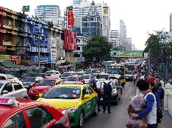
Life in the city 5. a.)
Goal
Labyrinth
The task:
Get from the START box to the GOAL box following the four directions (up, down, right, left), but you cannot move diagonally. Each direction is represented by a different coloured ArTeC Blocks element. You can use these to find the solution, or you can use arrows in the squares at the bottom of the page to indicate the correct path. Pass through each marked square and collect the elements associated with the path title.
Watch:
- Avoid the field(s) containing the wrong element!
- In the case of tracks which show some kind of process, correct order is important!
- In other cases there are several good solutions!
Up
Down
Right
Left
Start

Slide 13
Life in the city 5. b.)
Many
types
of jobs
Goal
Smallerplot sizes
Labyrinth
The task:
Get from the START box to the GOAL box following the four directions (up, down, right, left), but you cannot move diagonally. Each direction is represented by a different coloured ArTeC Blocks element. You can use these to find the solution, or you can use arrows in the squares at the bottom of the page to indicate the correct path. Pass through each marked square and collect the elements associated with the path title.
Watch:
- Avoid the field(s) containing the wrong element!
- In the case of tracks which show some kind of process, correct order is important!
- In other cases there are several good solutions!
Up
Down
Busy lifestyle
More expensive land prices
Right
Commercial, economic centre
Left
Start

Slide 14
Life in the city 5. - solution
Goal
Labyrinth
The task:
Get from the START box to the GOAL box following the four directions (up, down, right, left), but you cannot move diagonally. Each direction is represented by a different coloured ArTeC Blocks element. You can use these to find the solution, or you can use arrows in the squares at the bottom of the page to indicate the correct path. Pass through each marked square and collect the elements associated with the path title.
Watch:
- Avoid the field(s) containing the wrong element!
- In the case of tracks which show some kind of process, correct order is important!
- In other cases there are several good solutions!
Up
Down
Right
Left
Start

Slide 15
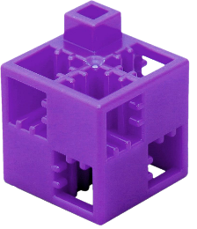
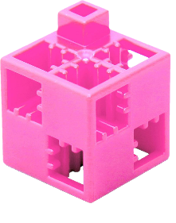
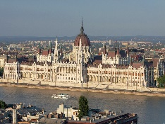
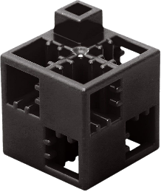
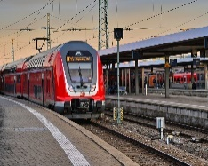
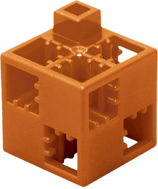
Public buildings 6. a.)
Labyrinth
The task:
Get from the START box to the GOAL box following the four directions (up, down, right, left), but you cannot move diagonally. Each direction is represented by a different coloured ArTeC Blocks element. You can use these to find the solution, or you can use arrows in the squares at the bottom of the page to indicate the correct path. Pass through each marked square and collect the elements associated with the path title.
Watch:
- Avoid the field(s) containing the wrong element!
- In the case of tracks which show some kind of process, correct order is important!
- In other cases there are several good solutions!
Up
Start
Down
Right
Goal
Left

Slide 16
Public buildings 6. b.)
Shopping
centre
Labyrinth
The task:
Get from the START box to the GOAL box following the four directions (up, down, right, left), but you cannot move diagonally. Each direction is represented by a different coloured ArTeC Blocks element. You can use these to find the solution, or you can use arrows in the squares at the bottom of the page to indicate the correct path. Pass through each marked square and collect the elements associated with the path title.
Watch:
- Avoid the field(s) containing the wrong element!
- In the case of tracks which show some kind of process, correct order is important!
- In other cases there are several good solutions!
Up
Start
Down
Parliament
House
Right
Railway
station
Cél
Left
Church

Slide 17
Public buildings 6. - solution
Labyrinth
The task:
Get from the START box to the GOAL box following the four directions (up, down, right, left), but you cannot move diagonally. Each direction is represented by a different coloured ArTeC Blocks element. You can use these to find the solution, or you can use arrows in the squares at the bottom of the page to indicate the correct path. Pass through each marked square and collect the elements associated with the path title.
Watch:
- Avoid the field(s) containing the wrong element!
- In the case of tracks which show some kind of process, correct order is important!
- In other cases there are several good solutions!
Up
Start
Down
Right
Goal
Left

Slide 18
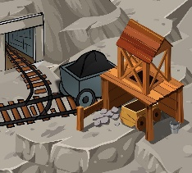
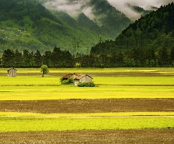
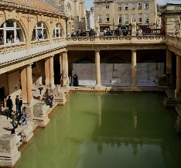
Types of cities with pictures 7.
Start
Labyrinth
The task:
Get from the START box to the GOAL box following the four directions (up, down, right, left), but you cannot move diagonally. Each direction is represented by a different coloured ArTeC Blocks element. You can use these to find the solution, or you can use arrows in the squares at the bottom of the page to indicate the correct path. Pass through each marked square and collect the elements associated with the path title.
Watch:
- Avoid the field(s) containing the wrong element!
- In the case of tracks which show some kind of process, correct order is important!
- In other cases there are several good solutions!
Up
Goal
Down
Right
Left

Slide 19
Types of cities with pictures 7. - solution
Start
Labyrinth
The task:
Get from the START box to the GOAL box following the four directions (up, down, right, left), but you cannot move diagonally. Each direction is represented by a different coloured ArTeC Blocks element. You can use these to find the solution, or you can use arrows in the squares at the bottom of the page to indicate the correct path. Pass through each marked square and collect the elements associated with the path title.
Watch:
- Avoid the field(s) containing the wrong element!
- In the case of tracks which show some kind of process, correct order is important!
- In other cases there are several good solutions!
Up
Goal
Down
Right
Left

Slide 20
Types of cities 8.
Miner
Start
Labyrinth
The task:
Get from the START box to the GOAL box following the four directions (up, down, right, left), but you cannot move diagonally. Each direction is represented by a different coloured ArTeC Blocks element. You can use these to find the solution, or you can use arrows in the squares at the bottom of the page to indicate the correct path. Pass through each marked square and collect the elements associated with the path title.
Watch:
- Avoid the field(s) containing the wrong element!
- In the case of tracks which show some kind of process, correct order is important!
- In other cases there are several good solutions!
Up
Goal
Garden
Down
School
Dwarf
Right
Bath
Left
Resort

Slide 21
Types of cities with text, with error 8. - solution
Miner
Start
Labyrinth
The task:
Get from the START box to the GOAL box following the four directions (up, down, right, left), but you cannot move diagonally. Each direction is represented by a different coloured ArTeC Blocks element. You can use these to find the solution, or you can use arrows in the squares at the bottom of the page to indicate the correct path. Pass through each marked square and collect the elements associated with the path title.
Watch:
- Avoid the field(s) containing the wrong element!
- In the case of tracks which show some kind of process, correct order is important!
- In other cases there are several good solutions!
Up
Goal
Garden
Down
School
Dwarf
Right
Bath
Left
Resort

Slide 22
Textile plants 9.
Hemp
Labyrinth
The task:
Get from the START box to the GOAL box following the four directions (up, down, right, left), but you cannot move diagonally. Each direction is represented by a different coloured ArTeC Blocks element. You can use these to find the solution, or you can use arrows in the squares at the bottom of the page to indicate the correct path. Pass through each marked square and collect the elements associated with the path title.
Watch:
- Avoid the field(s) containing the wrong element!
- In the case of tracks which show some kind of process, correct order is important!
- In other cases there are several good solutions!
Up
Start
Down
Cotton
Right
Jute
Left
Flax
Wool
Goal

Slide 23
Textile plants with error 9. - solution
Hemp
Labyrinth
The task:
Get from the START box to the GOAL box following the four directions (up, down, right, left), but you cannot move diagonally. Each direction is represented by a different coloured ArTeC Blocks element. You can use these to find the solution, or you can use arrows in the squares at the bottom of the page to indicate the correct path. Pass through each marked square and collect the elements associated with the path title.
Watch:
- Avoid the field(s) containing the wrong element!
- In the case of tracks which show some kind of process, correct order is important!
- In other cases there are several good solutions!
Up
Start
Down
Cotton
Right
Jute
Left
Flax
Wool
Goal

Slide 24
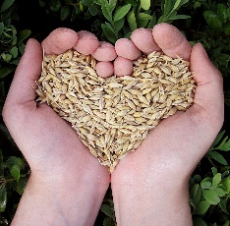
Smart Plate 10. a.)
Start
Labyrinth
The task:
Get from the START box to the GOAL box following the four directions (up, down, right, left), but you cannot move diagonally. Each direction is represented by a different coloured ArTeC Blocks element. You can use these to find the solution, or you can use arrows in the squares at the bottom of the page to indicate the correct path. Pass through each marked square and collect the elements associated with the path title.
Watch:
- Avoid the field(s) containing the wrong element!
- In the case of tracks which show some kind of process, correct order is important!
- In other cases there are several good solutions!
Up
Down
Right
Goal
Left

Slide 25
Smart Plate 10. b.)
Start
Hús, hal,
tojás, tej,
tejtermékek
Labyrinth
The task:
Get from the START box to the GOAL box following the four directions (up, down, right, left), but you cannot move diagonally. Each direction is represented by a different coloured ArTeC Blocks element. You can use these to find the solution, or you can use arrows in the squares at the bottom of the page to indicate the correct path. Pass through each marked square and collect the elements associated with the path title.
Watch:
- Avoid the field(s) containing the wrong element!
- In the case of tracks which show some kind of process, correct order is important!
- In other cases there are several good solutions!
Up
Vegetables
Down
Liquid
(mainly
water)
Right
Goal
Fruits
Left
Cereals

Slide 26
Smart Plate 10. - solution
Start
Labyrinth
The task:
Get from the START box to the GOAL box following the four directions (up, down, right, left), but you cannot move diagonally. Each direction is represented by a different coloured ArTeC Blocks element. You can use these to find the solution, or you can use arrows in the squares at the bottom of the page to indicate the correct path. Pass through each marked square and collect the elements associated with the path title.
Watch:
- Avoid the field(s) containing the wrong element!
- In the case of tracks which show some kind of process, correct order is important!
- In other cases there are several good solutions!
Up
Down
Right
Goal
Left

Slide 27
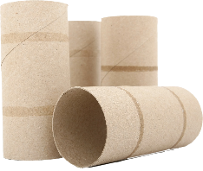
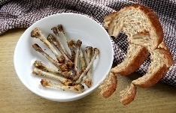
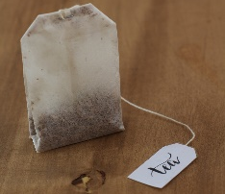
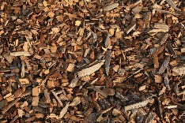
Compostable materials 11. a.)
Labyrinth
The task:
Get from the START box to the GOAL box following the four directions (up, down, right, left), but you cannot move diagonally. Each direction is represented by a different coloured ArTeC Blocks element. You can use these to find the solution, or you can use arrows in the squares at the bottom of the page to indicate the correct path. Pass through each marked square and collect the elements associated with the path title.
Watch:
- Avoid the field(s) containing the wrong element!
- In the case of tracks which show some kind of process, correct order is important!
- In other cases there are several good solutions!
Up
Start
Goal
Down
Right
Left

Slide 28
Compostable materials 11. b.)
Paper
rolls
Labyrinth
The task:
Get from the START box to the GOAL box following the four directions (up, down, right, left), but you cannot move diagonally. Each direction is represented by a different coloured ArTeC Blocks element. You can use these to find the solution, or you can use arrows in the squares at the bottom of the page to indicate the correct path. Pass through each marked square and collect the elements associated with the path title.
Watch:
- Avoid the field(s) containing the wrong element!
- In the case of tracks which show some kind of process, correct order is important!
- In other cases there are several good solutions!
Up
Start
Food
waste
Goal
Down
Tea
filter
Right
Wood
shavings
Left
Vegetables
and
fruit peel

Slide 29
Compostable materials with error 11. - solution
Labyrinth
The task:
Get from the START box to the GOAL box following the four directions (up, down, right, left), but you cannot move diagonally. Each direction is represented by a different coloured ArTeC Blocks element. You can use these to find the solution, or you can use arrows in the squares at the bottom of the page to indicate the correct path. Pass through each marked square and collect the elements associated with the path title.
Watch:
- Avoid the field(s) containing the wrong element!
- In the case of tracks which show some kind of process, correct order is important!
- In other cases there are several good solutions!
Up
Start
Goal
Down
Right
Left

