Slide 1
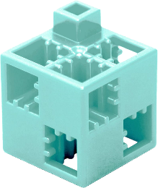
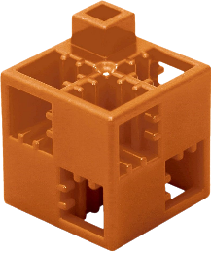
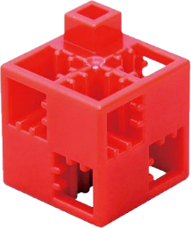
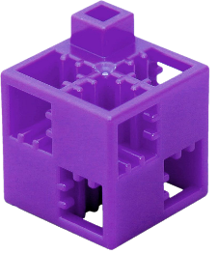
Human rights Article 30, 1.
Labyrinth
The task:
Get from the START box to the GOAL box following the four directions (up, down, right, left), but you cannot move diagonally. Each direction is represented by a different coloured ArTeC Blocks element. You can use these to find the solution, or you can use arrows in the squares at the bottom of the page to indicate the correct path. Pass through each marked square and collect the elements associated with the path title.
Care:
- Avoid the field(s) containing the wrong element!
- In the case of tracks which show some kind of process, correct order is important!
- In other cases there are several good solutions!
Right to education
Right to
play
Freedom of movement
Goal
Right to rest nad leisure
Up
Copyright
law
The right
to life
Duty
to your community
Right to privacy
Down
Right to adequate information
Start
Right
Left

Slide 2
Human rights Article 30, 1. with error - solution
Right to education
Up
Right to
play
Freedom of movement
Down
Goal
Right to rest nad leisure
Copyright law
The right
to life
Right
Duty
to your community
Right to privacy
Left
Right to adequate information
Start

Slide 3
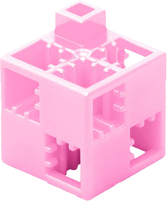
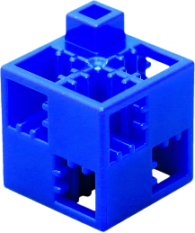
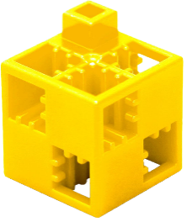
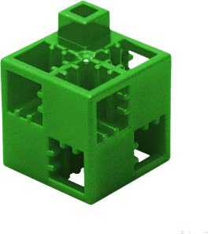
Citizens' rights 2.
Labyrinth
The task:
Get from the START box to the GOAL box following the four directions (up, down, right, left), but you cannot move diagonally. Each direction is represented by a different coloured ArTeC Blocks element. You can use these to find the solution, or you can use arrows in the squares at the bottom of the page to indicate the correct path. Pass through each marked square and collect the elements associated with the path title.
Watch:
- Avoid the field(s) containing the wrong element!
- In the case of tracks which show some kind of process, correct order is important!
- In other cases there are several good solutions!
Presumption of
innocence
Goal
Protection of personal data
Right to a market economy
Speech
and press freedom
Preserving the
integrity of your mail
Up
Right to
health
Freedom of assembly and association
Freedom
of religion and belief
Down
Start
Right to democracy
Right
Left

Slide 4
Citizens' rights 2. with error - solution
Presumption of
innocence
Goal
Protection of personal data
Right to a market economy
Speech
and press freedom
Up
Down
Preserving the
integrity of your mail
Right to
health
Right
Freedom of assembly and association
Freedom
of religion and belief
Left
Start
Right to democracy

Slide 5
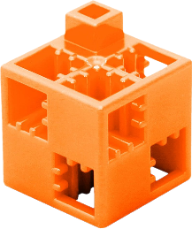
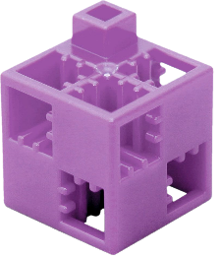
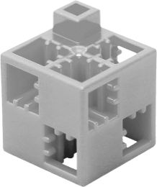
Democratic governance 3.
Labyrinth
The task:
Get from the START box to the GOAL box following the four directions (up, down, right, left), but you cannot move diagonally. Each direction is represented by a different coloured ArTeC Blocks element. You can use these to find the solution, or you can use arrows in the squares at the bottom of the page to indicate the correct path. Pass through each marked square and collect the elements associated with the path title.
Watch:
- Avoid the field(s) containing the wrong element!
- In the case of tracks which show some kind of process, correct order is important!
- In other cases there are several good solutions!
Market economy
3 separate branches
of power
Goal
Start
Presence
of civil organisations
Up
Free elections
Right of assembly
One-party system
Democracy
is a Latin word
Limited freedom of expression
Down
Local governments
Members are replacable
Right
Left

Slide 6
Democratic governance 3. with error - solution
Market economy
3 separate branches
of power
Up
Goal
Down
Start
Presence
of civil organisations
Right
Free elections
Right of assembly
One-party system
Democracy
is a Latin word
Limited freedom of expression
Left
Local governments
Members are replacable

Slide 7
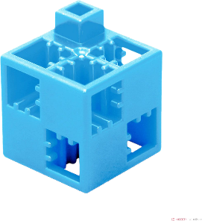
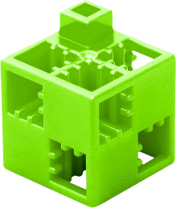
Characteristics of a state 4.
Labyrinth
The task:
Get from the START box to the GOAL box following the four directions (up, down, right, left), but you cannot move diagonally. Each direction is represented by a different coloured ArTeC Blocks element. You can use these to find the solution, or you can use arrows in the squares at the bottom of the page to indicate the correct path. Pass through each marked square and collect the elements associated with the path title.
Watch:
- Avoid the field(s) containing the wrong element!
- In the case of tracks which show some kind of process, correct order is important!
- In other cases there are several good solutions!
Geographical unit
Airspace
not part of
the state
Presence of civil organisations
Territorial unit
Surrounded by
a border
Up
Goal
Internationally recognised
Can border
up to 6 countries
Down
Start
A
community
of people living in
Right
Politcally independent
Left

Slide 8
Characteristics of a state 4. with error - solution
Geographical unit
Up
Airspace
not part of the state
Presence of civil organisations
Down
Territorial unit
Surrounded by
a border
Internationally recognised
Right
Goal
Can
border
up to 6 countries
Left
Start
A
community of people living in
Politcally independent

Slide 9
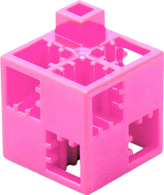
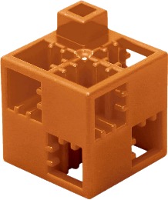
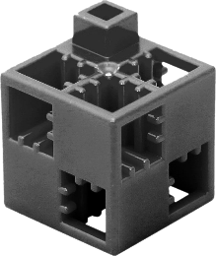
Geographical discoveries 1450 - 1650
Labyrinth
The task:
Get from the START box to the GOAL box following the four directions (up, down, right, left), but you cannot move diagonally. Each direction is represented by a different coloured ArTeC Blocks element. You can use these to find the solution, or you can use arrows in the squares at the bottom of the page to indicate the correct path. Pass through each marked square and collect the elements associated with the path title.
Watch:
- Avoid the field(s) containing the wrong element!
- In the case of tracks which show some kind of process, correct order is important!
- In other cases there are several good solutions!
The Ottoman Empire occupies Byzantium
The empire
of Charles
V is divided
Into
two parts
Bartolomeu Dias
bypasses
the Cape
of Good Hope
Start
Goal
Francisco Pizarro
conquers
the Inca
Empire
Cristoforo Colombo discovers America
Vasco de Gamma circumnavigates Africa
Up
Magellan
goes on a journey
around
the Earth
Down
Treaty of Tordesillas
Cortez
conquers
the Aztec
Empire
Right
Left

Slide 10
Geographical discoveries 1450 - 1650 - solution
The Ottoman Empire occupies Byzantium
The empire
of Charles
V is divided
Into
two parts
Bartolomeu Dias
bypasses
the Cape of
Good Hope
Up
Start
Goal
Francisco Pizarro
conquers
the Inca
Empire
Down
Cristoforo Colombo discovers America
Vasco de Gamma circumnavigates Africa
Right
Magellan goes on a journey around the Earth
Treaty of Tordesillas
Left
Cortez
conquers
the Aztec
Empire

Slide 11
Birth of nation-states 6.
Labyrinth
The task:
Get from the START box to the GOAL box following the four directions (up, down, right, left), but you cannot move diagonally. Each direction is represented by a different coloured ArTeC Blocks element. You can use these to find the solution, or you can use arrows in the squares at the bottom of the page to indicate the correct path. Pass through each marked square and collect the elements associated with the path title.
Watch:
- Avoid the field(s) containing the wrong element!
- In the case of tracks which show some kind of process, correct order is important!
- In other cases there are several good solutions!
The creation of the
German customs union
Suffragette movement
in Britain
Start
Goal
German Empire introduces compulsory social insurance
Spring of Nations
Battle of Sedan
Declaration of the German Empire
Up
Battle of Solferino
The Kingdom
of Italy occupies Venice
Down
Right
Garibaldi's crusade
Left

Slide 12
Birth of nation-states 6. - solution
The creation of the
german customs union
Suffragette movement in Britain
Up
Start
Goal
German Empire introduces compulsory social insurance
Down
Spring of Nations
Battle of Sedan
Declaration of the German Empire
Right
The Kingdom of Italy occupies Venice
Battle of Solferino
Left
Garibaldi's crusade

Slide 13
Structural similarities between animal and plant cells 7.
Labyrinth
The task:
Get from the START box to the GOAL box following the four directions (up, down, right, left), but you cannot move diagonally. Each direction is represented by a different coloured ArTeC Blocks element. You can use these to find the solution, or you can use arrows in the squares at the bottom of the page to indicate the correct path. Pass through each marked square and collect the elements associated with the path title.
Watch:
- Avoid the field(s) containing the wrong element!
- In the case of tracks which show some kind of process, correct order is important!
- In other cases there are several good solutions!
Endoplasmic reticulum network
Cell
membran
Cell wall
Liposome
Start
Goal
Up
Golgi
apparatus
Down
Mitochondria
Cell
nucleus
Right
Left

Slide 14
Structural similarities between animal and plant cells 7. with error - solution
Up
Endoplasmic reticulum
network
Cell
wall
Cell
membran
Down
Liposome
Start
Goal
Golgi
apparatus
Right
Left
Mitochondria
Cell nucleus

Slide 15
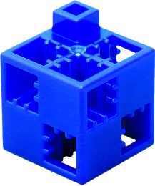
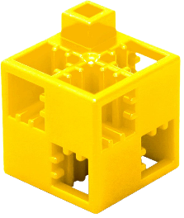
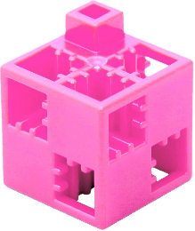
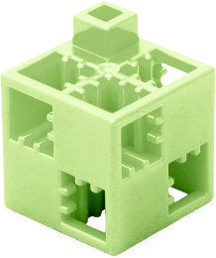
General structure of the nerve cell 8.
Labyrinth
The task:
Get from the START box to the GOAL box following the four directions (up, down, right, left), but you cannot move diagonally. Each direction is represented by a different coloured ArTeC Blocks element. You can use these to find the solution, or you can use arrows in the squares at the bottom of the page to indicate the correct path. Pass through each marked square and collect the elements associated with the path title.
Watch:
- Avoid the field(s) containing the wrong element!
- In the case of tracks which show some kind of process, correct order is important!
- In other cases there are several good solutions!
Cell
nucleus
Schwann’s
cells
Cells with elongated structure
Subcutis
(hypodermis)
Axon
Terminals
Up
Dendrites
Goal
Down
Start
Nerve fibre bundle
Axon
Right
Cell Body
Left

Slide 16
General structure of the nerve cell 8. with error - solution
Cell
nucleus
Schwann’s
cells
Up
Cells with elongated structure
Down
Subcutis
(hypodermis)
Axon
Terminals
Dendrites
Cél
Right
Goal
Nerve
fibre
bundle
Start
Left
Start
Axon
Cell Body

Slide 17
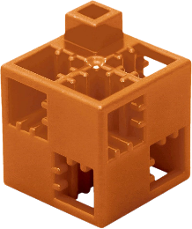
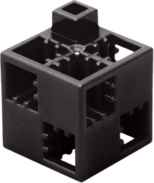
Composers of the Baroque period 1600 (1580) - 1750 9.
Labyrinth
The task:
Get from the START box to the GOAL box following the four directions (up, down, right, left), but you cannot move diagonally. Each direction is represented by a different coloured ArTeC Blocks element. You can use these to find the solution, or you can use arrows in the squares at the bottom of the page to indicate the correct path. Pass through each marked square and collect the elements associated with the path title.
Watch:
- Avoid the field(s) containing the wrong element!
- In the case of tracks which show some kind of process, correct order is important!
- In other cases there are several good solutions!
Antonio Vivaldi
Wolfgang Amadeus Mozart
Franz Seraph Peter Schubert
Claudio Monteverdi
Up
Johann Sebastian Bach
Goal
Down
Start
Giacomo Carissimi
Georg
Friedrich Händel
Right
Left

Slide 18
Composers of the Baroque period 1600 (1580) - 1750 9. with error - solution
Antonio Vivaldi
Goal
Wolfgang Amadeus Mozart
Franz Seraph Peter Schubert
Up
Down
Johann Sebastian Bach
Claudio Monteverdi
Giacomo Carissimi
Right
Left
Start
Georg
Friedrich Händel

Slide 19
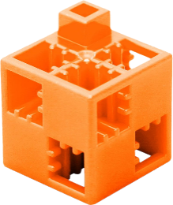
Painters of the Renaissance 10.
Labyrinth
The task:
Get from the START box to the GOAL box following the four directions (up, down, right, left), but you cannot move diagonally. Each direction is represented by a different coloured ArTeC Blocks element. You can use these to find the solution, or you can use arrows in the squares at the bottom of the page to indicate the correct path. Pass through each marked square and collect the elements associated with the path title.
Watch:
- Avoid the field(s) containing the wrong element!
- In the case of tracks which show some kind of process, correct order is important!
- In other cases there are several good solutions!
Sandro Botticelli
Raffaello Sanzio
Michelangelo
di Lodovico Buonarroti Simoni
Jacopo Tintoretto
Goal
Up
Leonardo di ser Piero da Vinci
Michelangelo Merisi da Caravaggio
Sir
Peter Paul Rubens
Down
Tiziano Vecellio
Start
Jean Fouquet
Right
Left

Slide 20
Painters of the Renaissance 10. with error - solution
Sandro Botticelli
Raffaello Sanzio
Michelangelo
di Lodovico Buonarroti Simoni
Up
Down
Jacopo Tintoretto
Goal
Leonardo di ser Piero da Vinci
Michelangelo Merisi da Caravaggio
Sir
Peter Paul Rubens
Right
Tiziano Vecellio
Left
Start
Jean Fouquet

