Slide 1
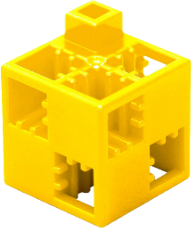
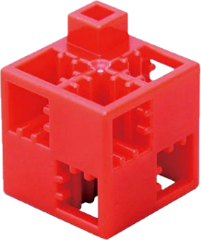
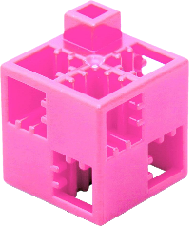
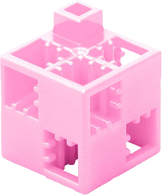
Colour according to the colour codes! 1. a.)
1
1
2
1
2
1
2
2
3
2
4
2
3
2
3
3
3
2
4
1
2
3
2
1
1
1
2
1
1
Colour the puzzle according to the colours of the cubes marked with numbers.
If you have an ArTeC Blocks construction set, you can build the coloured shape.

Slide 2
Colour according to the colour codes! 1. b.)
White
Yellow
Purple
Red
Pink
Dark green
Light pink
Black
Binary colouring
(binary)
At the ends of a tree-like diagram you see colours, which you can access through an "up-down" decision process. The value of „up” is 1 and the value of „down” is 0 . To select the colour of each field, start from the centre and work your way up or down the branches of the diagram, based on the elements of the numerical sequence associated with that field, to the colour you want to select.
e.g.: 101 -> up - down - up
0100 -> down - up - down - down
110 100 110 100 110
100 011 100 001 100
100 011 011 011 100
110 100 011 100 110
110 110 100 110 110

Slide 3
Colour according to the colour codes!
Heart
1
1
2
1
2
1
2
2
3
2
4
2
3
2
3
3
3
2
4
1
2
3
2
1
1
1
2
1
1

Slide 4
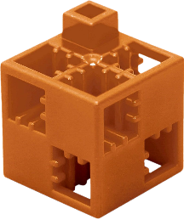
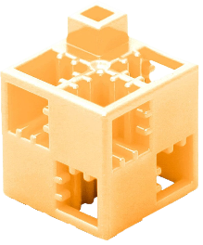
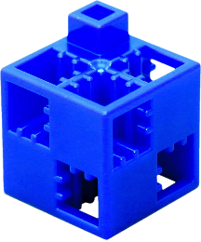
Colour according to the colour codes!
2. a.)
1
1
1
1
1
1
2
1
2
2
2
1
3
2
3
2
3
2
2
2
2
2
2
4
2
2
4
2
2
Colour the puzzle according to the colours of the cubes marked with numbers.
If you have an ArTeC Blocks construction set, you can build the coloured shape.

Slide 5
Colour according to the colour codes!
2. b.)
Brown
Yellow
Pastel orange
Red
Blue
Dark green
Grey
Black
Binary colouring
(binary)
At the ends of a tree-like diagram you see colours, which you can access through an "up-down" decision process. The value of „up” is 1 and the value of „down” is 0 . To select the colour of each field, start from the centre and work your way up or down the branches of the diagram, based on the elements of the numerical sequence associated with that field, to the colour you want to select.
e.g.: 101 -> up - down - up
0100 -> down - up - down - down
111 111 111 111 111
111 101 101 101 111
101 011 101 011 101
101 101 101 101 101
101 101 100 101 101

Slide 6
Colour according to the colour codes!
Head
1
2
3
4

Slide 7
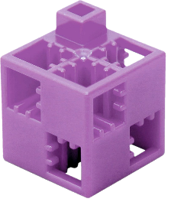
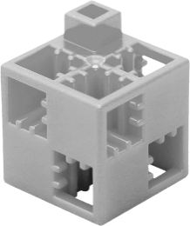
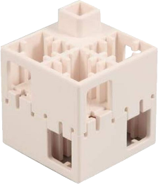
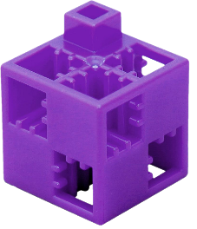
Colour according to the colour codes! 3. a.)
1
5
6
2
6
3
4
6
Colour the puzzle according to the colours of the cubes marked with numbers.
If you have an ArTeC Blocks construction set, you can build the coloured shape.

Slide 8
Colour according to the colour codes! 3. b.)
White
Light grey
Dark pink
Dark green
Light pink
Pastel yellow
Dark purple
Light purple
Binary colouring
(binary)
At the ends of a tree-like diagram you see colours, which you can access through an "up-down" decision process. The value of „up” is 1 and the value of „down” is 0 . To select the colour of each field, start from the centre and work your way up or down the branches of the diagram, based on the elements of the numerical sequence associated with that field, to the colour you want to select.
e.g.: 101 -> up - down - up
0100 -> down - up - down - down
000 111 111 111 000
001 101 110 101 001
101 011 110 011 101
001 101 110 101 001
000 111 111 111 000

Slide 9
Colour according to the colour codes! Butterfly
1
5
2
6
3
4

Slide 10
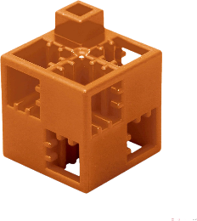
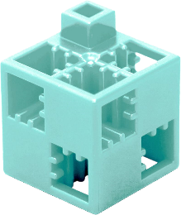
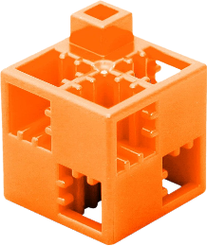
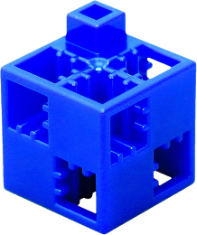
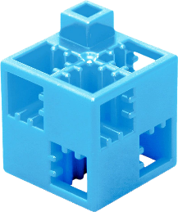
Colour according to the colour codes! 4. a.)
1
5
2
6
3
3
3
3
3
3
4
1
1
1
1
1
1
Colour the puzzle according to the colours of the cubes marked with numbers.
If you have an ArTeC Blocks construction set, you can build the coloured shape.

Slide 11
Colour according to the colour codes! 4. b.)
White
Orange
Brown
Red
Dark blue
Light blue
Aqua
Pastel orange
Binary colouring
(binary)
At the ends of a tree-like diagram you see colours, which you can access through an "up-down" decision process. The value of „up” is 1 and the value of „down” is 0 . To select the colour of each field, start from the centre and work your way up or down the branches of the diagram, based on the elements of the numerical sequence associated with that field, to the colour you want to select.
e.g.: 101 -> up - down - up
0100 -> down - up - down - down
000 000 001 000 000
000 010 010 010 000
011 011 011 011 011
101 101 101 101 101
110 101 101 101 110

Slide 12
Colour according to the colour codes! Wooden cubic structure
1
5
2
6
3
4

Slide 13
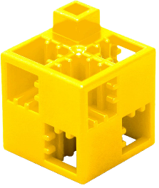
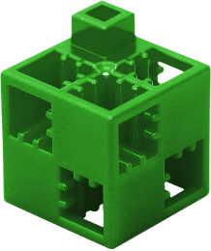
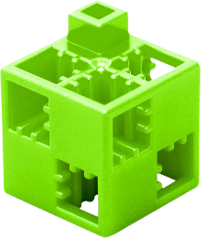
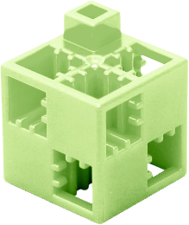
Colour according to the colour codes! 5. a.)
1
5
2
6
3
4
Colour the puzzle according to the colours of the cubes marked with numbers.
If you have an ArTeC Blocks construction set, you can build the coloured shape.

Slide 14
Colour according to the colour codes! 5. b.)
Brown
Yellow
Purple
Dark green
Dark blue
Light green
White
Pastel green
Binary colouring
(binary)
At the ends of a tree-like diagram you see colours, which you can access through an "up-down" decision process. The value of „up” is 1 and the value of „down” is 0 . To select the colour of each field, start from the centre and work your way up or down the branches of the diagram, based on the elements of the numerical sequence associated with that field, to the colour you want to select.
e.g.: 101 -> up - down - up
0100 -> down - up - down - down
001 010 010 000 110
001 100 010 010 000
001 001 111 010 010
001 111 001 100 010
111 001 001 001 001

Slide 15
Colour according to the colour codes!
Sword
1
5
2
6
3
4

Slide 16
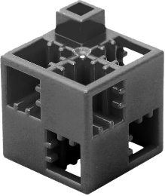
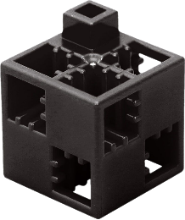
Colour according to the colour codes!
6. a.)
1
5
2
6
3
7
4
4
4
Colour the puzzle according to the colours of the cubes marked with numbers.
If you have an ArTeC Blocks construction set, you can build the coloured shape.

Slide 17
Colour according to the colour codes! 6. b.)
Light grey
Yellow
Light blue
Red
Black
White
Dark grey
Brown
Binary colouring
(binary)
At the ends of a tree-like diagram you see colours, which you can access through an "up-down" decision process. The value of „up” is 1 and the value of „down” is 0 . To select the colour of each field, start from the centre and work your way up or down the branches of the diagram, based on the elements of the numerical sequence associated with that field, to the colour you want to select.
e.g.: 101 -> up - down - up
0100 -> down - up - down - down
010 010 001 010 110
010 001 001 010 010
010 010 000 011 010
111 111 000 111 111
101 111 111 111 101

Slide 18
Colour according to the colour codes!
Boat
1
5
2
6
3
7
4

Slide 19
Colour according to the colour codes!
7. a.)
1
5
1
1
1
2
1
1
3
2
2
2
2
2
3
2
2
4
2
2
2
Colour the puzzle according to the colours of the cubes marked with numbers.
If you have an ArTeC Blocks construction set, you can build the coloured shape.

Slide 20
Colour according to the colour codes!
7. b.)
Dark blue
Dark green
Purple
Light green
Orange
White
Dark purple
Black
Binary colouring
(binary)
At the ends of a tree-like diagram you see colours, which you can access through an "up-down" decision process. The value of „up” is 1 and the value of „down” is 0 . To select the colour of each field, start from the centre and work your way up or down the branches of the diagram, based on the elements of the numerical sequence associated with that field, to the colour you want to select.
e.g.: 101 -> up - down - up
0100 -> down - up - down - down
110 010 010 110 110
010 110 010 110 010
001 100 100 100 001
100 100 011 100 100
010 100 100 100 010

Slide 21
Colour according to the colour codes!
UFO
1
5
2
3
4

Slide 22
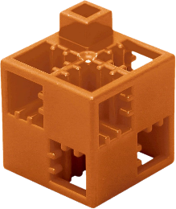
Colour according to the colour codes!
8. a.)
1
5
2
3
4
Colour the puzzle according to the colours of the cubes marked with numbers.
If you have an ArTeC Blocks construction set, you can build the coloured shape.

Slide 23
Colour according to the colour codes!
8. b.)
Red
Yellow
Light green
Dark blue
White
Brown
Dark green
Black
Binary colouring
(binary)
At the ends of a tree-like diagram you see colours, which you can access through an "up-down" decision process. The value of „up” is 1 and the value of „down” is 0 . To select the colour of each field, start from the centre and work your way up or down the branches of the diagram, based on the elements of the numerical sequence associated with that field, to the colour you want to select.
e.g.: 101 -> up - down - up
0100 -> down - up - down - down
011 101 101 001 101
101 011 010 010 011
011 010 011 011 010
111 111 011 111 111
111 111 011 111 111

Slide 24
Colour according to the colour codes! 8.
Cherry
1
5
2
3
4

Slide 25
Colour according to the colour codes! 9. a.)
1
2
3
Colour the puzzle according to the colours of the cubes marked with numbers.
If you have an ArTeC Blocks construction set, you can build the coloured shape.

Slide 26
Colour according to the colour codes! 9. b.)
White
Yellow
Light purple
Red
Dark blue
Light blue
Orange
Black
Binary colouring
(binary)
At the ends of a tree-like diagram you see colours, which you can access through an "up-down" decision process. The value of „up” is 1 and the value of „down” is 0 . To select the colour of each field, start from the centre and work your way up or down the branches of the diagram, based on the elements of the numerical sequence associated with that field, to the colour you want to select.
e.g.: 101 -> up - down - up
0100 -> down - up - down - down
111 010 111 010 111
101 101 010 101 101
101 101 010 101 101
010 010 010 010 010
101 101 010 101 101

Slide 27
Colour according to the colour codes! 9.
Package
1
2
3

Slide 28
Colour according to the colour codes!
10. a.)
1
2
3
4
Colour the puzzle according to the colours of the cubes marked with numbers.
If you have an ArTeC Blocks construction set, you can build the coloured shape.

Slide 29
Colour according to the colour codes!
10. b.)
Dark blue
Yellow
Brown
Red
Dark grey
White
Dark green
Black
Binary colouring
(binary)
At the ends of a tree-like diagram you see colours, which you can access through an "up-down" decision process. The value of „up” is 1 and the value of „down” is 0 . To select the colour of each field, start from the centre and work your way up or down the branches of the diagram, based on the elements of the numerical sequence associated with that field, to the colour you want to select.
e.g.: 101 -> up - down - up
0100 -> down - up - down - down
110 110 010 001 010
110 001 001 001 001
010 001 001 001 001
010 101 101 101 101
010 010 101 101 010

Slide 30
Colour according to the colour codes!
Cactus
1
2
3
4

