Slide 1
HOW CAN WE REDUCE DIGITAL STRESS AS PARENTS?
.
This is something we should learn and teach our children growing up in the digital age.
And let's start with ourselves.

Slide 2
B. About the project: Digitmarket
Marketplace of Knowledge for Digital Education Methodology (DIGIMARKET)
You can read and learn about Erasmus Plus at these 2 links:
https://ec.europa.eu/programmes/erasmus-plus/resources/coronavirus-impact_en
https://ec.europa.eu/programmes/erasmus-plus/resources/coronavirus-impact_en

Slide 3
Hi, I'm Hajnalka Fulop, andragogue, internet security specialist. I teach parents, teachers and students how to use digital tools safely and how to improve their lives with online tools.
I am a mother of 5 children, and my children are screenagers.
What does the word "screenager" mean? What do you think?

Slide 4
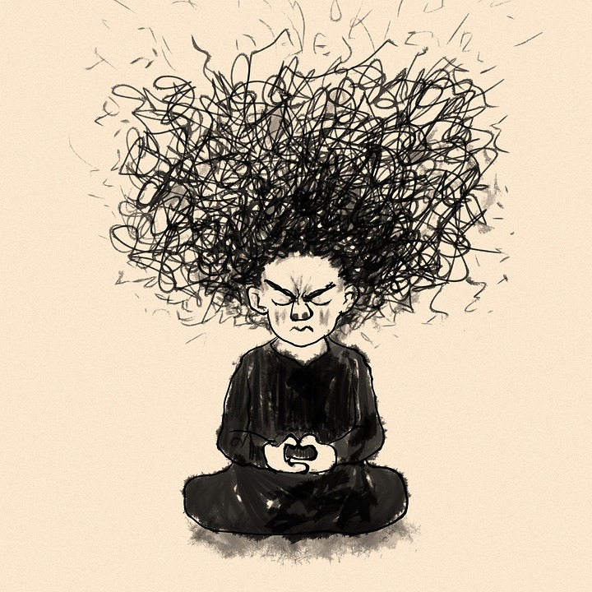
A. "Digital stress" means: the internal tension when we think we can do several things efficiently and flawlessly at once with digital tools and it turns out we can't. What's more, we always feel behind in some online activity.
Digital stress can also be caused by too much digital information and the blurring of perceptions of reality.
Digital stress can take two forms:
good stress - motivating feeling
creator
related
creator
a community experience
bad stress - feeling overwhelmed, depressed
causes tension
paralyse
narrows your thinking
disconnects you from the community

Slide 5
This topic - digital stress - is very important - one of the most common situations in the 21st century - all over the world.
B. Four aspects of digital stress in our daily lives:
We develop bad time management habits due to excessive use of digital devices.
This can lead to broken or missed human connections due to poor time management
Stress related to digital devices can lead to poor work and learning performance
Secondary effect: problems resulting from lack of physical activity.
See the Interment website for more types of digital stress.

Slide 6
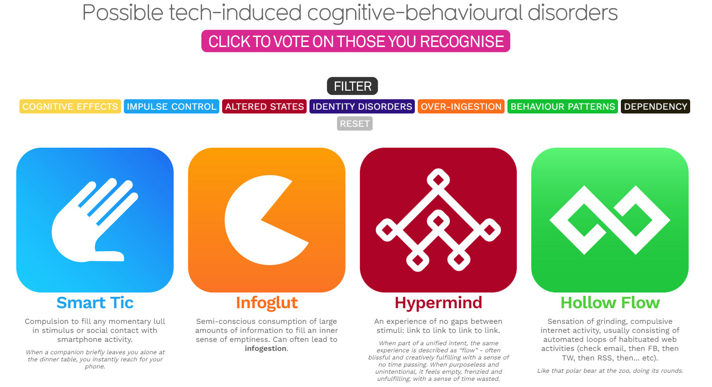
Information is beutiful- Intermental - types of mental digital stress syndromes

Slide 7
Solutions
Time limit - setting a time limit
Set a limit on the number of emails you can answer immediately, even if they are work-related. When we leave work or other commitments, say no to the constant pressure to check. It is worth letting colleagues and acquaintances know when we are offline.

Slide 8
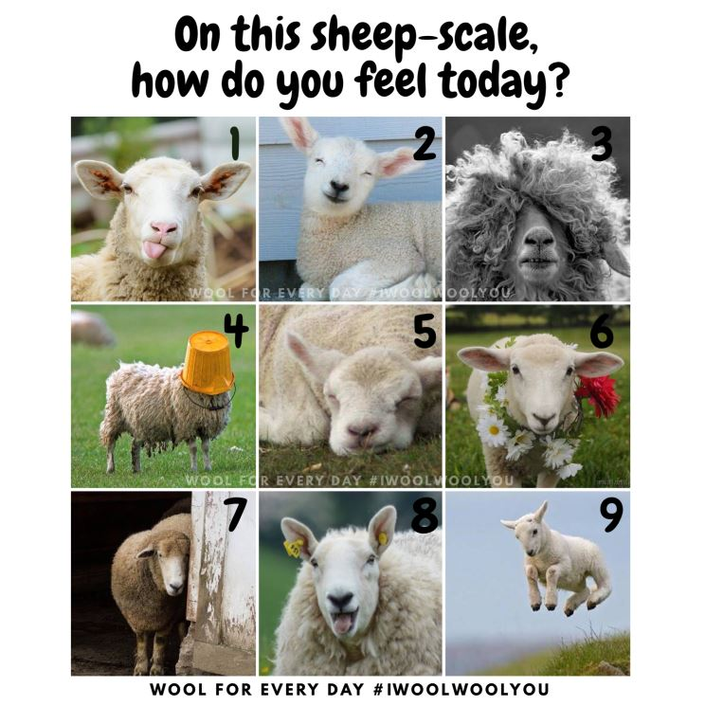
Try to make an effort to have important conversations in person or by phone. This avoids the digital stress of misunderstandings and waiting for a response.

Slide 9
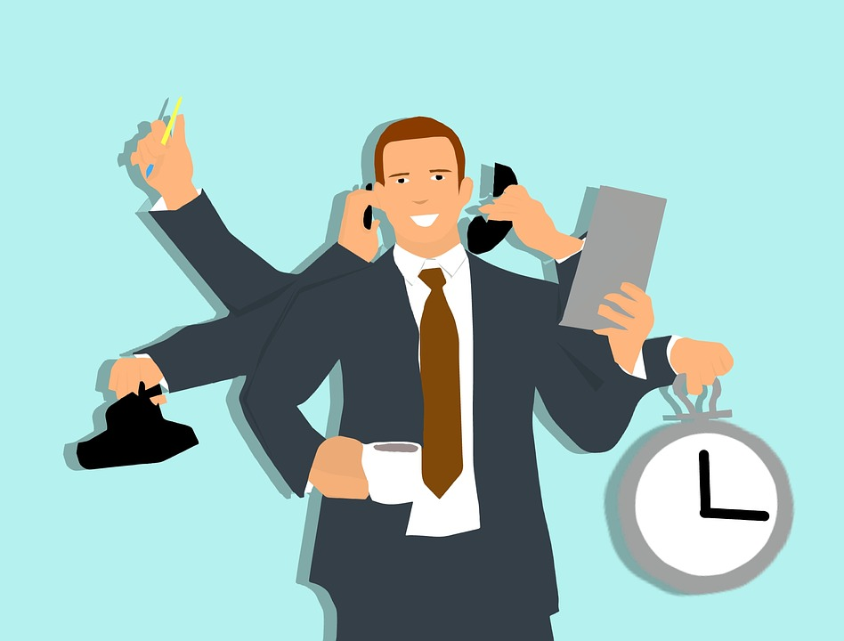
The last tip is perhaps the most important, and that is to try to organise regular periods when you switch off all electronic devices and try to communicate face-to-face.

Slide 10
"Tell and I will forget, show and I will remember; involve me and I will understand."
- Confucius
Questions:
- How much time a day does your family spend on their phone or any other screen?
- And how much time are your children online?
- How many screens do you have in your house/flat? What rules apply to screen usage?
:

Slide 11
See clearly: children reflect us in their behaviour and emotional state.
How can we reduce stress and build resilience?
There are several ways to do this: deep breathing, flexing muscles, shouting, singing, walking [Infographic]
this is first aid.

Slide 12
Digital curfew:
no media half an hour before bedtime? An hour? Maybe even two? No touching the phone before your morning coffee? Before breakfast? Before a morning workout? Maybe no media before morning meditation?
Shrines without technology: family dinner? Bedroom (definitely!)? Homework time? Maybe finally technology-free social gatherings?
Grouping: group your digital activities together: for example, checking social networking sites or emails twice every five minutes.
Digital detox: a deliberate period of 24 hours without media.
Digital Detox Plus: from a few days to a few weeks CAN IT WORK?
It could become a new endurance sport - who knows?

Slide 13
C. Decide what we can do to solve it.
Concluding remarks:
A. No more FOMO: Fear of missing out.
Instead, try JOMO - The Joy of Missing Out.
B. Unplug the power cord from "Being Informed".
Pull it from social media
Practice a sensible social media diet
C. Let's work together
D. Take baby steps: don't go without digital devices for long at first,
but gradually increase "rapidly" the duration of the digital device.
Does it include this?
Some research on digital stress (psychology, medicine, neuroscience, biology, etc.): how it affects us and how we can manage it.
I wish you good luck with this!

