Slide 1
Teacher presentation on the different forms of online bullying (Cyberbullying tutorial)

Slide 2
Sextortion Dissing Sexting Cyber Stalking
Catfishing Identity theft Bash boarding
Exclusion Exposing Deception
Grooming Flaming Harassment - spreading a bad reputation
Revenge porn Harrasment

Slide 3
DEFINITION OF CYBERBULLYING
It happens in the virtual world, 24 hours a day you can feel hurt or humiliated or threatened.

Slide 4
TYPES OF CYBERBULLYING
Harassment - spreading a bad reputation: BASH BOARDING; DISSING
Identity theft
Exclusion
Exposing
Deception

Slide 5
TYPES OF CYBERBULLYING
FLAMING
CYBER STALKING
ONLINE HARASSMENT
SEXTING
GROOMING
SEXTORTION
REVENGE PORN

Slide 6
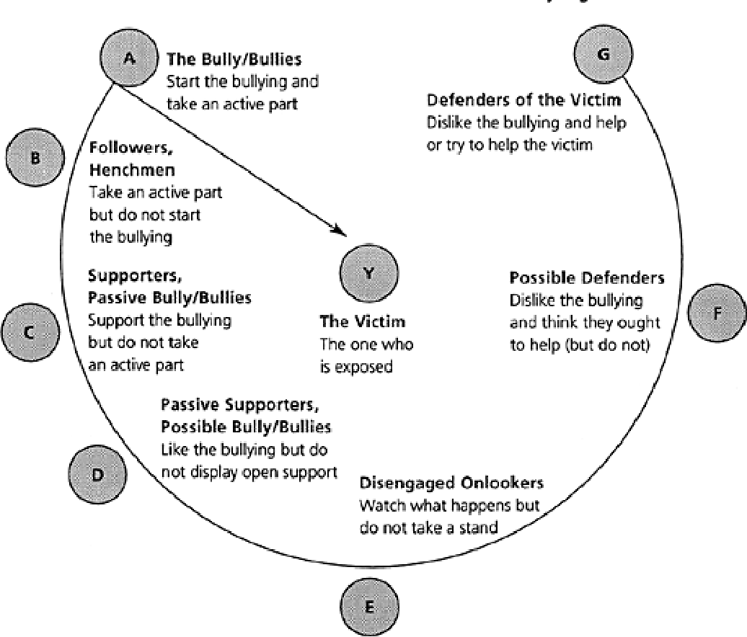
Dan Olweus Bullying Circle
Notes:
https://www.pcsd.org/site/handlers/filedownload.ashx?moduleinstanceid=6061&dataid=16514&FileName=BullyCircle_0107_handout-1.pdf
Source of the image: https://www.semanticscholar.org/paper/A-Profile-of-Bullying-at-School.-Olweus/56a780bc1bc5908982359beadd499d16592e2751/figure/0

