Slide 1
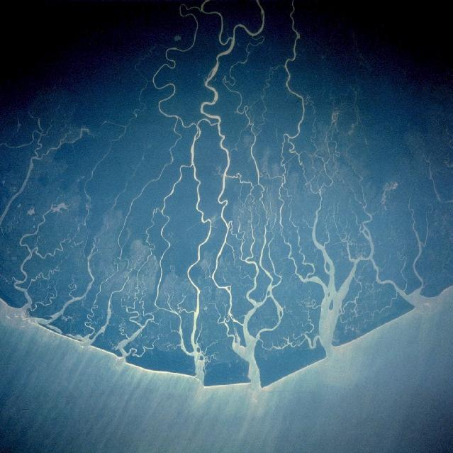
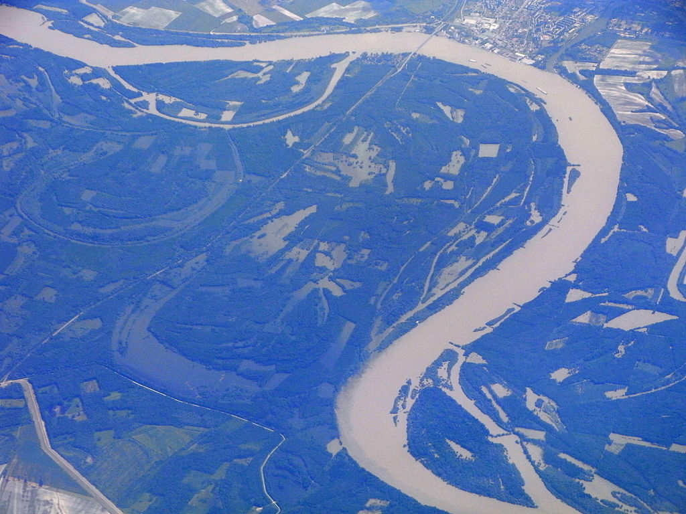
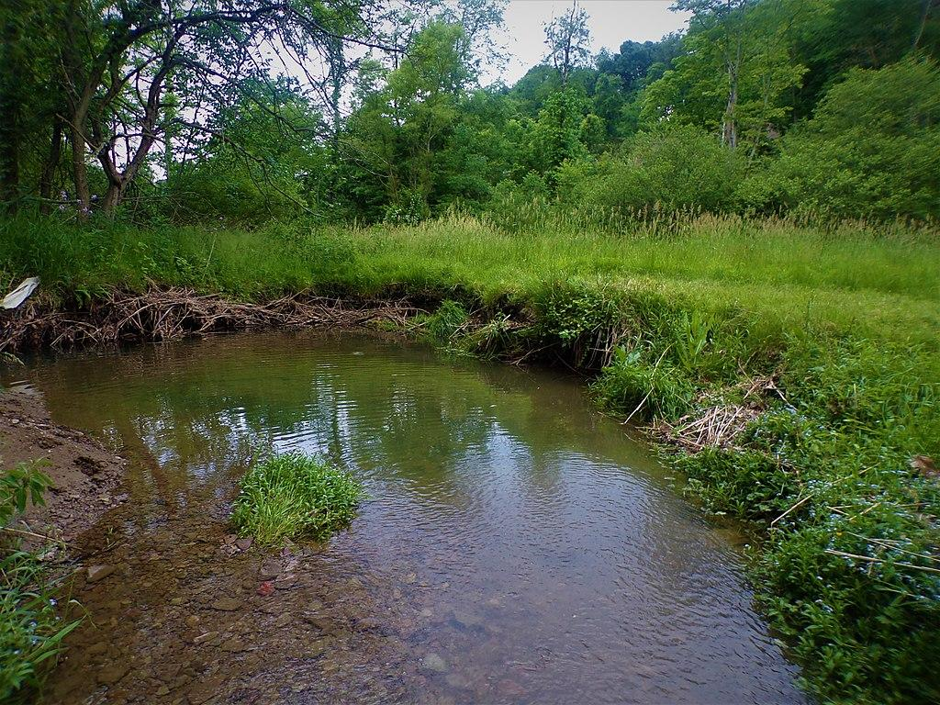
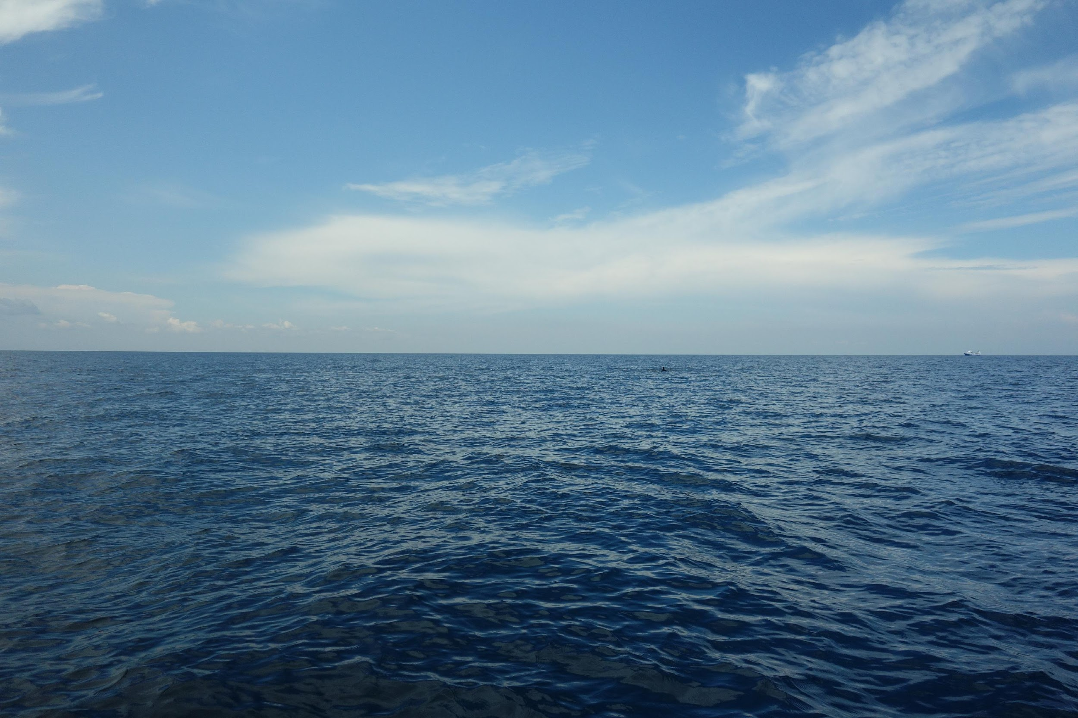
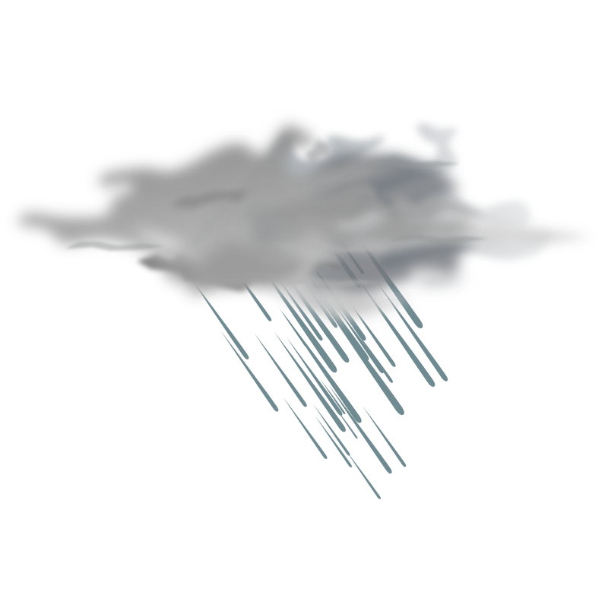
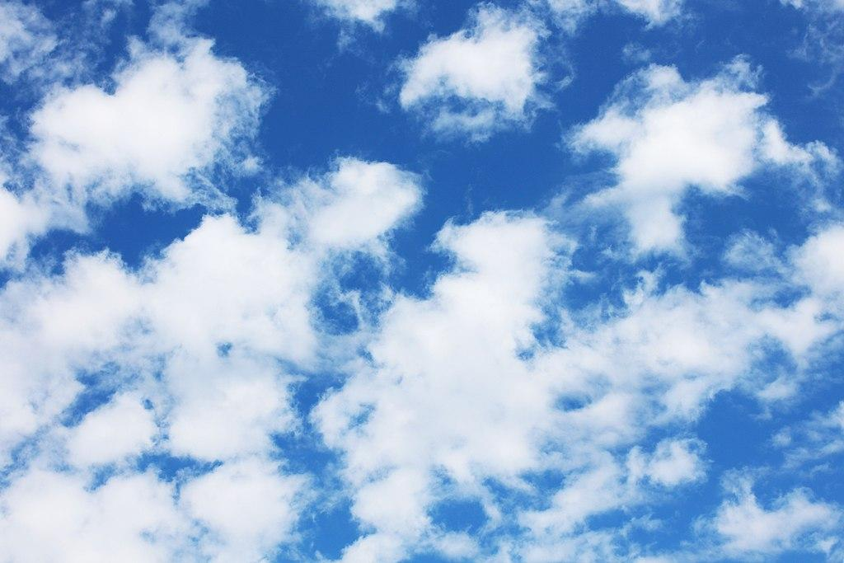
Challenge:
The water cycle:
Go through the course according to the water cycle!

Slide 2
River Delta
River
Streams
Sea
Raining
Challenge:
The water cycle:
Go through the course according to the water cycle!
Evaporation,
Clouds

Slide 3
Challenge:
The water cycle:
Go through the course according to the water cycle!

Slide 4
River Delta
River
Streams
Sea
Raining
Challenge:
The water cycle:
Go through the course according to the water cycle!
Evaporation,
Clouds

Slide 5
Challenge:
The water cycle:
Go through the course according to the water cycle!

Slide 6
River Delta
River
Streams
Sea
Raining
Challenge:
The water cycle:
Go through the course according to the water cycle!
Evaporation,
Clouds

Slide 7
Solution
Challenge:
The water cycle:
Go through the course according to the water cycle!

Slide 8
River
delta
Water
Streams
Sea
Raining
Solution
Challenge:
The water cycle:
Go through the course according to the water cycle!
Evaporation,
Clouds

