Slide 1
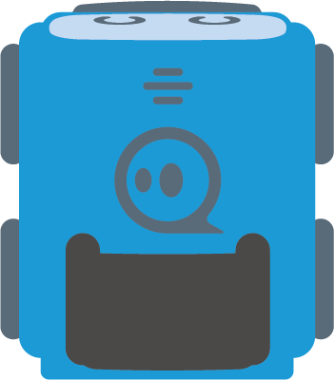
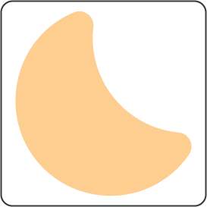
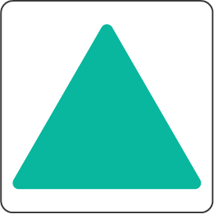
Pain receptor
Sensory nerve
Spinal
cord synapse
Motor nerve
Challenge:
Go through a neural pathway that controls a reflex.
Muscle

Slide 2
Pain receptor
Sensory nerve
Spinal
cord synapse
Motor nerve
Challenge:
Go through a neural pathway that controls a reflex.
Muscle

Slide 3
Pain receptor
Sensory nerve
Spinal
cord synapse
Motor nerve
Challenge:
Go through a neural pathway that controls a reflex.
Muscle

Slide 4
Pain receptor
Sensory nerve
Spinal
cord synapse
Motor nerve
Solution
Challenge:
Go through a neural pathway that controls a reflex.
Muscle

Slide 5
Cere-
bellum
Challenge:
Go through a neural pathway that controls a reflex.
Avoid everything else!
Pain receptor
Sensory nerve
Spinal
cord synapse
Motor nerve
Inner
ear
Muscle
Cranial nerve

Slide 6
Cere-
bellum
Challenge:
Go through a neural pathway that controls a reflex.
Avoid everything else!
Pain receptor
Sensory nerve
Spinal
cord synapse
Motor nerve
Inner
ear
Muscle
Cranial nerve

Slide 7
Cere-
bellum
Challenge:
Go through a neural pathway that controls a reflex.
Avoid everything else!
Pain receptor
Sensory nerve
Spinal
cord synapse
Motor nerve
Inner
ear
Muscle
Cranial nerve

Slide 8
Cere-
bellum
Challenge:
Go through a neural pathway that controls a reflex.
Avoid everything else!
Pain receptor
Sensory nerve
Solution
Spinal
cord synapse
Motor nerve
Inner
ear
Muscle
Cranial nerve

