Slide 1













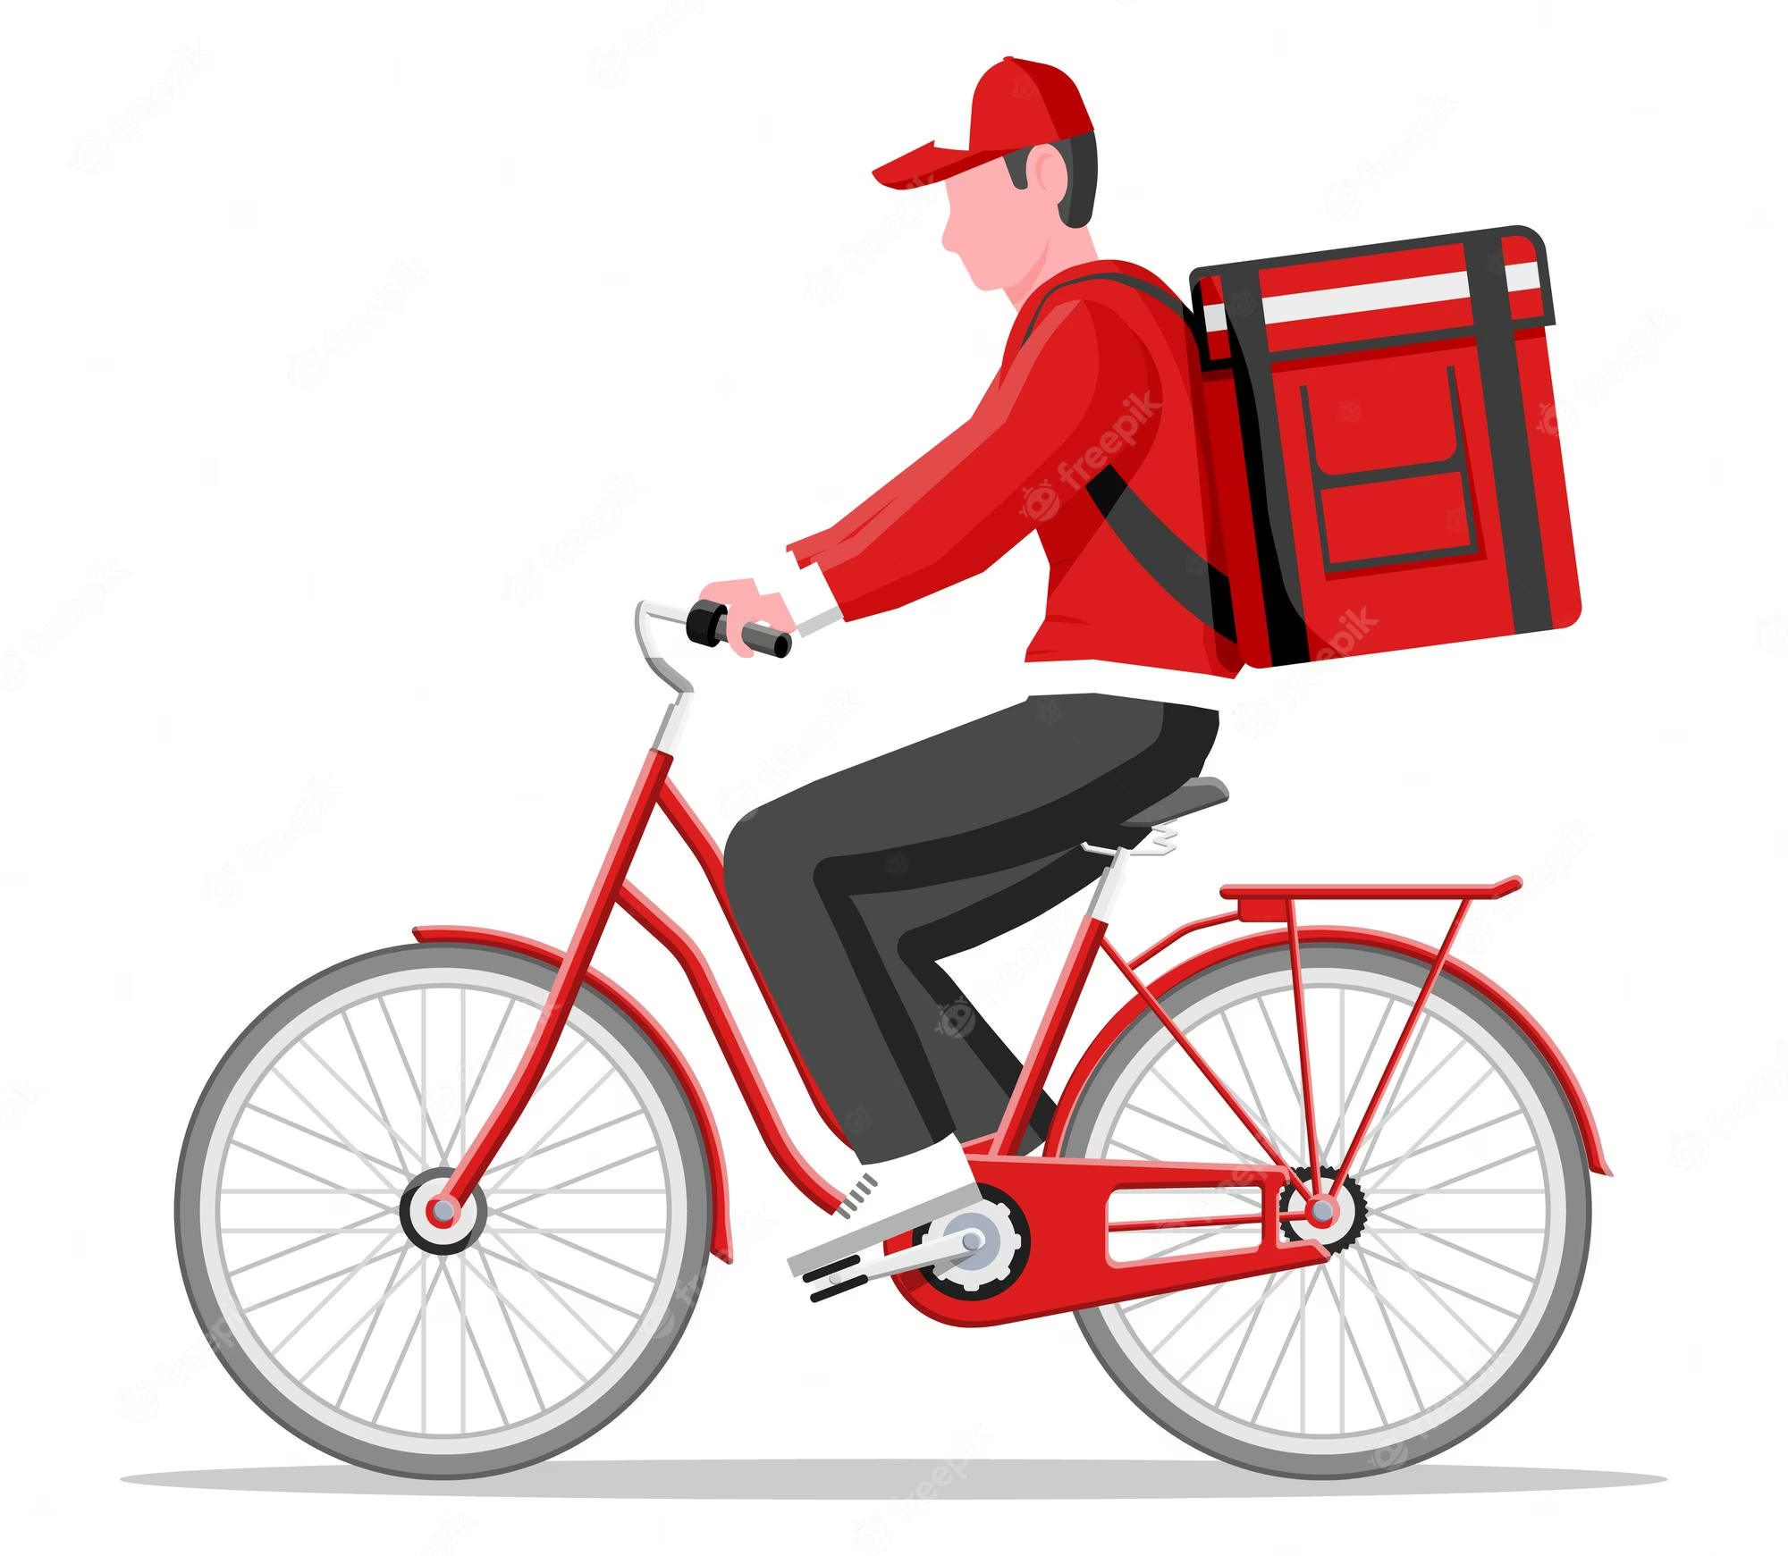
5
4
3
2
Challenge:
Find the shortest route for the food courier to deliver all the orders.
1
Notes:
Interactive Challenge Card
Display with your classroom projector
Drag and drop each color square to create a path for indi.

Slide 2
5
4
3
2
Challenge:
Find the shortest route for the food courier to deliver all the orders.
1
Notes:
Interactive Challenge Card
Display with your classroom projector
Drag and drop each color square to create a path for indi.

Slide 3
5
4
3
2
Challenge:
Find the shortest route for the food courier to deliver all the orders.
1
Notes:
Interactive Challenge Card
Display with your classroom projector
Drag and drop each color square to create a path for indi.

Slide 4
5
4
3
2
Solution
Challenge:
Find the shortest route for the food courier to deliver all the orders.
1
Notes:
Interactive Challenge Card
Display with your classroom projector
Drag and drop each color square to create a path for indi.

Slide 5

3
4
1
5
Challenge:
Find the shortest route for the food courier to deliver all the orders.
2
6
Notes:
Interactive Challenge Card
Display with your classroom projector
Drag and drop each color square to create a path for indi.

Slide 6
3
4
1
5
Challenge:
Find the shortest route for the food courier to deliver all the orders.
2
6
Notes:
Interactive Challenge Card
Display with your classroom projector
Drag and drop each color square to create a path for indi.

Slide 7
3
4
1
5
Challenge:
Find the shortest route for the food courier to deliver all the orders.
2
6
Notes:
Interactive Challenge Card
Display with your classroom projector
Drag and drop each color square to create a path for indi.

Slide 8
3
4
1
5
Solution
Challenge:
Find the shortest route for the food courier to deliver all the orders.
2
6
Notes:
Interactive Challenge Card
Display with your classroom projector
Drag and drop each color square to create a path for indi.

Slide 9
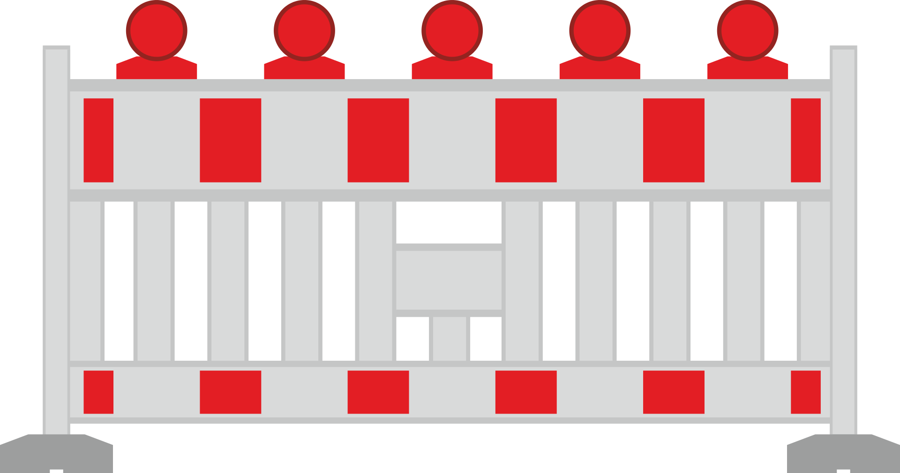
Challenge:
Find the shortest route for the food courier to deliver all the orders.
Avoid the roadblock!
3
4
6
2
5
7
1
8
Notes:
futár

Slide 10
Challenge:
Find the shortest route for the food courier to deliver all the orders.
Avoid the roadblock!
3
4
6
2
5
7
1
8
Notes:
futár

Slide 11
Challenge:
Find the shortest route for the food courier to deliver all the orders.
Avoid the roadblock!
3
4
6
2
5
7
1
8
Notes:
futár

Slide 12
Challenge:
Find the shortest route for the food courier to deliver all the orders.
Avoid the roadblock!
3
4
Solution
6
2
5
7
1
8
Notes:
futár

Slide 13
Challenge:
Find the shortest route for the food courier to deliver all the orders.
13
12
9
10
11
8
4
3
7
5
1
2
6

Slide 14
Challenge:
Find the shortest route for the food courier to deliver all the orders.
13
12
9
10
11
8
4
3
7
5
1
2
6

Slide 15
Challenge:
Find the shortest route for the food courier to deliver all the orders.
13
12
9
10
11
8
4
3
7
5
1
2
6

Slide 16
Challenge:
Find the shortest route for the food courier to deliver all the orders.
Solution
13
12
9
10
11
8
4
3
7
5
1
2
6

