Slide 1
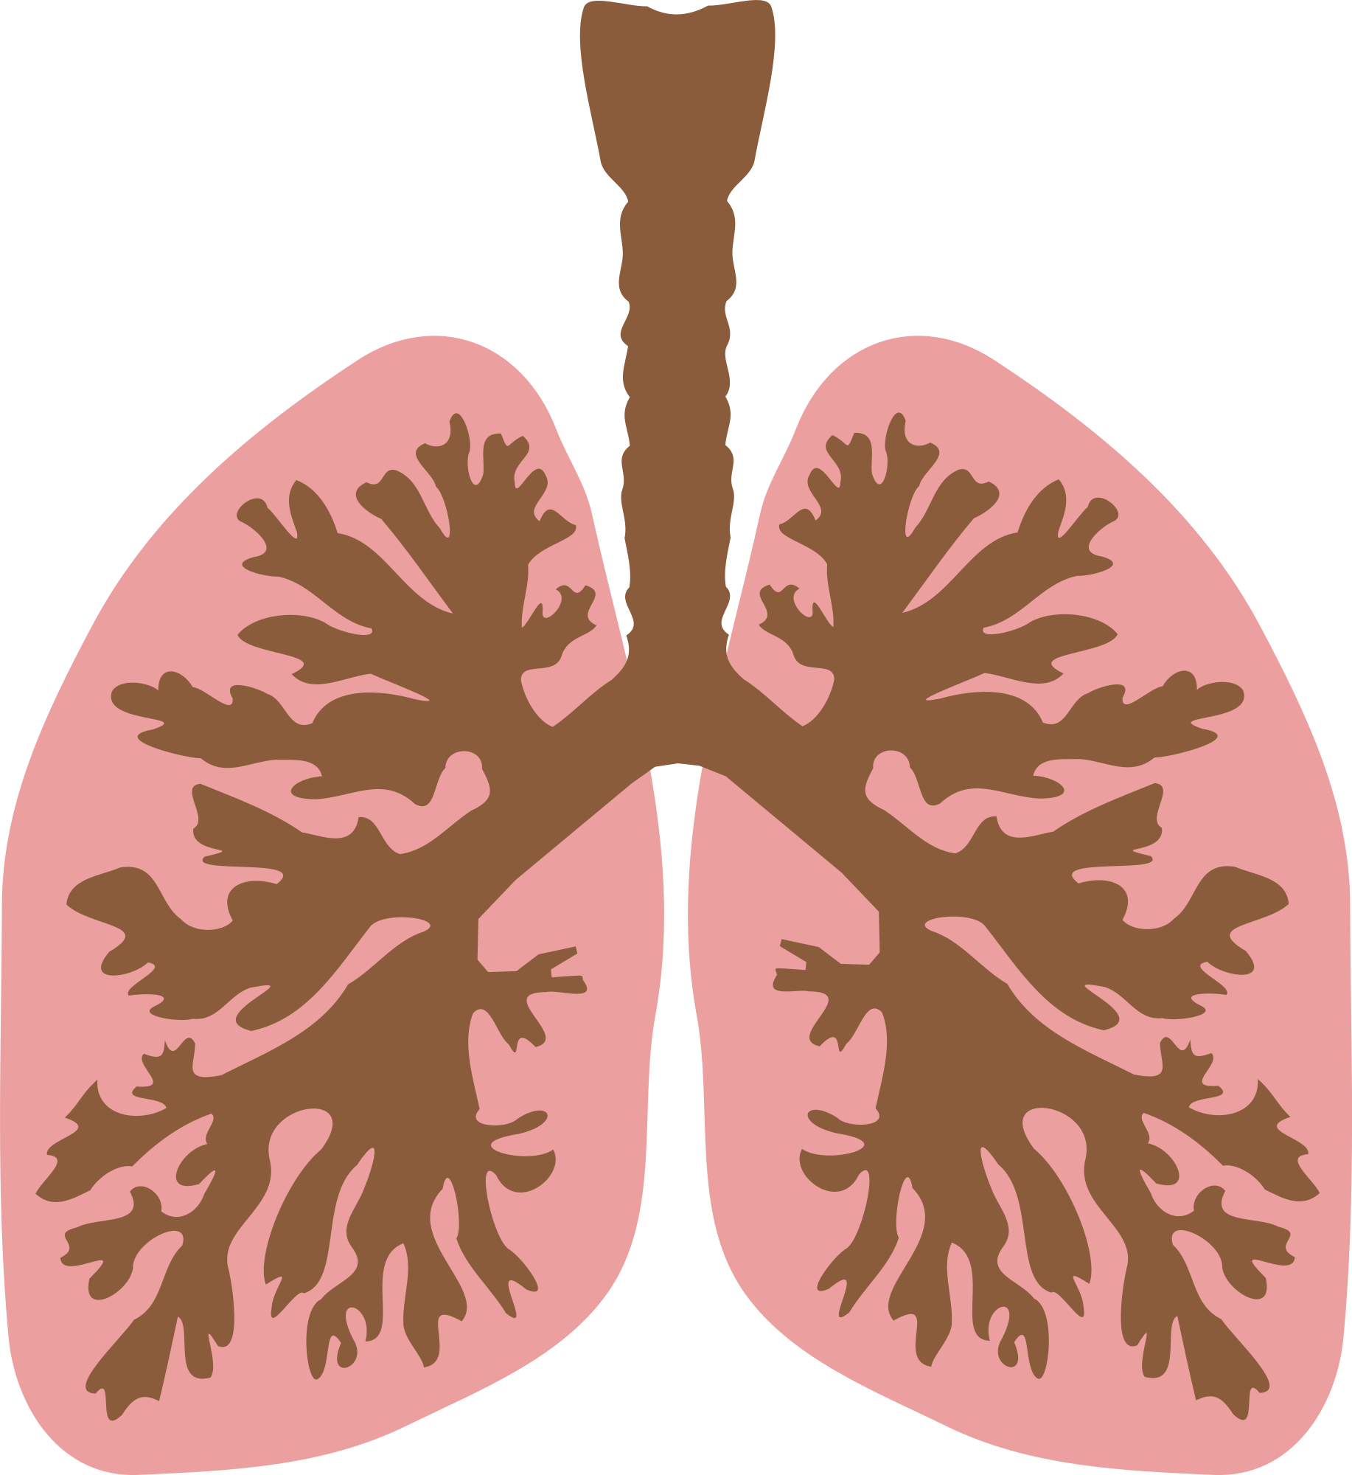
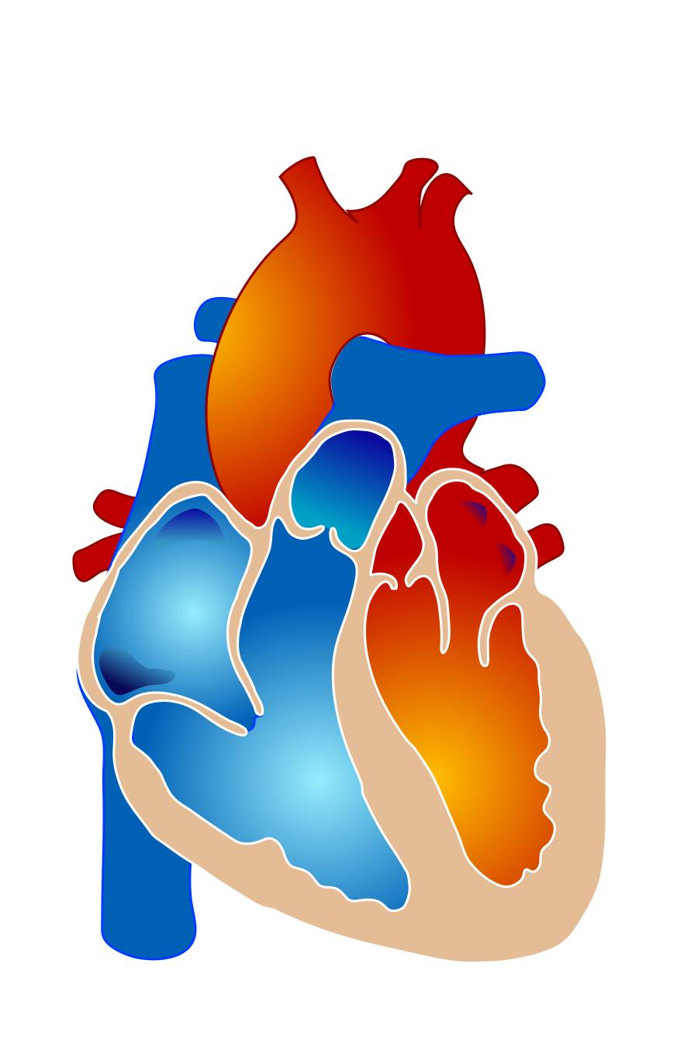
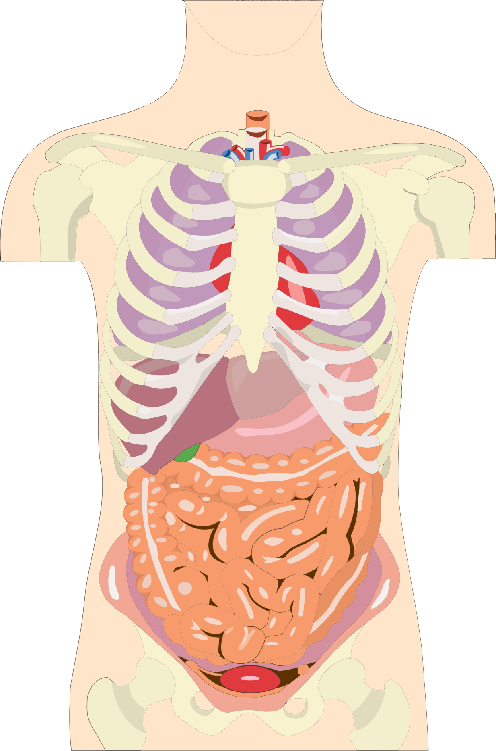
Pulmonary veins
Pulmonary
arteries
Body
arteries
Body veins
Challenge:
Make a complete delivery cycle in the bloodstream! Meanwhile, name the difference between arteries and veins.

Slide 2
Pulmonary veins
Pulmonary
arteries
Body
arteries
Body veins
Challenge:
Make a complete delivery cycle in the bloodstream! Meanwhile, name the difference between arteries and veins.

Slide 3
Pulmonary veins
Pulmonary
arteries
Body
arteries
Body veins
Challenge:
Make a complete delivery cycle in the bloodstream! Meanwhile, name the difference between arteries and veins.

Slide 4
Pulmonary veins
Pulmonary
arteries
Solution
Body
arteries
Body veins
Challenge:
Make a complete delivery cycle in the bloodstream! Meanwhile, name the difference between arteries and veins.

