Slide 1
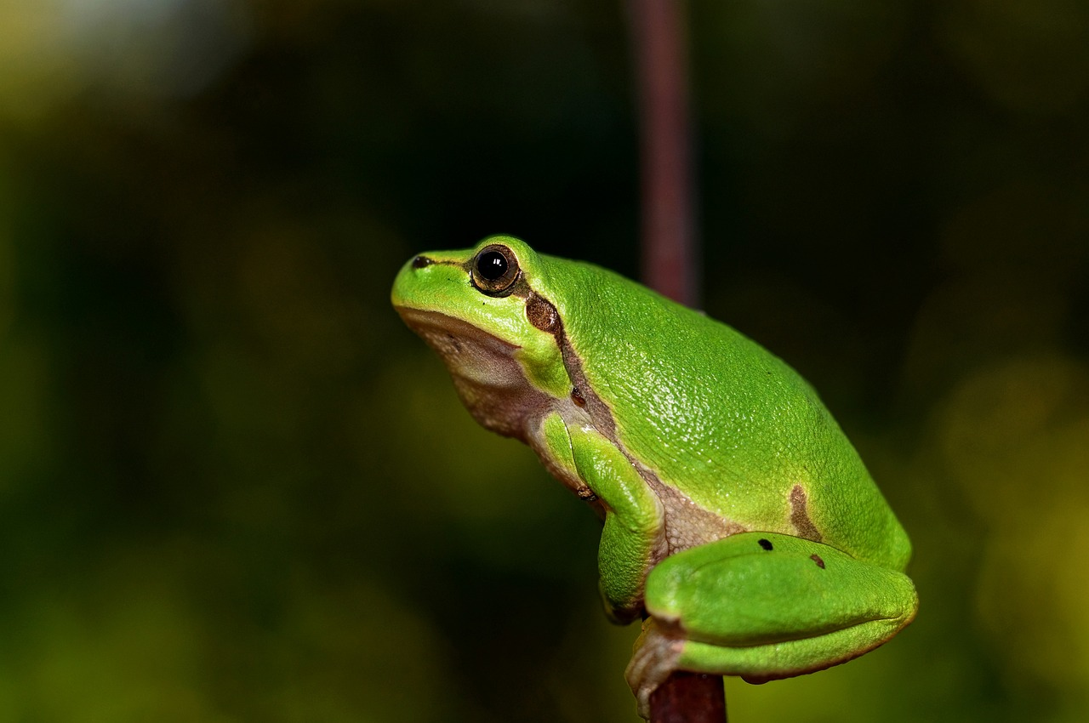
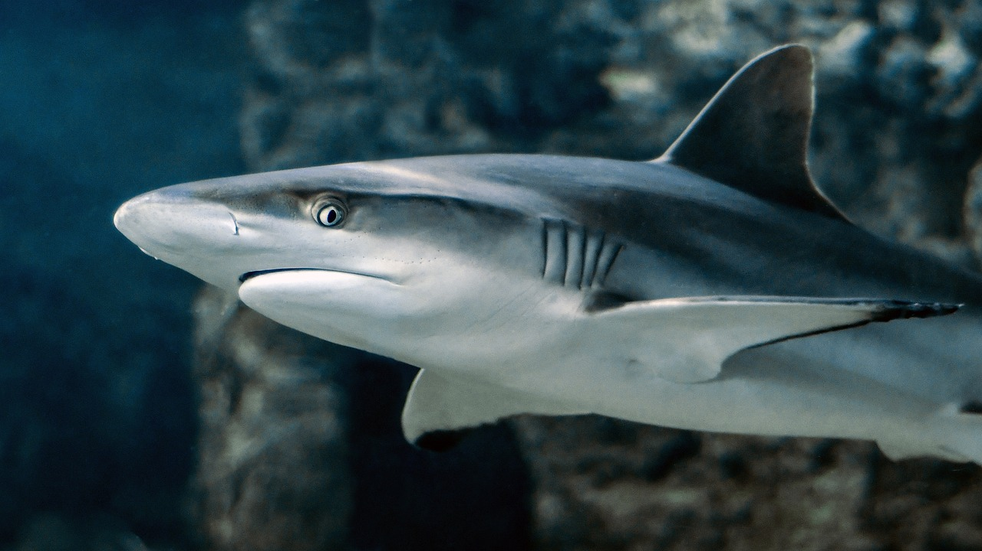
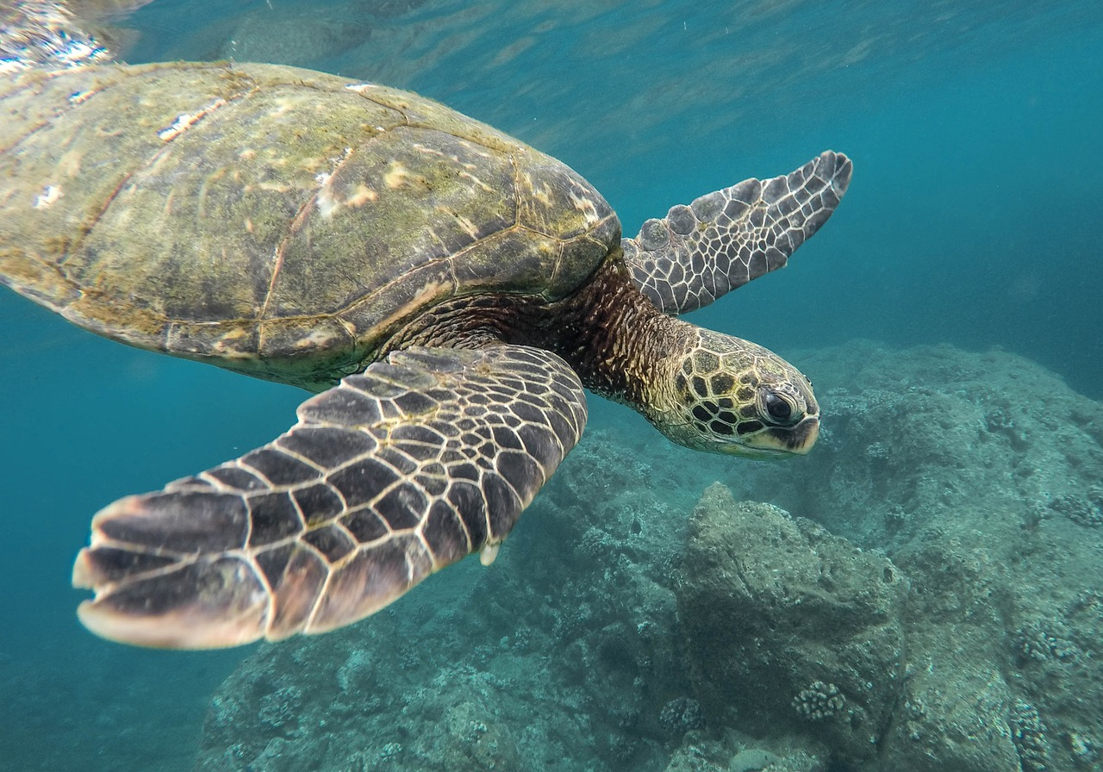
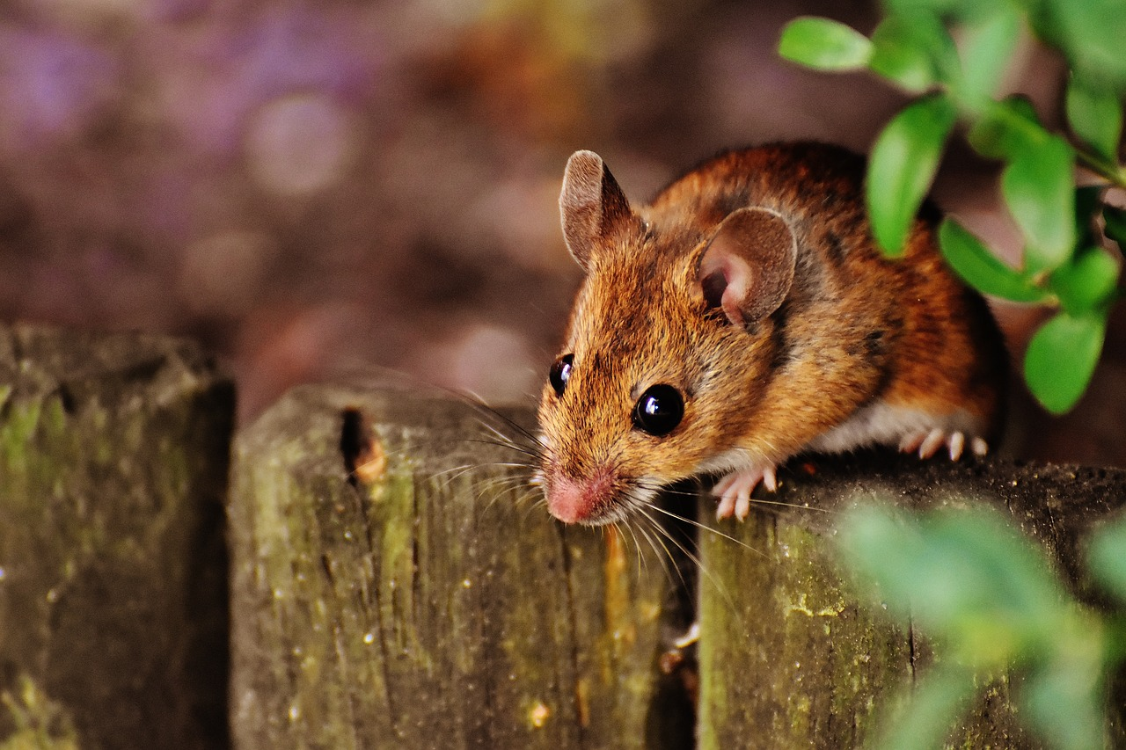
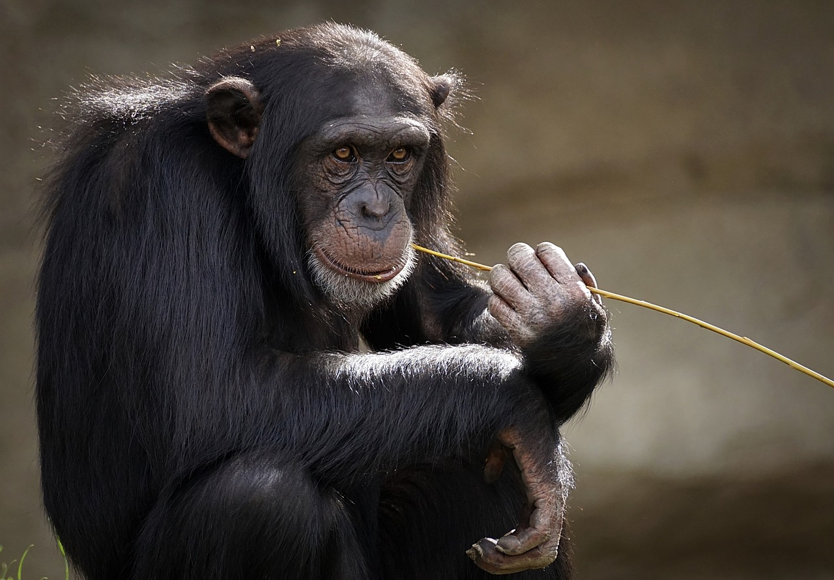
Challenge:
Evolutionary affinities: Go through all the living creatures below. First go to the human, and then move from our closest relatives to our most distant relatives!

Slide 2
Frog
Fish
Turtle
Mouse
Insect
Chim-
panzee
Challenge:
Evolutionary affinities: Go through all the living creatures below. First go to the human, and then move from our closest relatives to our most distant relatives!
Human

Slide 3
Challenge:
Evolutionary affinities: Go through all the living creatures below. First go to the human, and then move from our closest relatives to our most distant relatives!

Slide 4
Frog
Fish
Turtle
Mouse
Insect
Chim-
panzee
Challenge:
Evolutionary affinities: Go through all the living creatures below. First go to the human, and then move from our closest relatives to our most distant relatives!
Human

Slide 5
Challenge:
Evolutionary affinities: Go through all the living creatures below. First go to the human, and then move from our closest relatives to our most distant relatives!

Slide 6
Frog
Fish
Turtle
Mouse
Insect
Chim-
panzee
Challenge:
Evolutionary affinities: Go through all the living creatures below. First go to the human, and then move from our closest relatives to our most distant relatives!
Human

Slide 7
Solution
Challenge:
Evolutionary affinities: Go through all the living creatures below. First go to the human, and then move from our closest relatives to our most distant relatives!

Slide 8
Frog
Fish
Turtle
Mouse
Insect
Solution
Chim-
panzee
Challenge:
Evolutionary affinities: Go through all the living creatures below. First go to the human, and then move from our closest relatives to our most distant relatives!
Human

