Slide 1
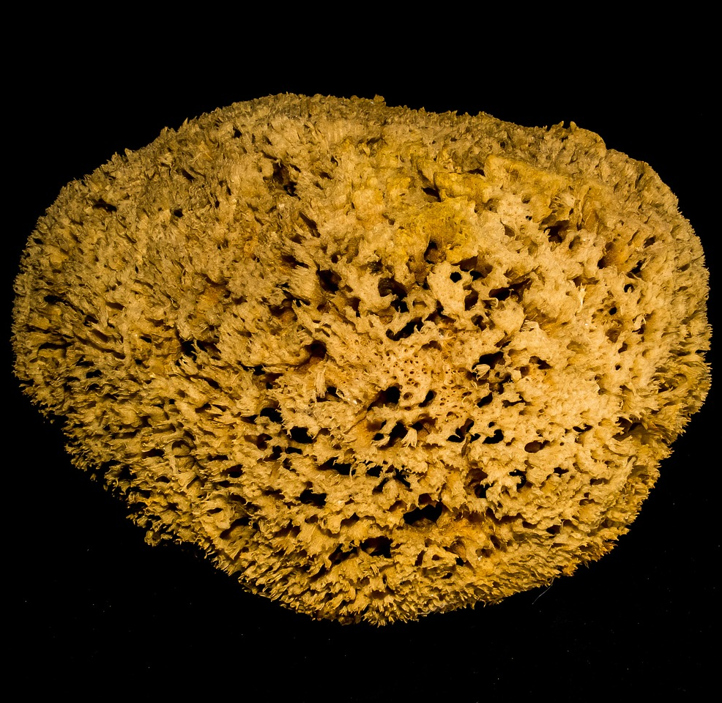
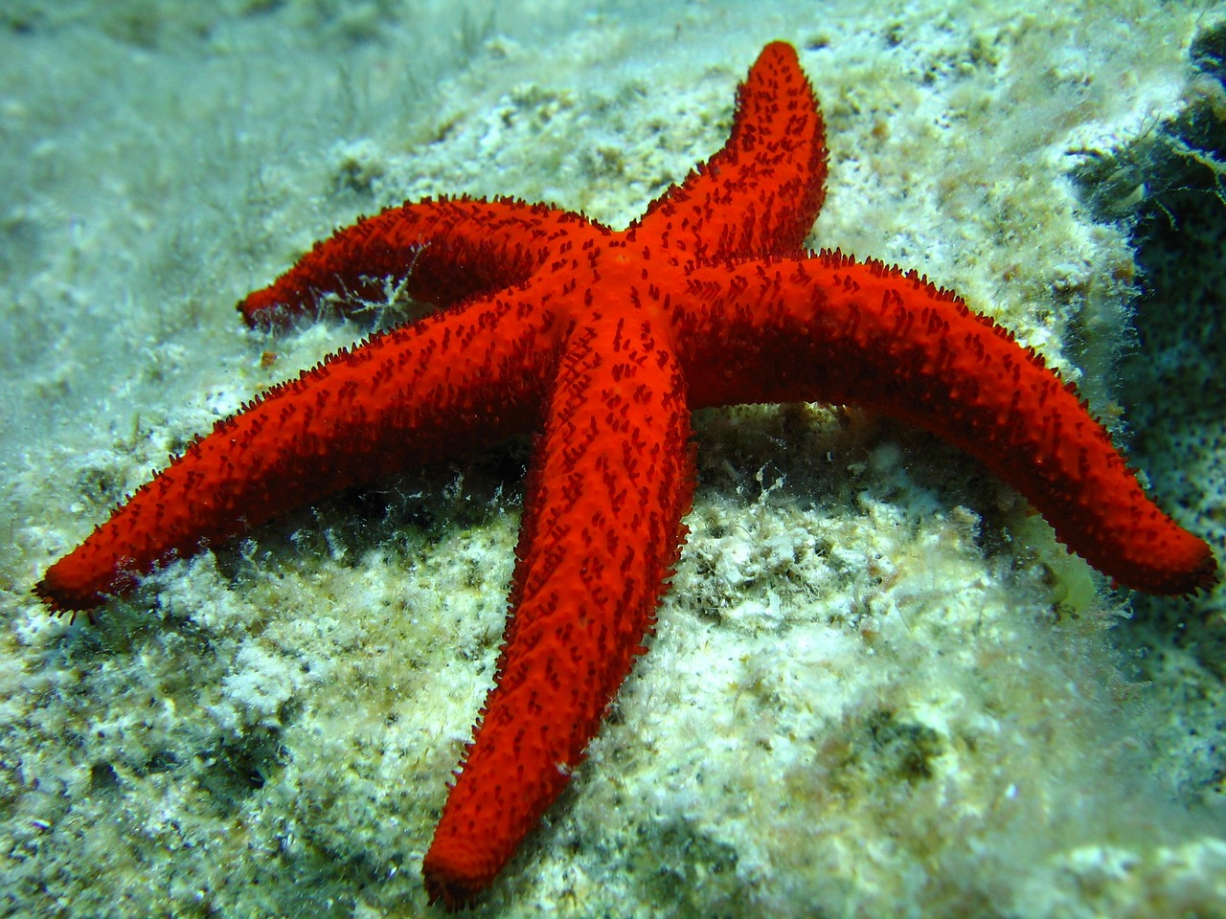
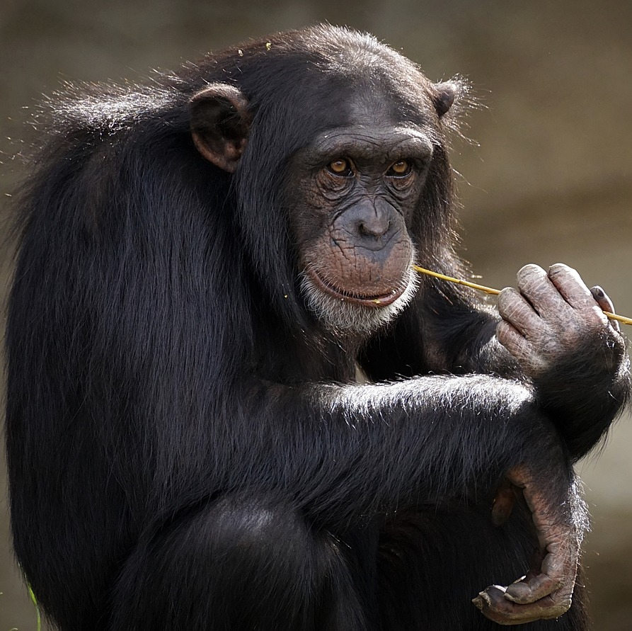
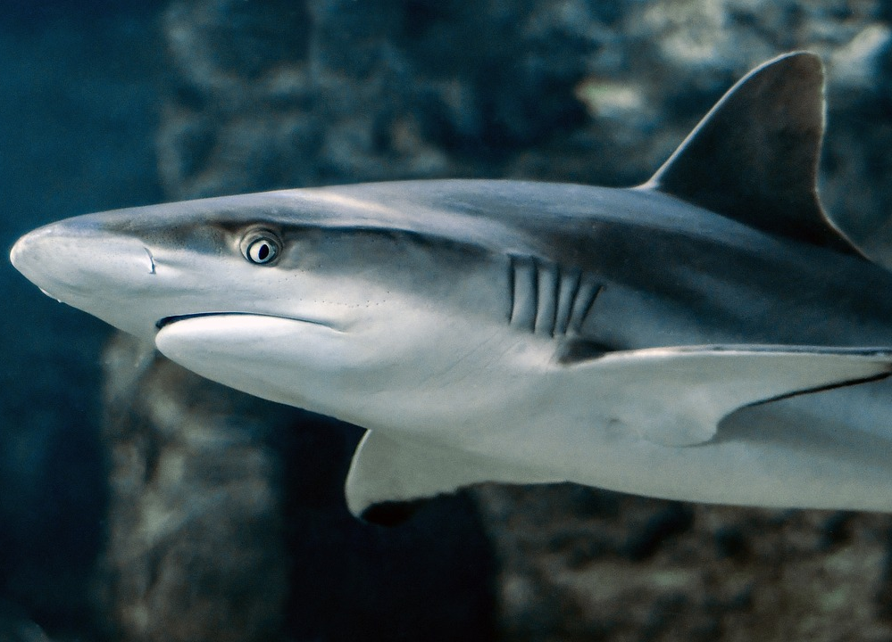
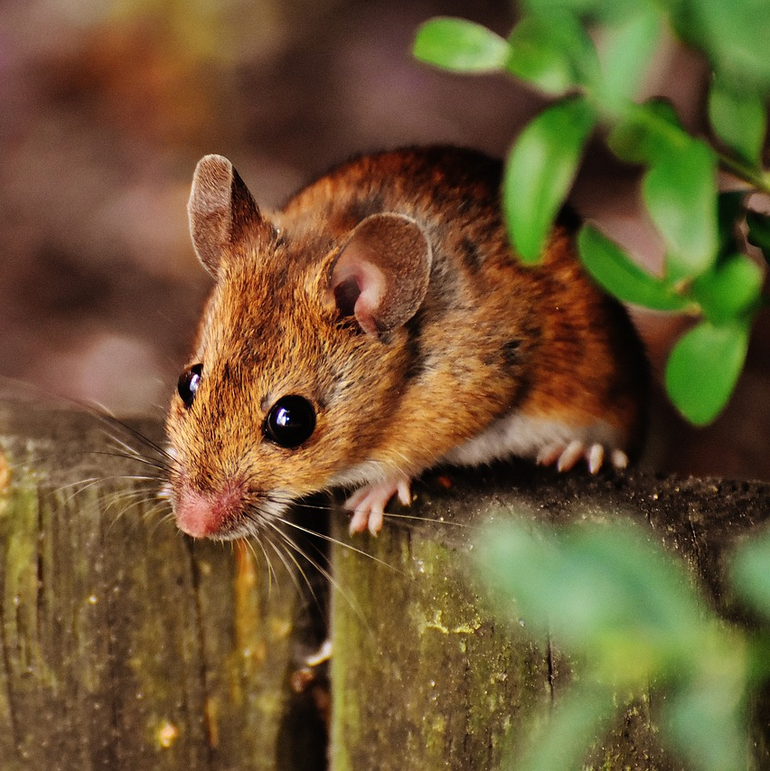
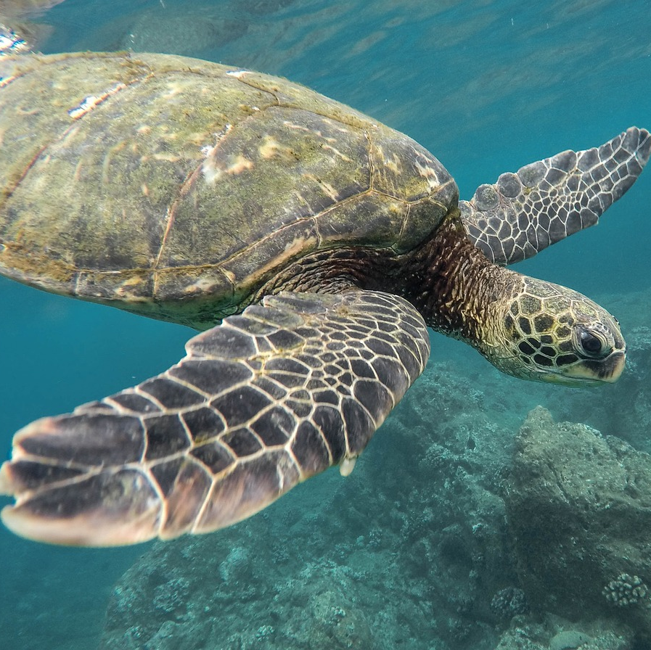
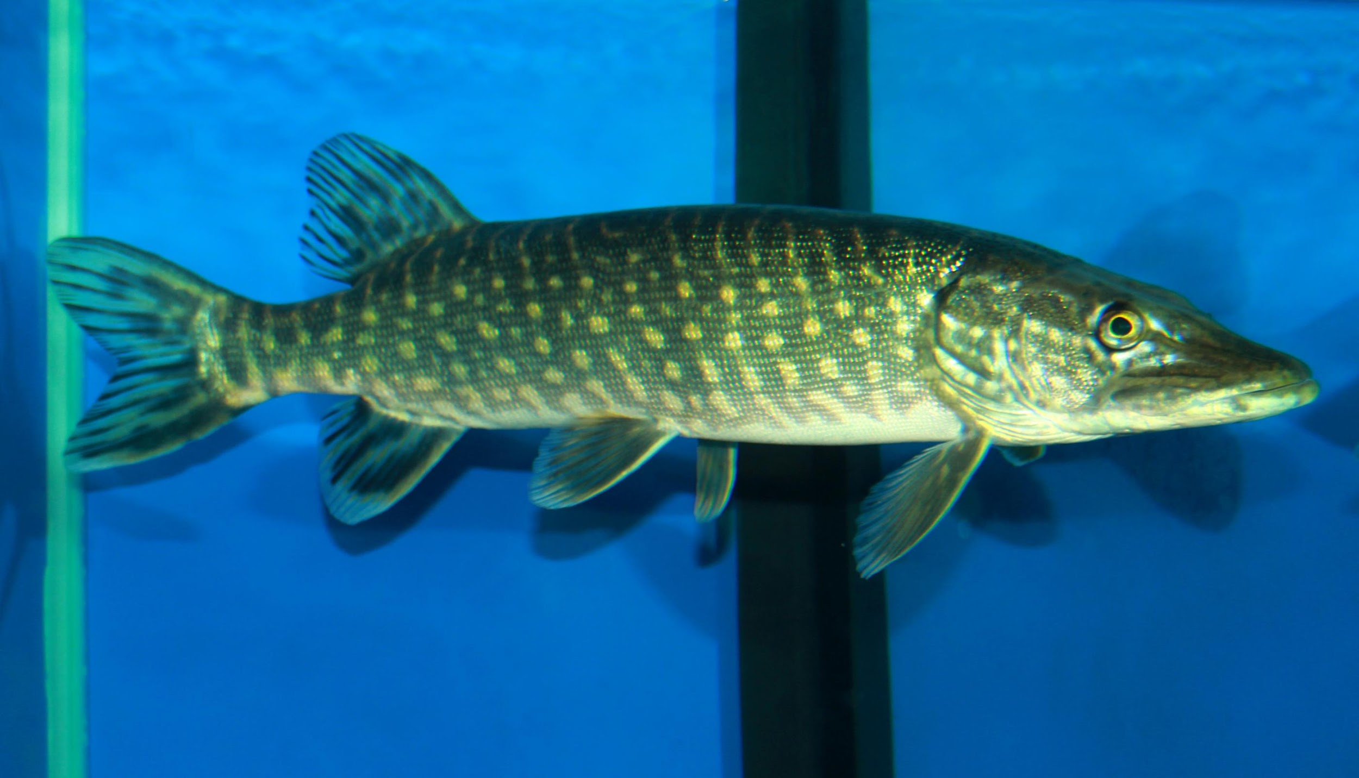
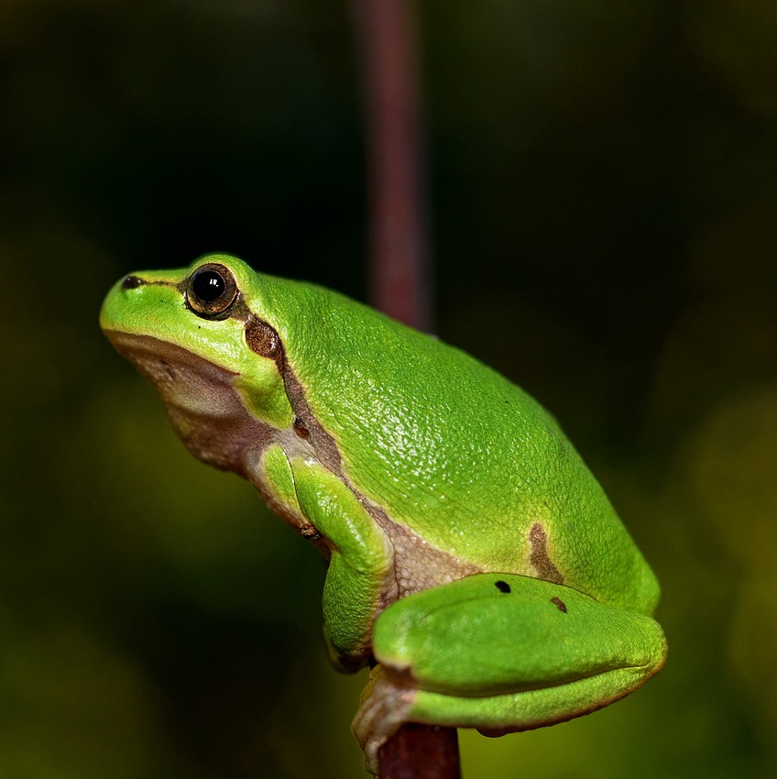
Challenge:
Evolutionary affinities: Go through all the living creatures below. First go to the human, and then move from our closest relatives to our most distant relatives!
X

Slide 2
Challenge:
Evolutionary affinities: Go through all the living creatures below. First go to the human, and then move from our closest relatives to our most distant relatives!
Sponge
Insect
Starfish
Chim-
panzee
Human
Shark
Mouse
Kanga-
roo
X
Turtle
Bony
fish
Frog

Slide 3
Challenge:
Evolutionary affinities: Go through all the living creatures below. First go to the human, and then move from our closest relatives to our most distant relatives!
X

Slide 4
Challenge:
Evolutionary affinities: Go through all the living creatures below. First go to the human, and then move from our closest relatives to our most distant relatives!
Sponge
Insect
Starfish
Chim-
panzee
Human
Shark
Mouse
Kanga-
roo
X
Turtle
Bony
fish
Frog

Slide 5
Challenge:
Evolutionary affinities: Go through all the living creatures below. First go to the human, and then move from our closest relatives to our most distant relatives!
X

Slide 6
Challenge:
Evolutionary affinities: Go through all the living creatures below. First go to the human, and then move from our closest relatives to our most distant relatives!
Sponge
Insect
Starfish
Chim-
panzee
Human
Shark
Mouse
Kanga-
roo
X
Turtle
Bony
fish
Frog

Slide 7
Challenge:
Evolutionary affinities: Go through all the living creatures below. First go to the human, and then move from our closest relatives to our most distant relatives!
Solution
X

Slide 8
Challenge:
Evolutionary affinities: Go through all the living creatures below. First go to the human, and then move from our closest relatives to our most distant relatives!
Sponge
Insect
Starfish
Chim-
panzee
Human
Shark
Mouse
Kanga-
roo
X
Turtle
Bony
fish
Frog

