Slide 1






















Challenge:
Collect all the figures for which the following statement is true:
There is an acute angle.
Notes:
Interactive Challenge Card
Display with your classroom projector
Drag and drop each color square to create a path for indi.

Slide 2
Challenge:
Collect all the figures for which the following statement is true:
There is an acute angle.
Notes:
Interactive Challenge Card
Display with your classroom projector
Drag and drop each color square to create a path for indi.

Slide 3
Challenge:
Collect all the figures for which the following statement is true:
There is an acute angle.
Notes:
Interactive Challenge Card
Display with your classroom projector
Drag and drop each color square to create a path for indi.

Slide 4
Solution
Challenge:
Collect all the figures for which the following statement is true:
There is an acute angle.
Notes:
Interactive Challenge Card
Display with your classroom projector
Drag and drop each color square to create a path for indi.

Slide 5
Challenge:
Collect all the figures for which the following statement is true:
It has two parallel sides.
Notes:
Interactive Challenge Card
Display with your classroom projector
Drag and drop each color square to create a path for indi.

Slide 6
Challenge:
Collect all the figures for which the following statement is true:
It has two parallel sides.
Notes:
Interactive Challenge Card
Display with your classroom projector
Drag and drop each color square to create a path for indi.

Slide 7
Challenge:
Collect all the figures for which the following statement is true:
It has two parallel sides.
Notes:
Interactive Challenge Card
Display with your classroom projector
Drag and drop each color square to create a path for indi.

Slide 8
Solution
Challenge:
Collect all the figures for which the following statement is true:
It has two parallel sides.
Notes:
Interactive Challenge Card
Display with your classroom projector
Drag and drop each color square to create a path for indi.

Slide 9

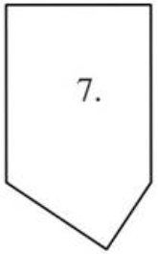
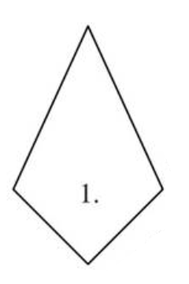
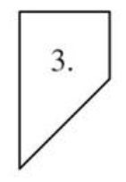
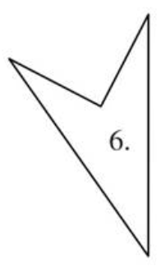
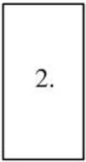
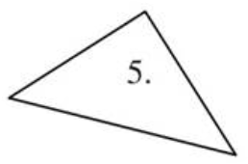
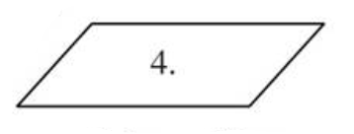
Challenge:
Collect all the figures for which the following statement is true:
There is an acute angle.

Slide 10
Challenge:
Collect all the figures for which the following statement is true:
There is an acute angle.

Slide 11
Challenge:
Collect all the figures for which the following statement is true:
There is an acute angle.

Slide 12
Solution
Challenge:
Collect all the figures for which the following statement is true:
There is an acute angle.

