Slide 1
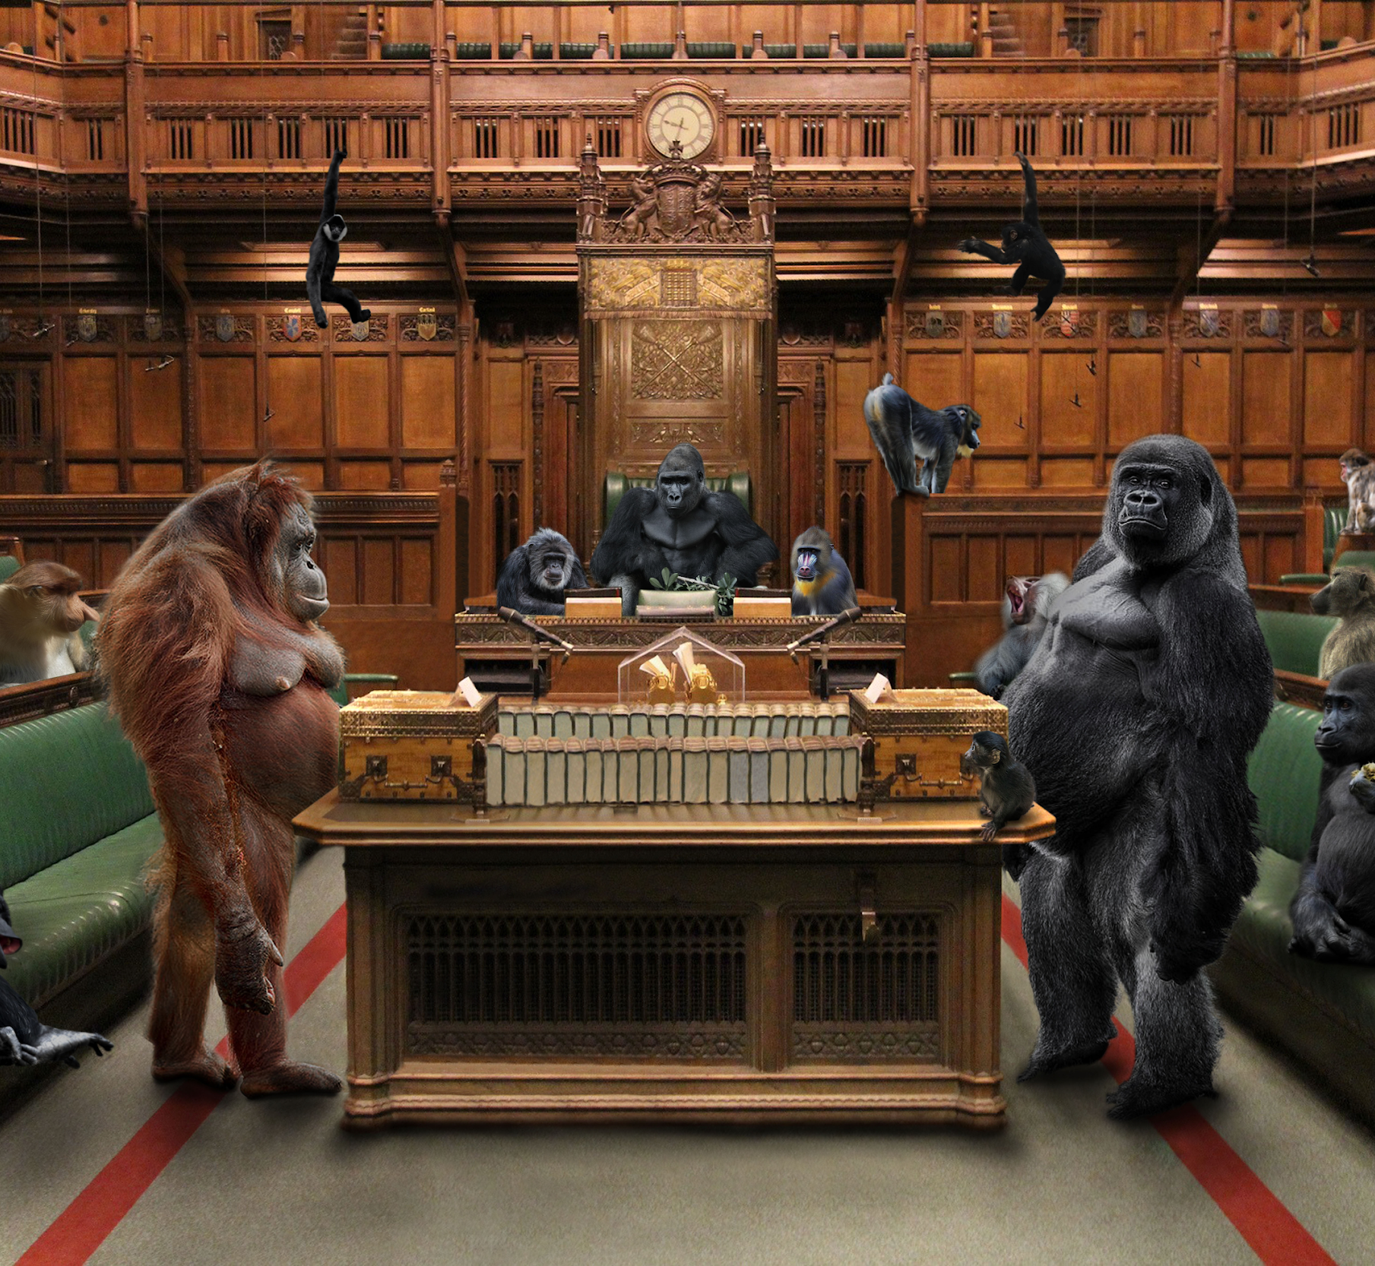
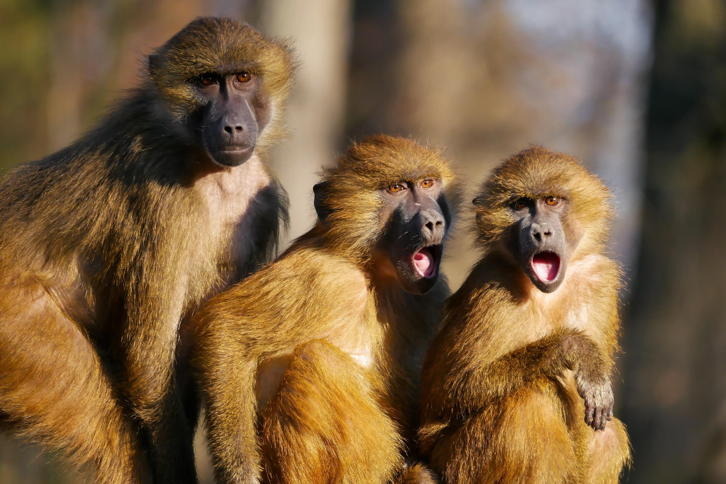
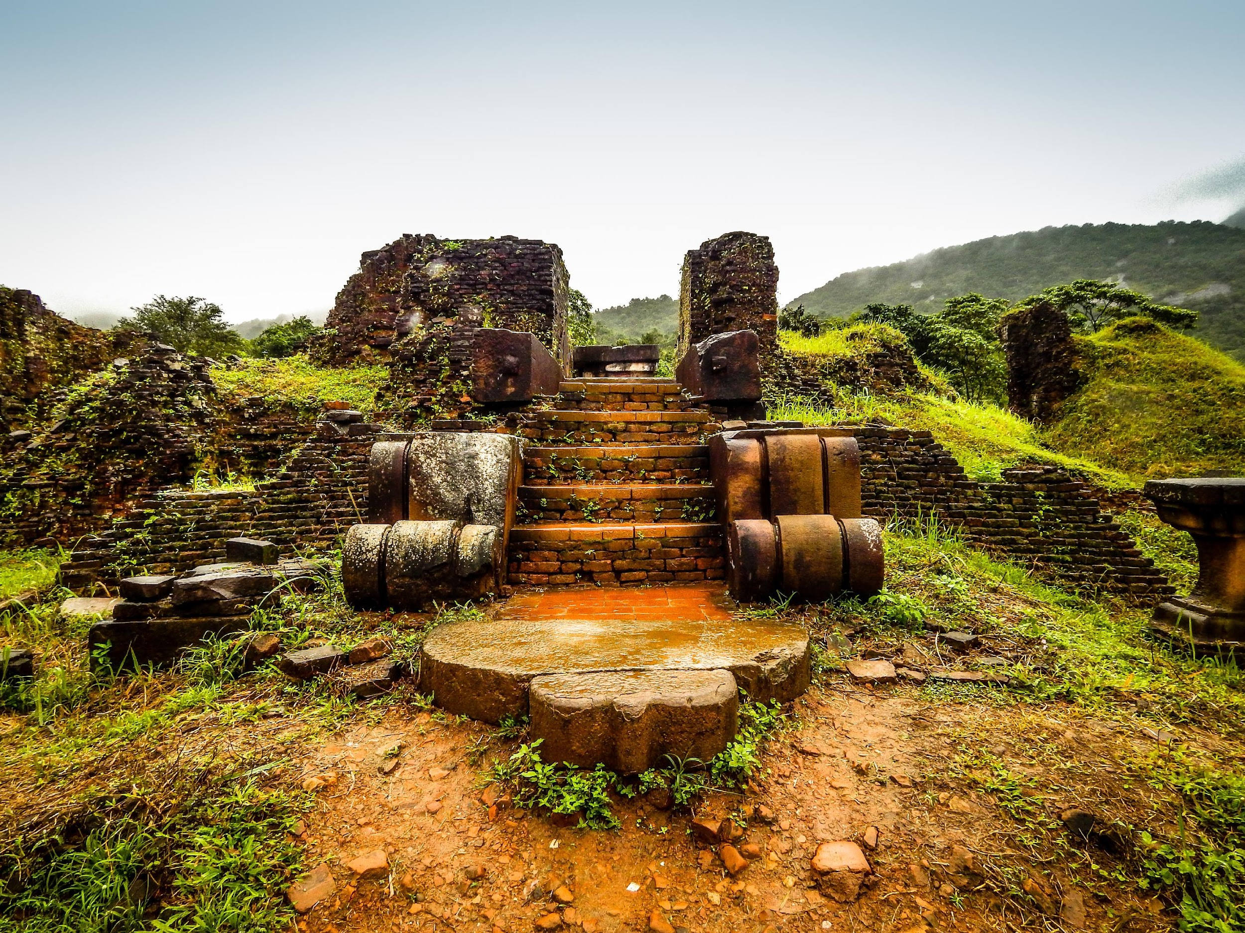
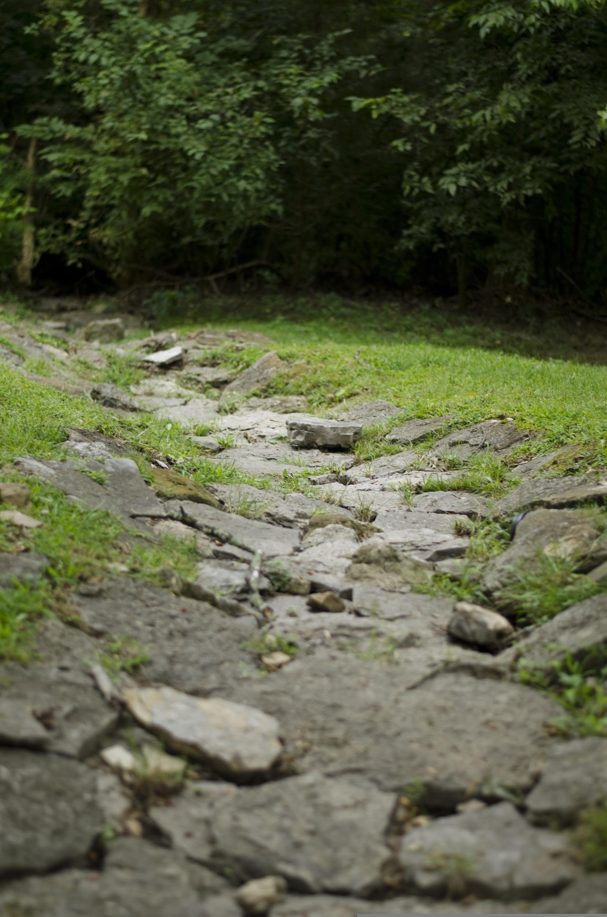
Challenge:
Follow the story!
Read the story and get through the map in the right order!
(short text 1)

Slide 2
Challenge:
Follow the story!
Read the story and get through the map in the right order!
(short text 1)

Slide 3
Challenge:
Follow the story!
Read the story and get through the map in the right order!
(short text 1)

Slide 4
Solution
Challenge:
Follow the story!
Read the story and get through the map in the right order!
(short text 1)

Slide 5
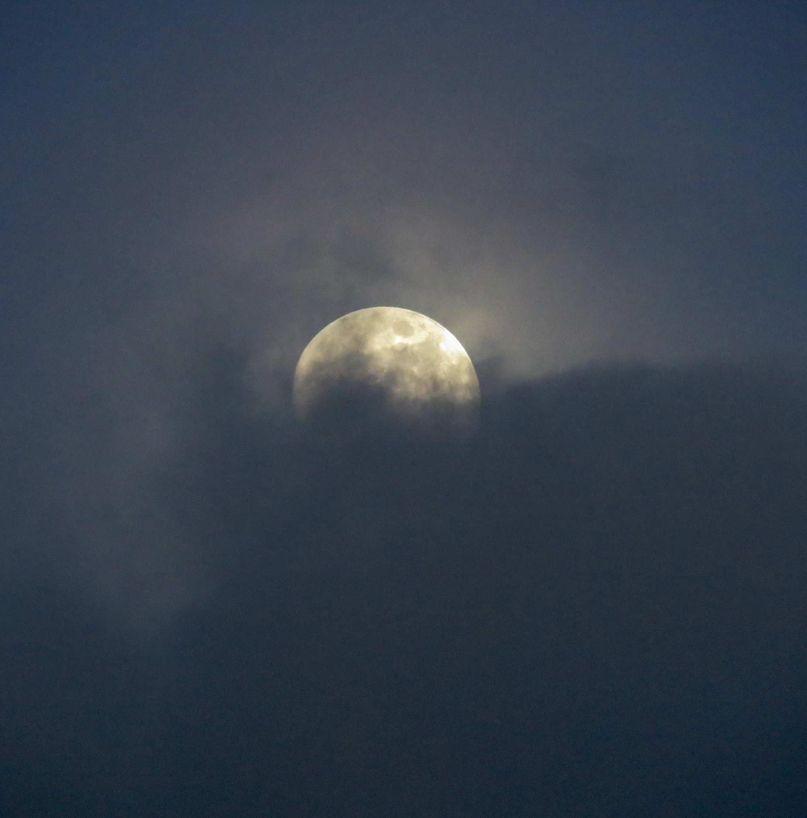
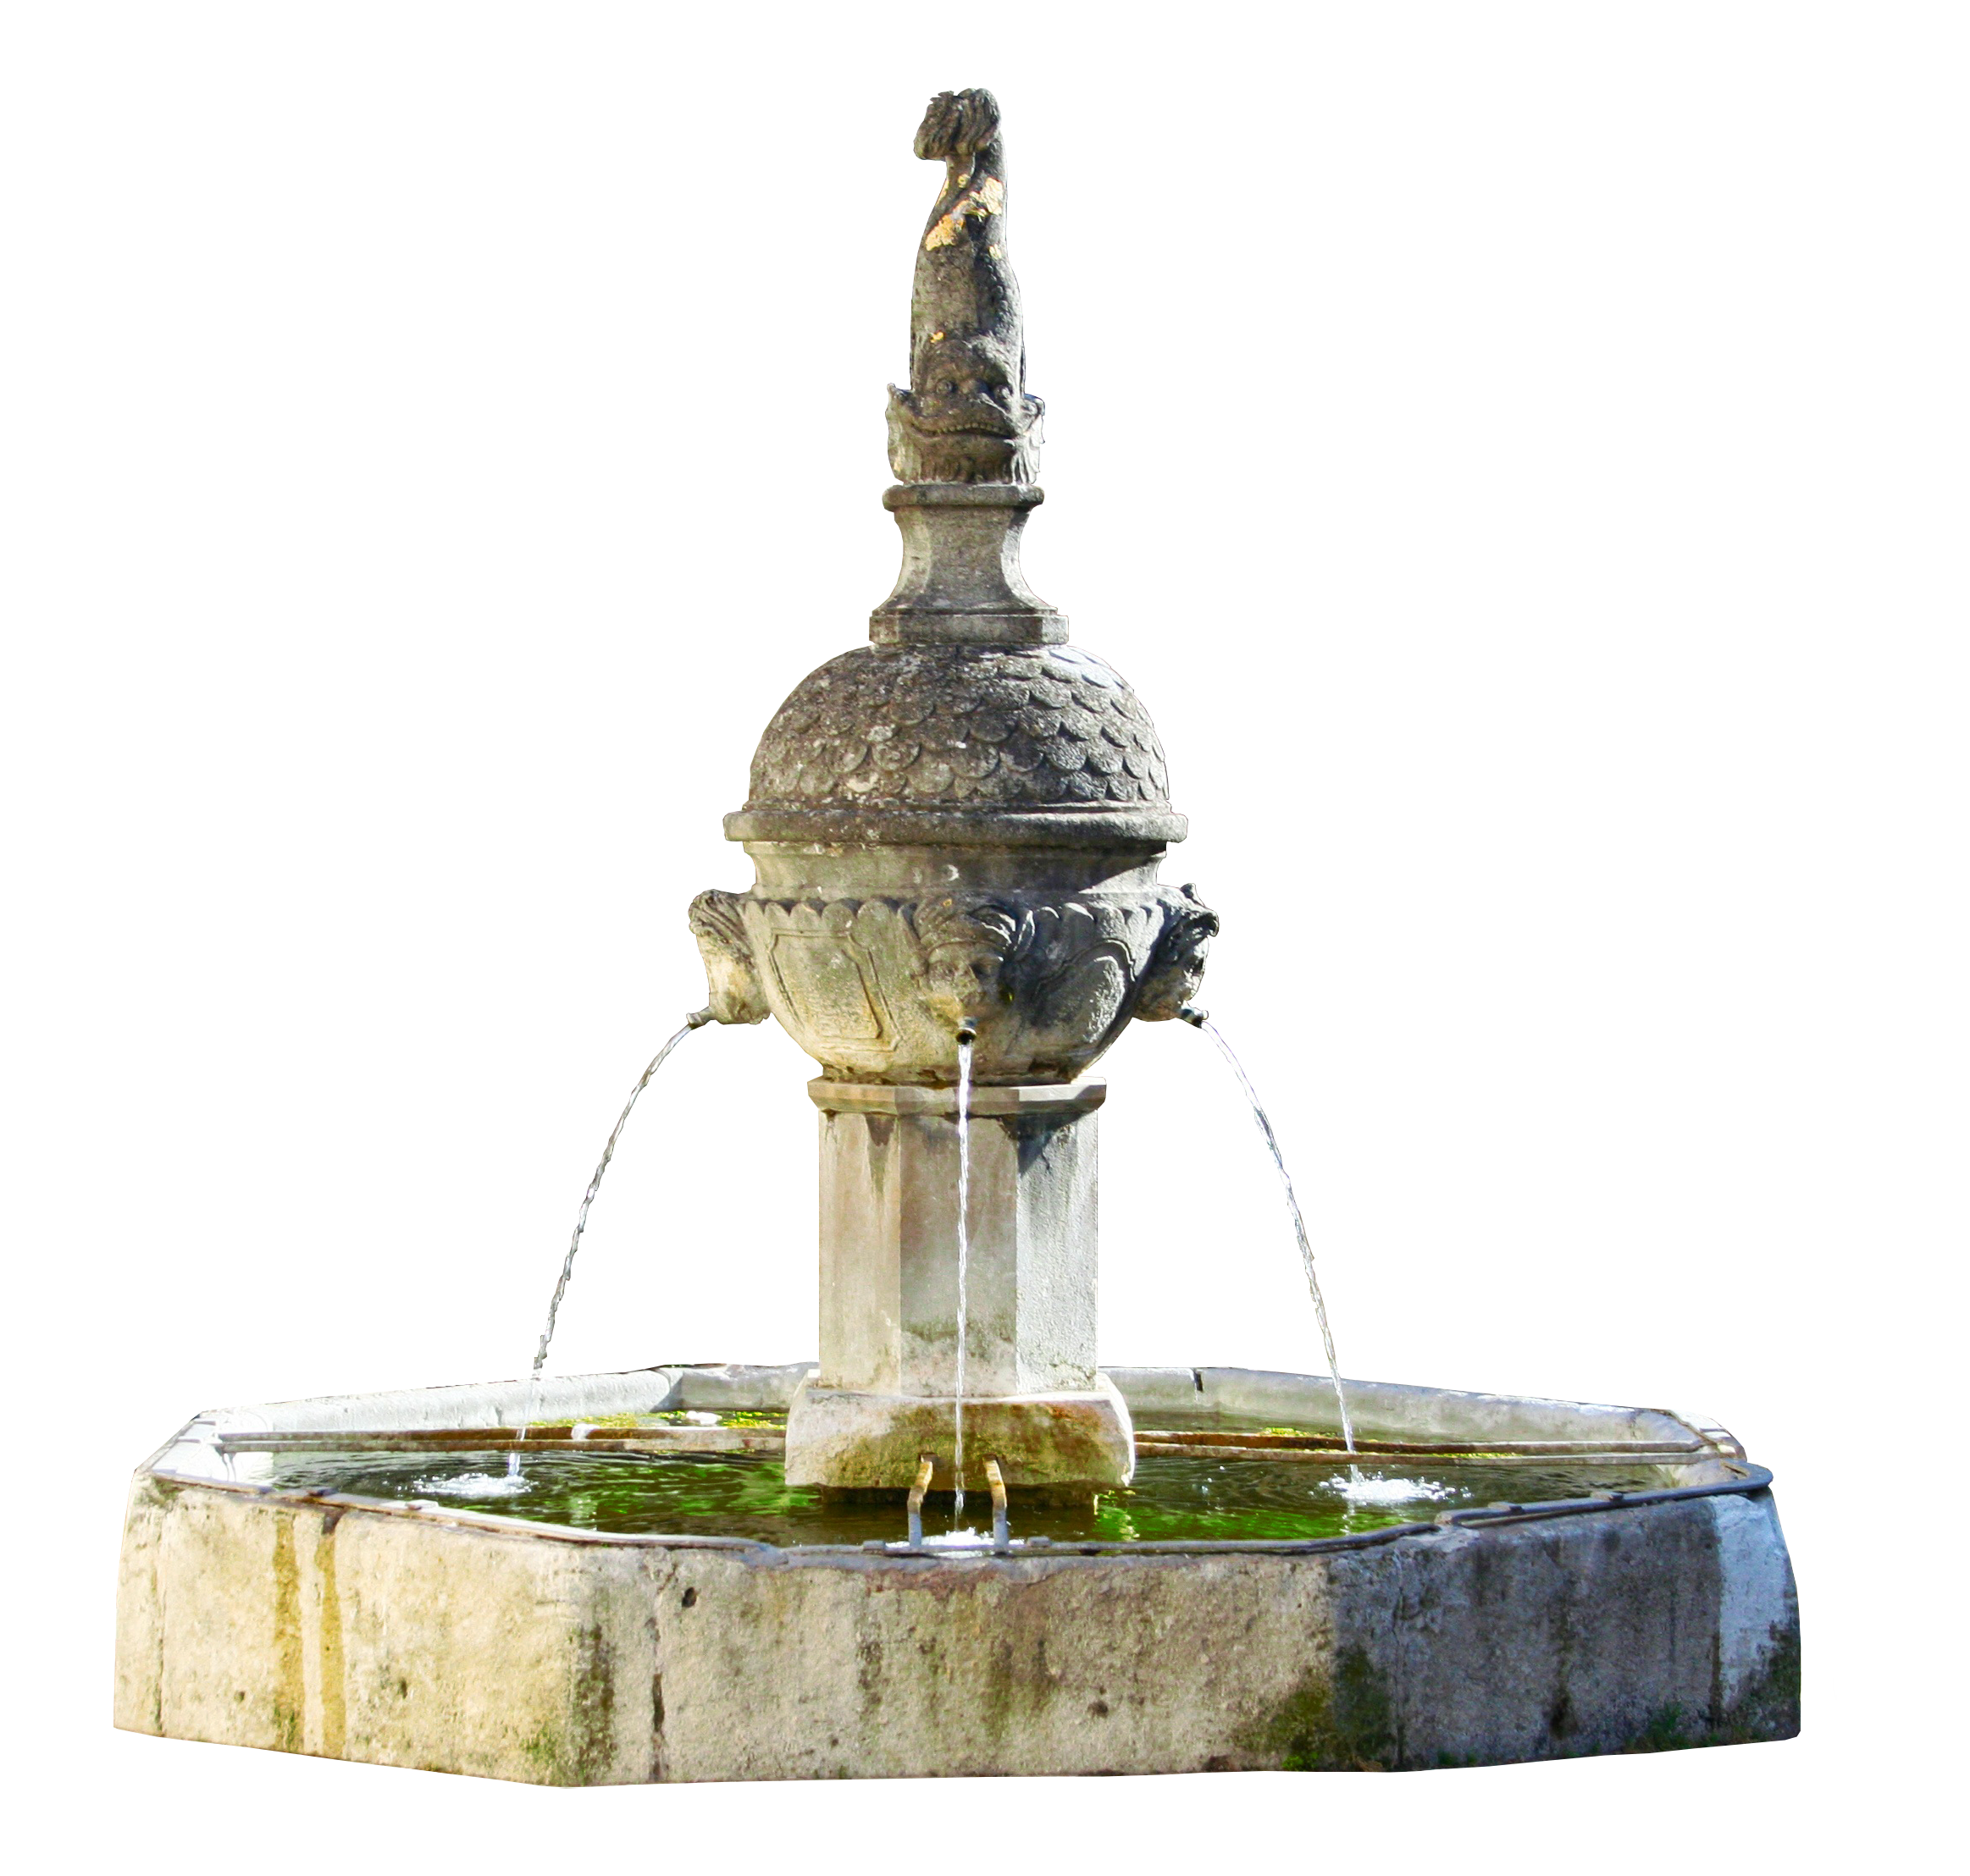
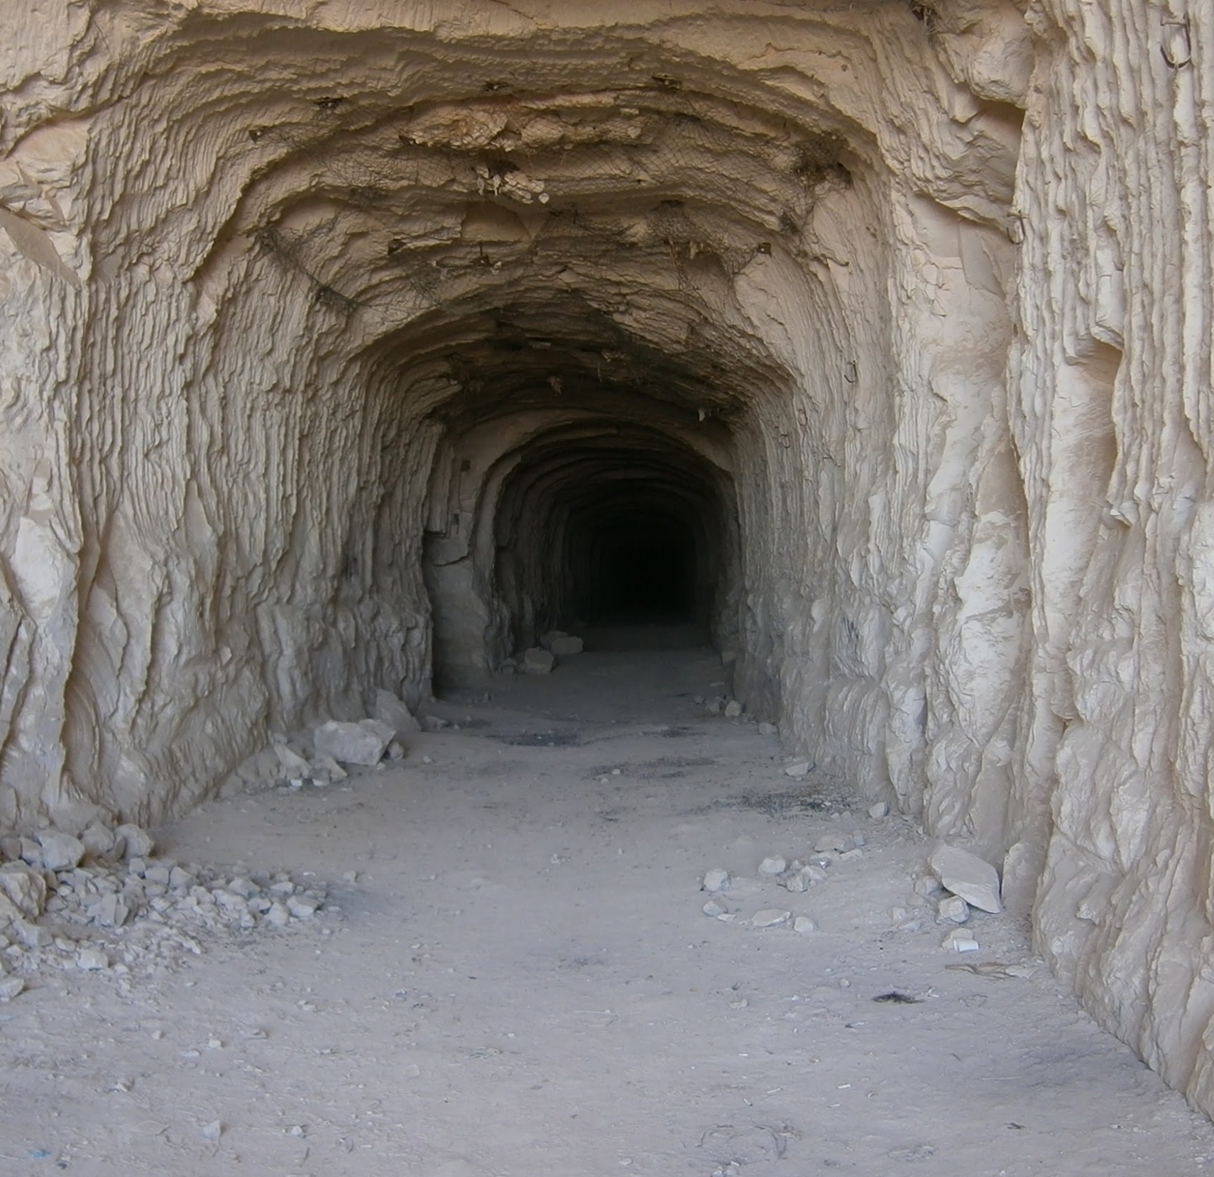
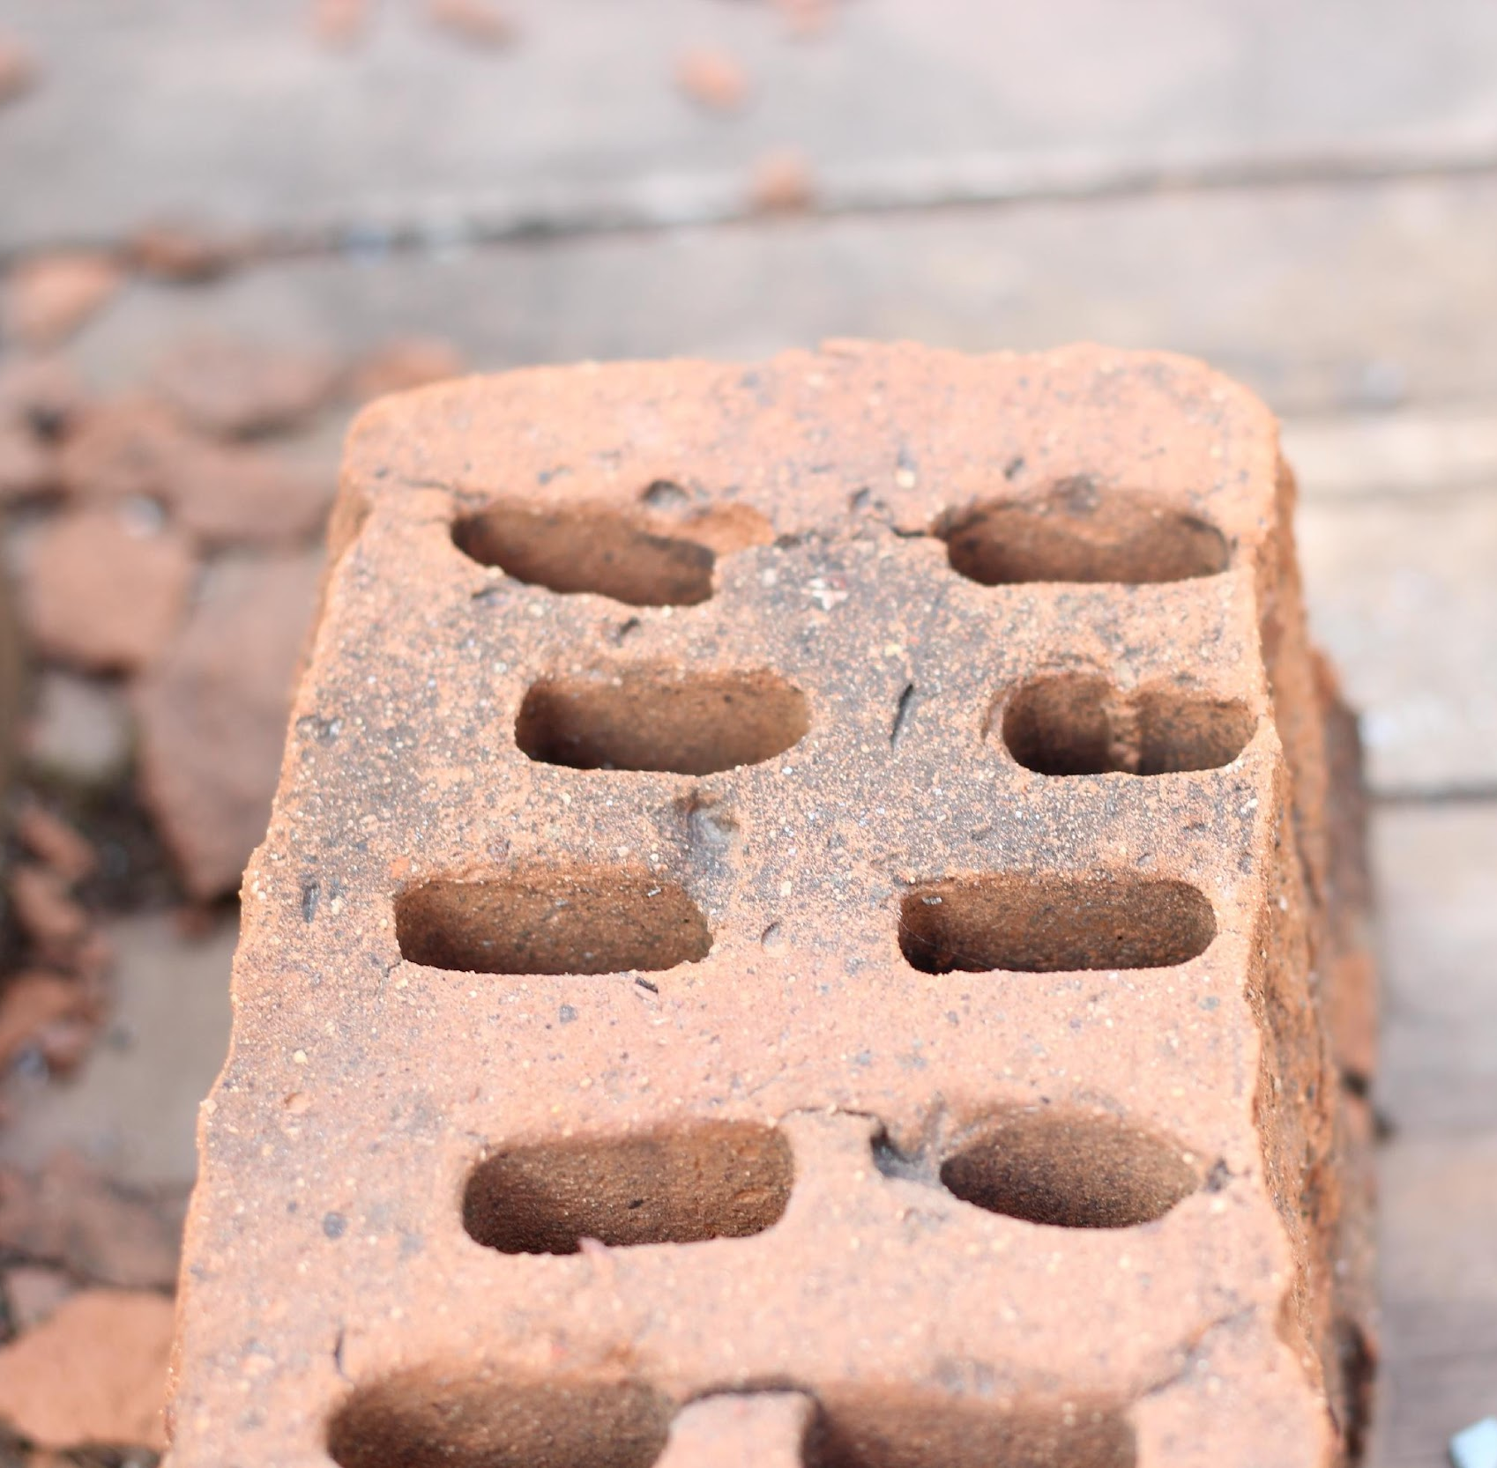
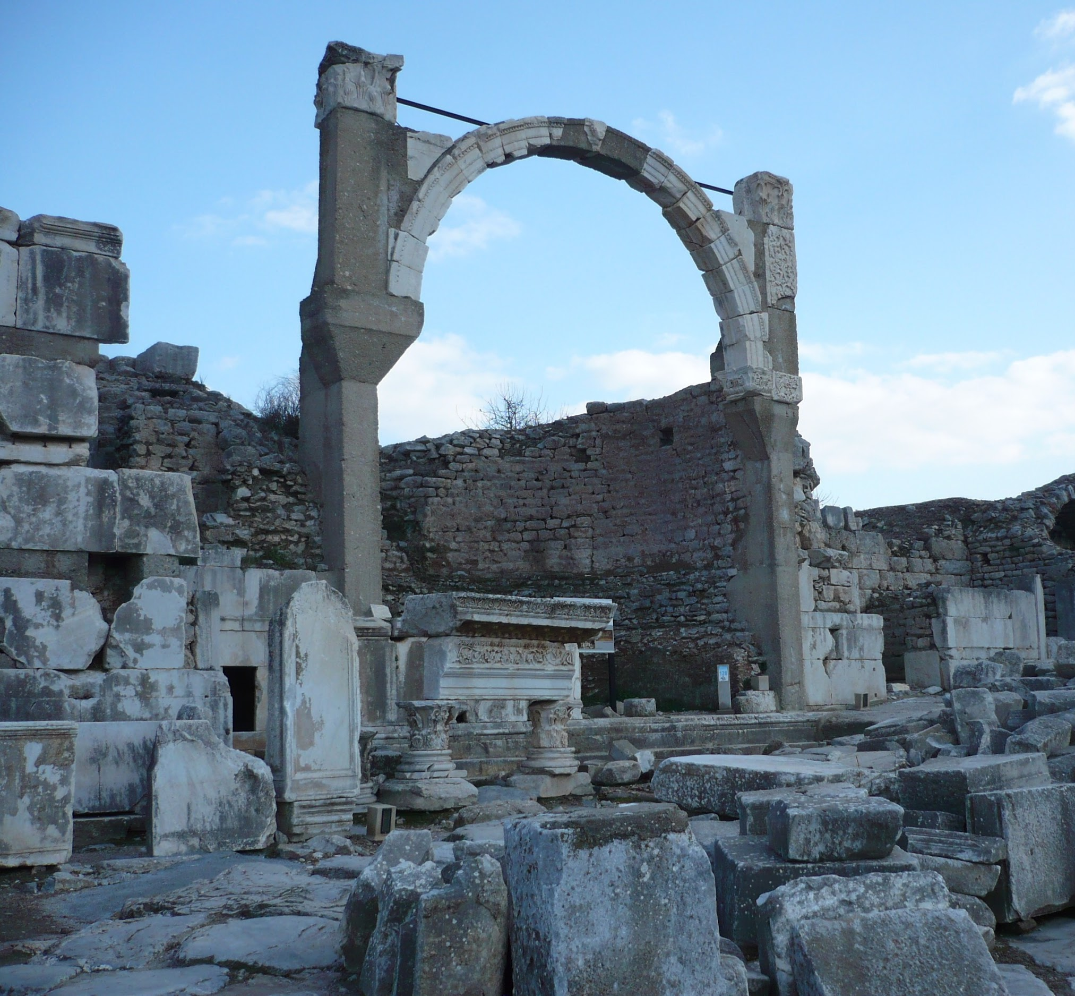
Challenge:
Follow the story!
Read the story and get through the map in the right order!
(long text 1)

Slide 6
Challenge:
Follow the story!
Read the story and get through the map in the right order!
(long text 1)

Slide 7
Challenge:
Follow the story!
Read the story and get through the map in the right order!
(long text 1)

Slide 8
Challenge:
Follow the story!
Read the story and get through the map in the right order!
(long text 1)
Solution

Slide 9
Challenge:
Follow the story!
Read the story and get through the map in the right order!
(short text 2)

Slide 10
Challenge:
Follow the story!
Read the story and get through the map in the right order!
(short text 2)

Slide 11
Challenge:
Follow the story!
Read the story and get through the map in the right order!
(short text 2)

Slide 12
Solution
Challenge:
Follow the story!
Read the story and get through the map in the right order!
(short text 2)

Slide 13
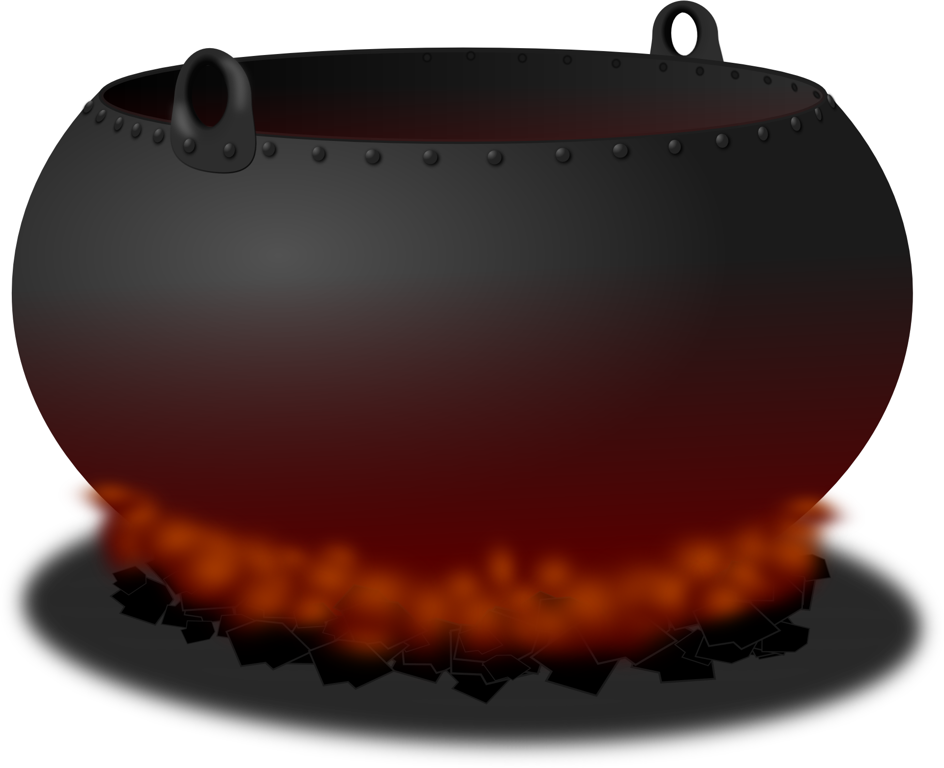
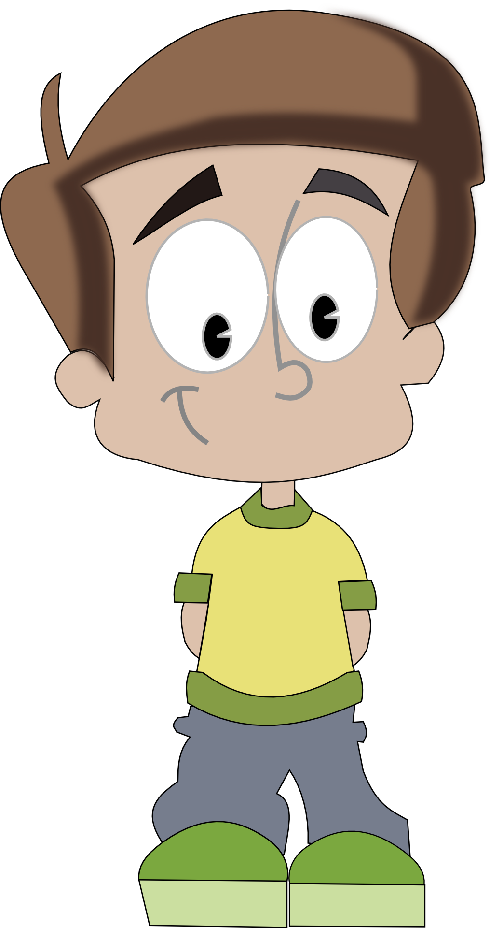
Challenge:
Follow the story!
Read the story and get through the map in the right order!
(short text 3)

Slide 14
Challenge:
Follow the story!
Read the story and get through the map in the right order!
(short text 3)

Slide 15
Challenge:
Follow the story!
Read the story and get through the map in the right order!
(short text 3)

Slide 16
Solution
Challenge:
Follow the story!
Read the story and get through the map in the right order!
(short text 3)

Slide 17
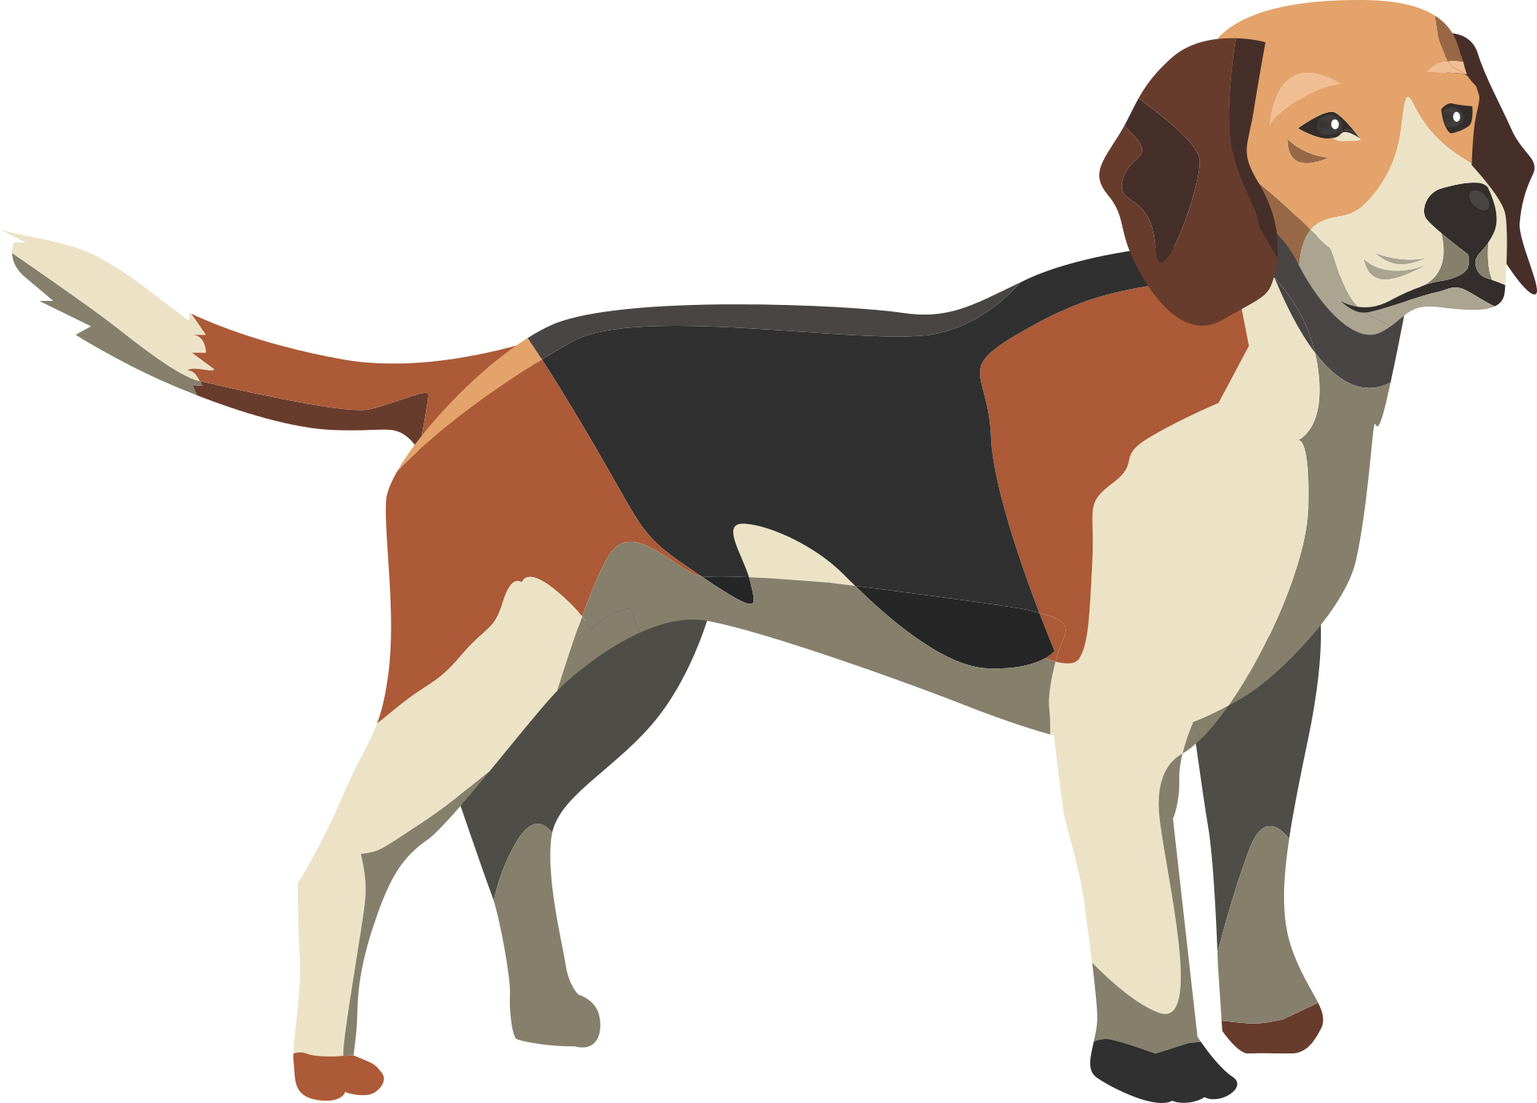
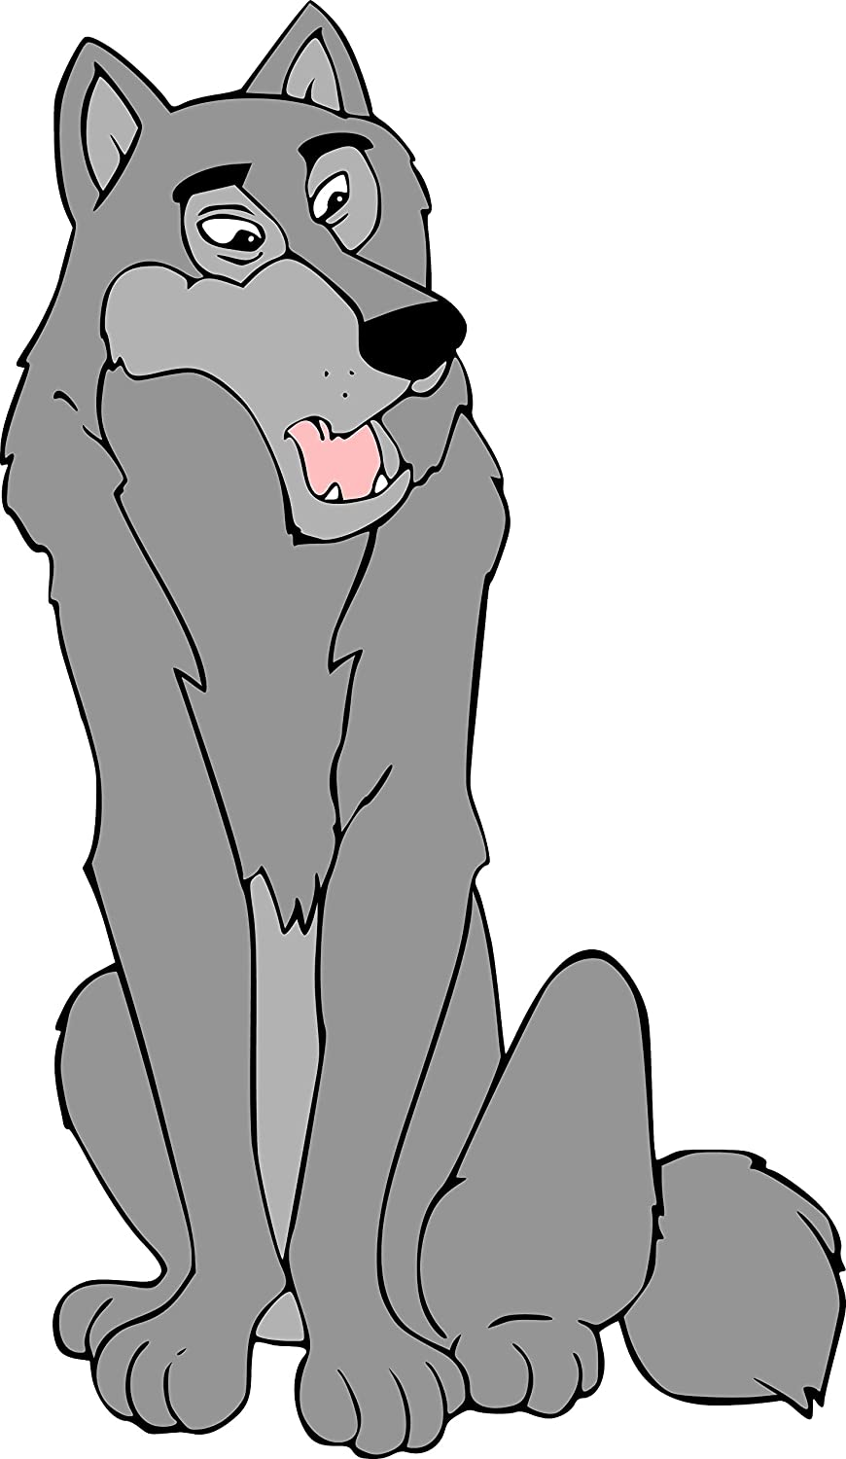
Challenge:
Follow the story!
Read the story and get through the map in the right order!
(short text 4)

Slide 18
Challenge:
Follow the story!
Read the story and get through the map in the right order!
(short text 4)

Slide 19
Challenge:
Follow the story!
Read the story and get through the map in the right order!
(short text 4)

Slide 20
Solution
Challenge:
Follow the story!
Read the story and get through the map in the right order!
(short text 4)

