Slide 1
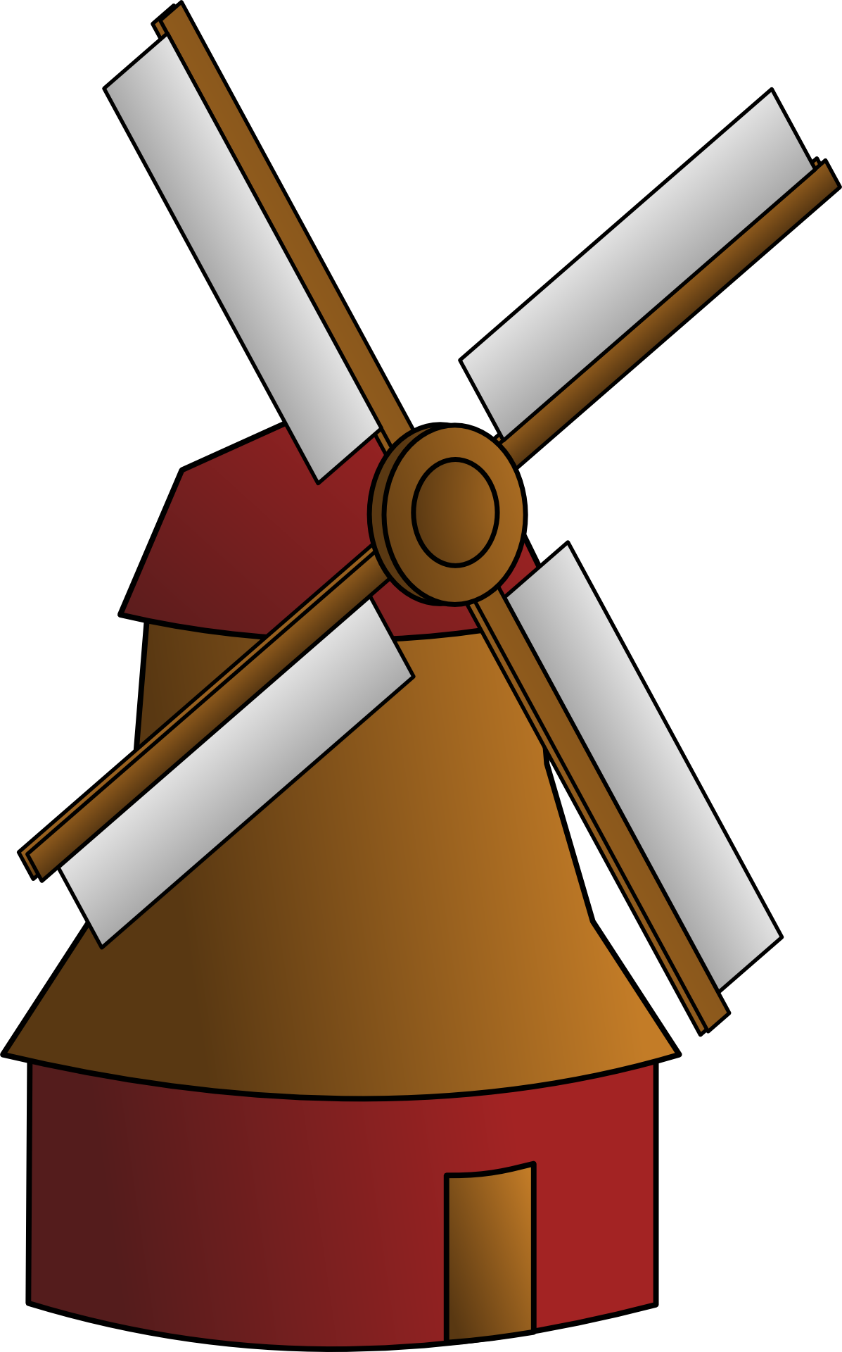
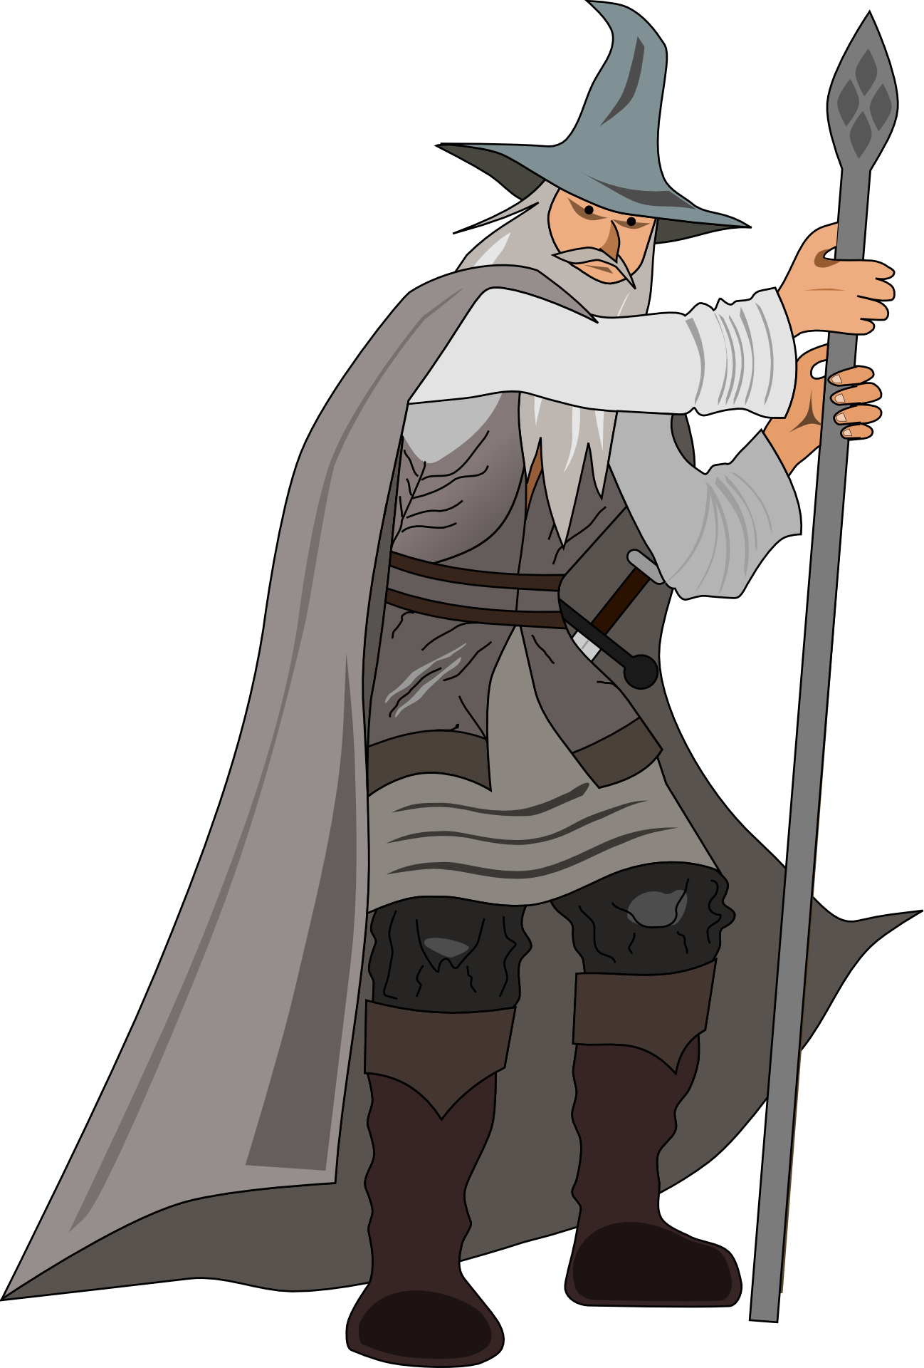
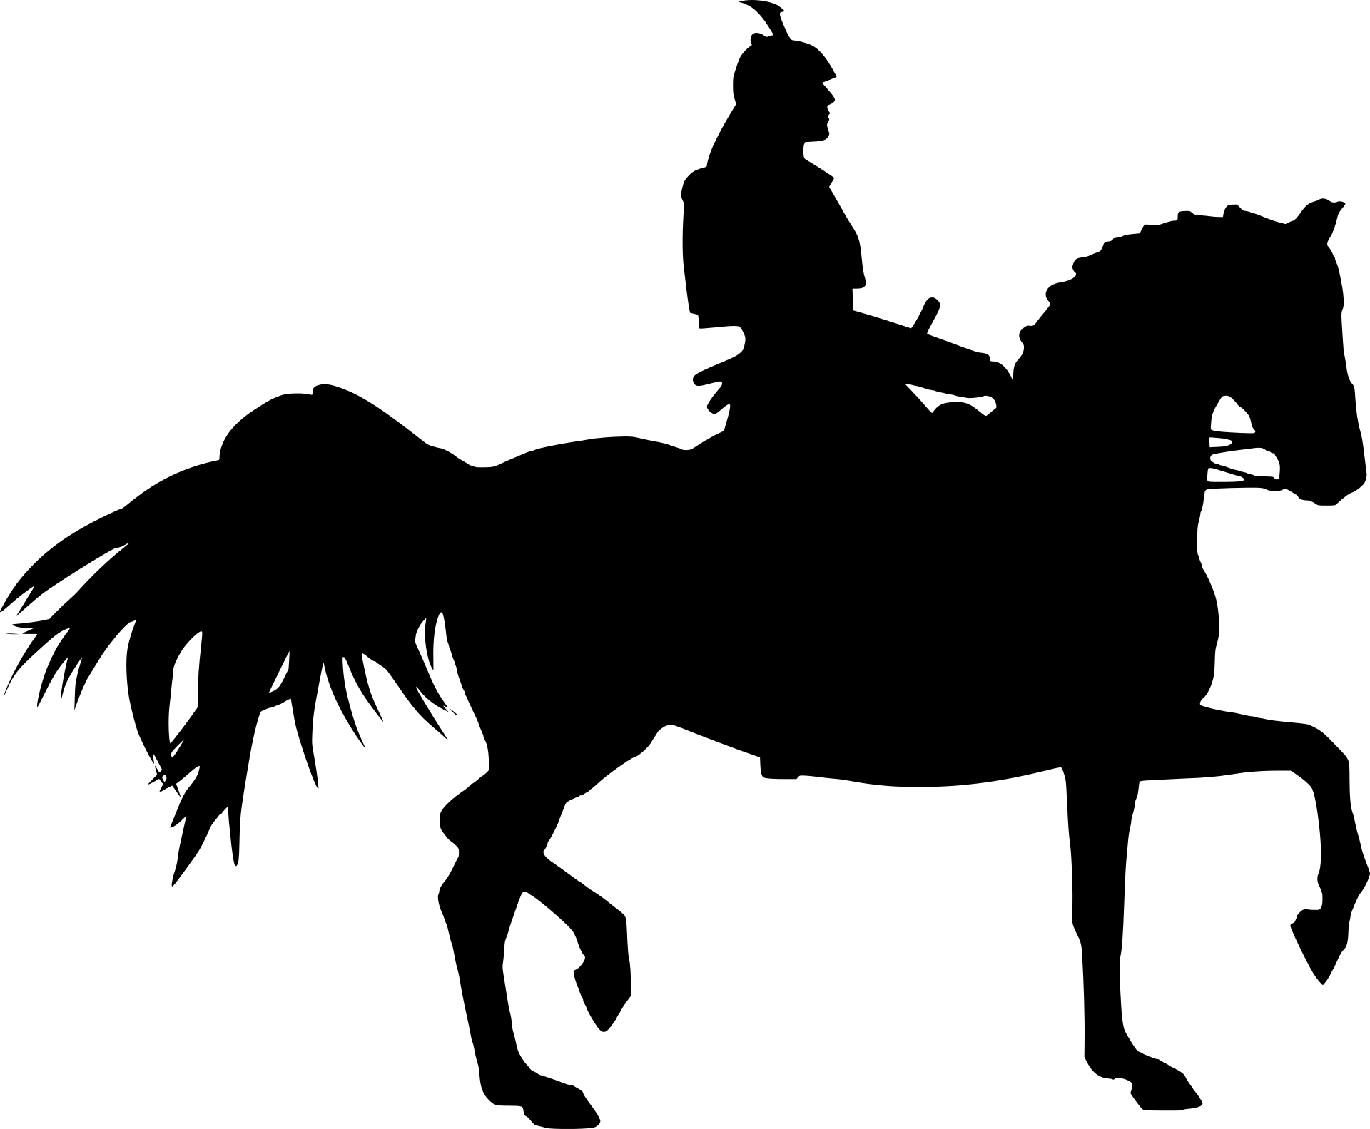
Challenge:
Follow the story of Don Quixote's adventures in chronological order and collect all the icons.

Slide 2
Challenge:
Follow the story of Don Quixote's adventures in chronological order and collect all the icons.

Slide 3
Challenge:
Follow the story of Don Quixote's adventures in chronological order and collect all the icons.

Slide 4
Solution
Challenge:
Follow the story of Don Quixote's adventures in chronological order and collect all the icons.

Slide 5
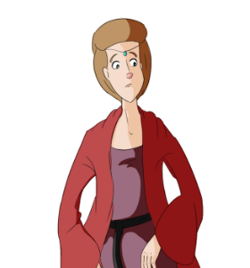
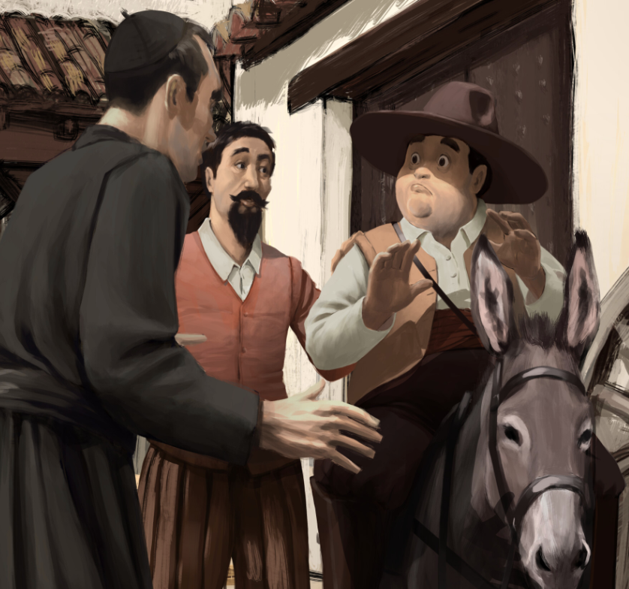
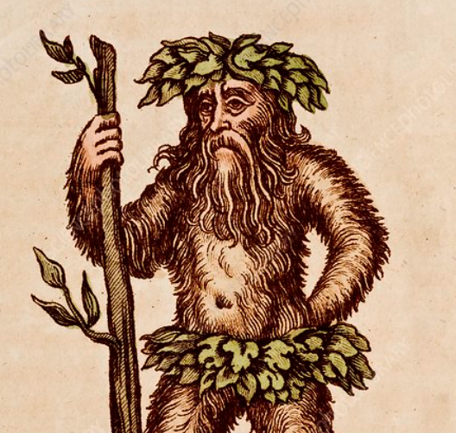
Challenge:
Follow the story of Don Quixote with Cardenio, Dorotea and Don Fernando in chronological order. Collect all the icons!

Slide 6
Challenge:
Follow the story of Don Quixote with Cardenio, Dorotea and Don Fernando in chronological order. Collect all the icons!

Slide 7
Challenge:
Follow the story of Don Quixote with Cardenio, Dorotea and Don Fernando in chronological order. Collect all the icons!

Slide 8
Solution
Challenge:
Follow the story of Don Quixote with Cardenio, Dorotea and Don Fernando in chronological order. Collect all the icons!

Slide 9
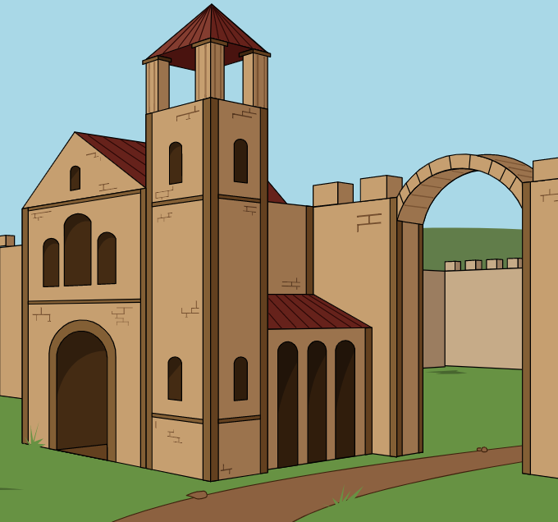
Challenge:
Follow the story of Don Quixote's adventures in chronological order and collect all the icons.

Slide 10
Kihívás:
Kövesse Don Quijote kalandjainak történetét időrendi sorrendben, és gyűjtse össze az összes ikont.
Challenge:
Follow the story of Don Quixote's adventures in chronological order and collect all the icons.

Slide 11
Challenge:
Follow the story of Don Quixote's adventures in chronological order and collect all the icons.

Slide 12
Solution
Challenge:
Follow the story of Don Quixote's adventures in chronological order and collect all the icons.

Slide 13
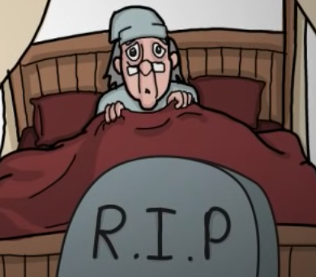
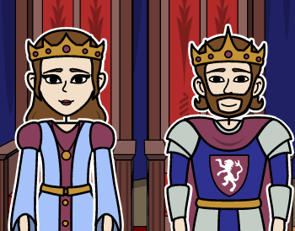
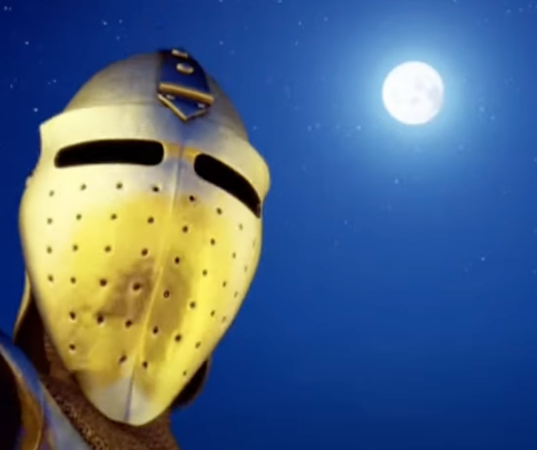
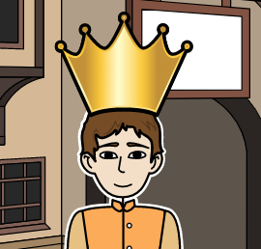
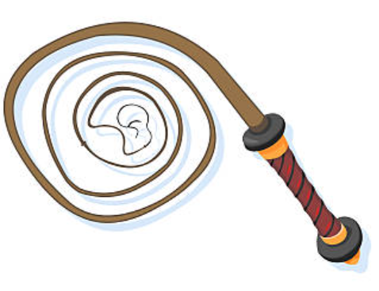
Challenge:
Follow the adventures of Don Quixote and Sancho in chronological order and collect all the icons.

Slide 14
Challenge:
Follow the adventures of Don Quixote and Sancho in chronological order and collect all the icons.

Slide 15
Challenge:
Follow the adventures of Don Quixote and Sancho in chronological order and collect all the icons.

Slide 16
Challenge:
Follow the adventures of Don Quixote and Sancho in chronological order and collect all the icons.
Solution

