Slide 1













1
2
3
7
4
5
Challenge:
Follow the story!
Read the story and help Alice get through the map in the right order!
6

Slide 2
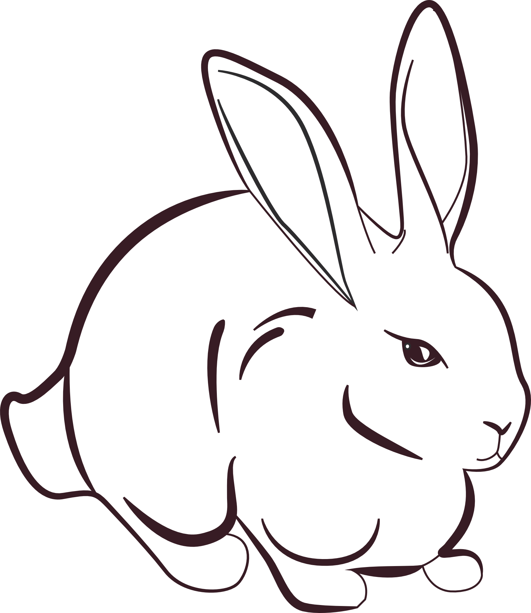
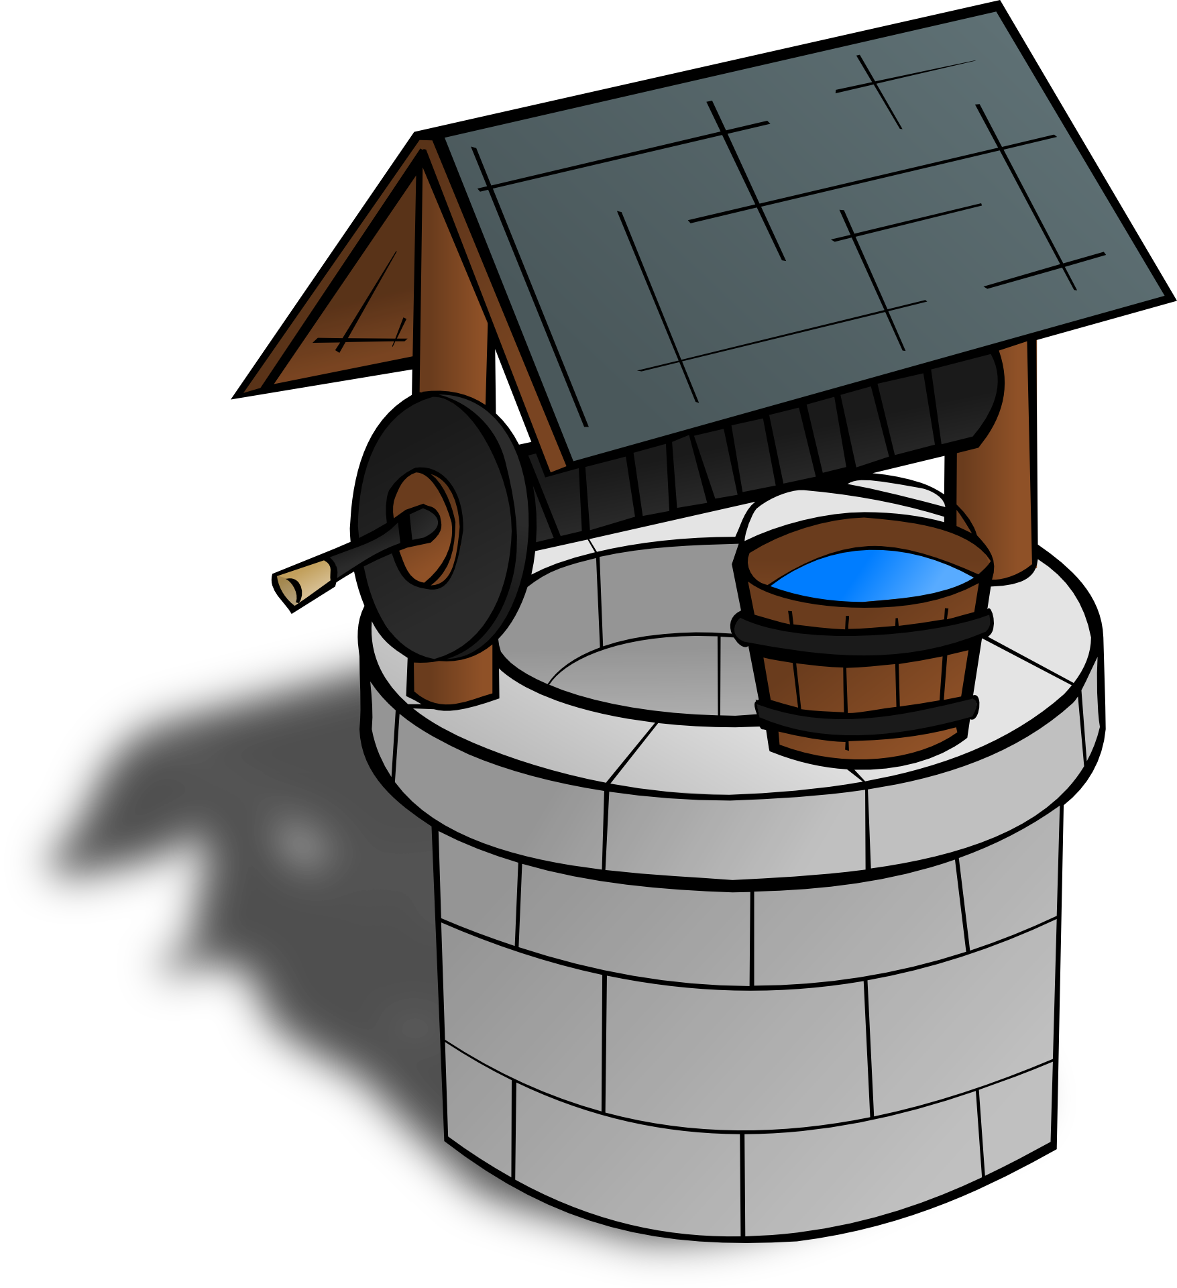
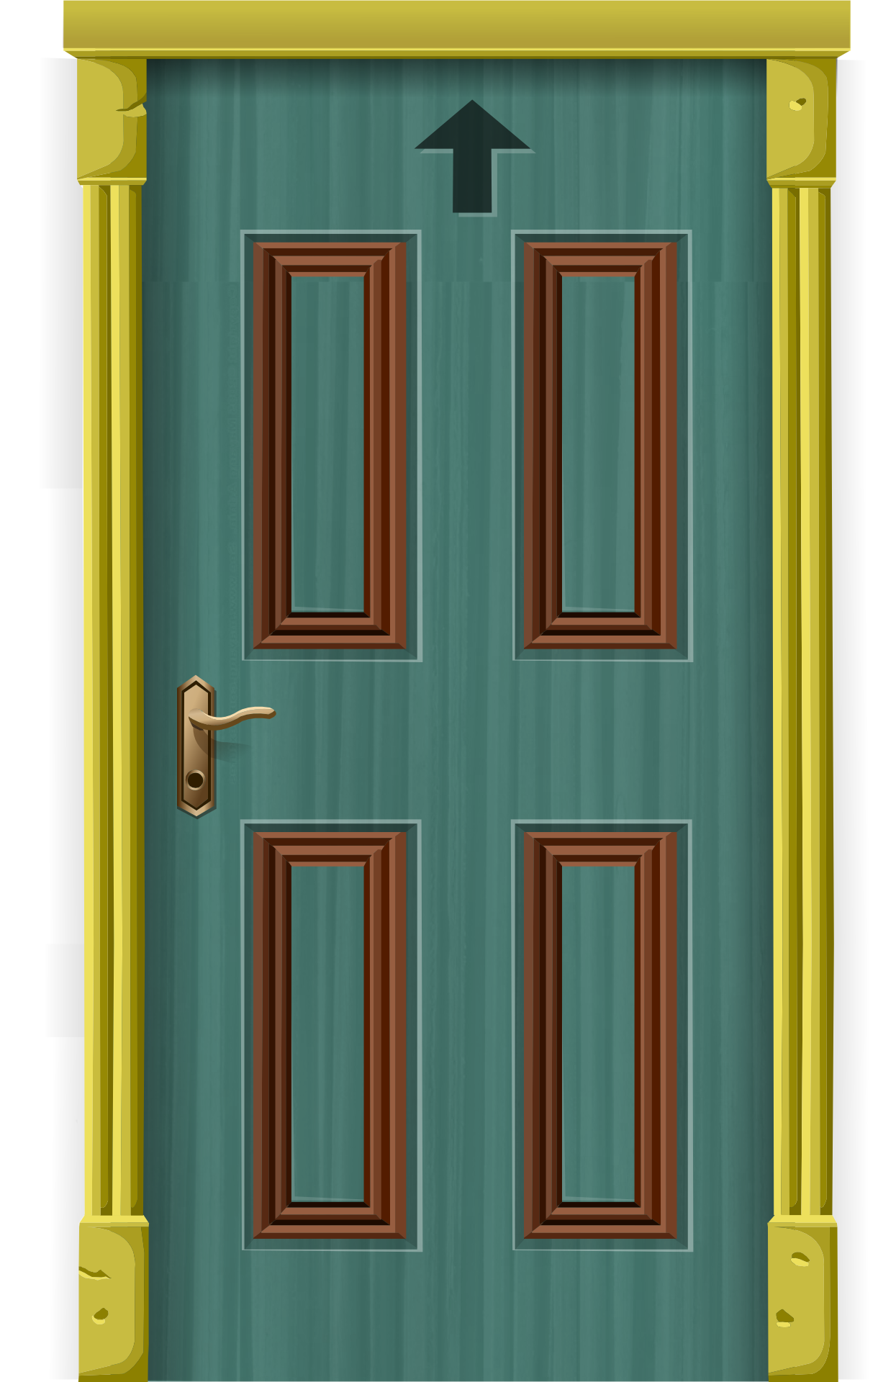




Challenge:
Follow the story!
Read the story and help Alice get through the map in the right order!

Slide 3
Challenge:
Follow the story!
Read the story and help Alice get through the map in the right order!

Slide 4
Challenge:
Follow the story!
Read the story and help Alice get through the map in the right order!

Slide 5
Solution
Challenge:
Follow the story!
Read the story and help Alice get through the map in the right order!

Slide 6
6
7
5
1
4
Challenge:
Follow the story!
Read the story and help Alice get through the map in the right order!
2
3

Slide 7
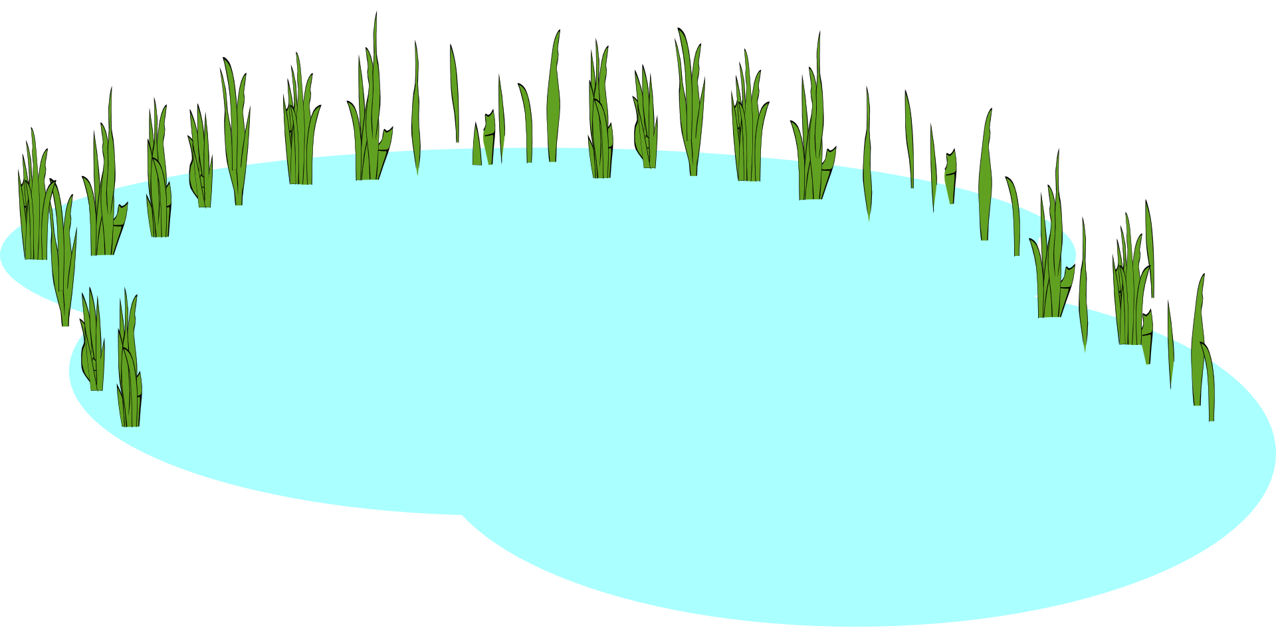
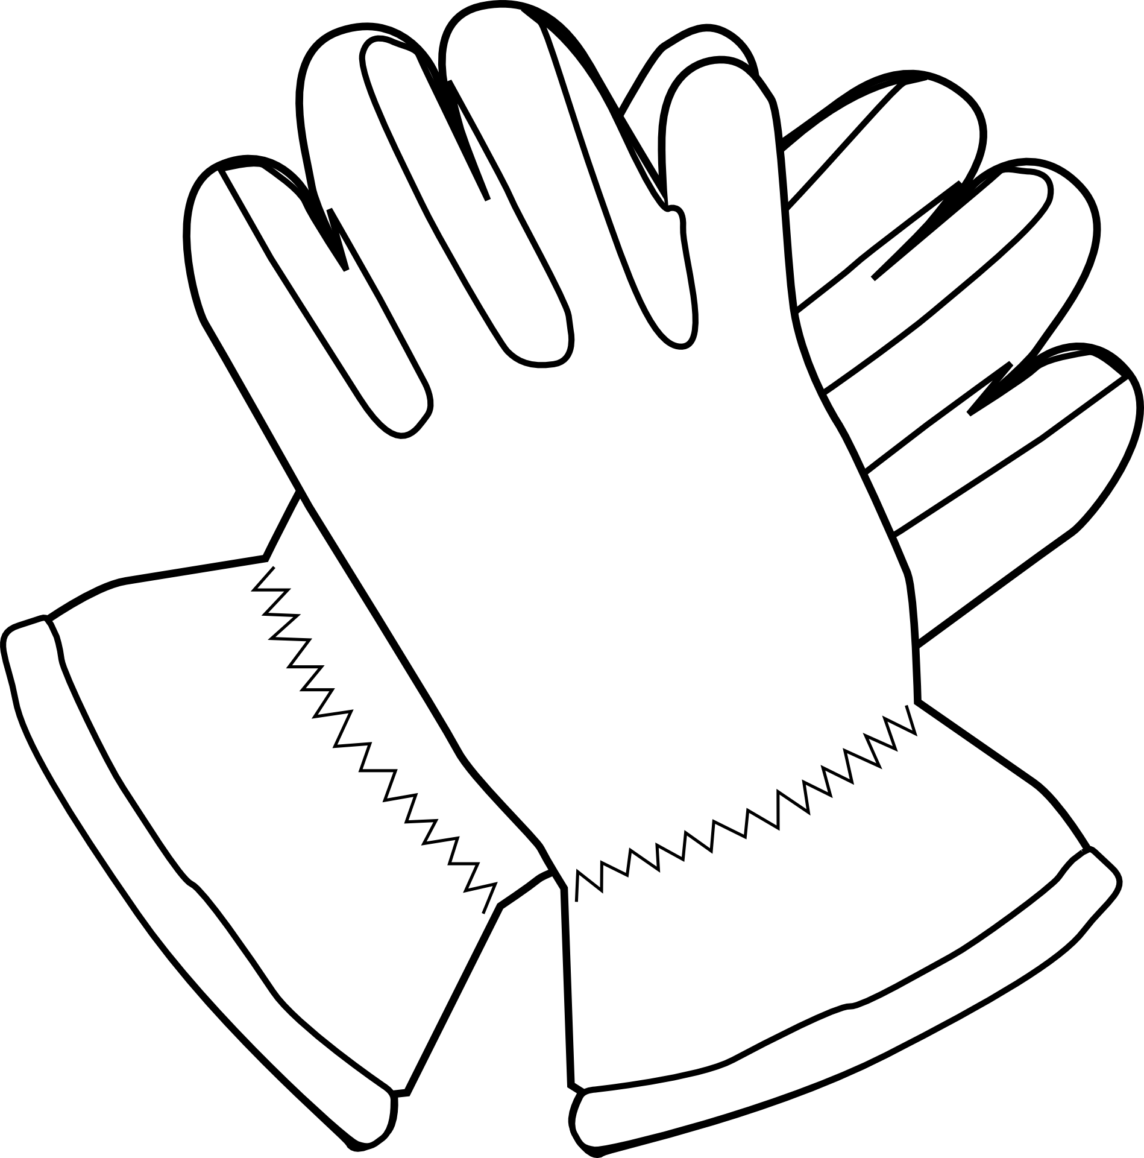
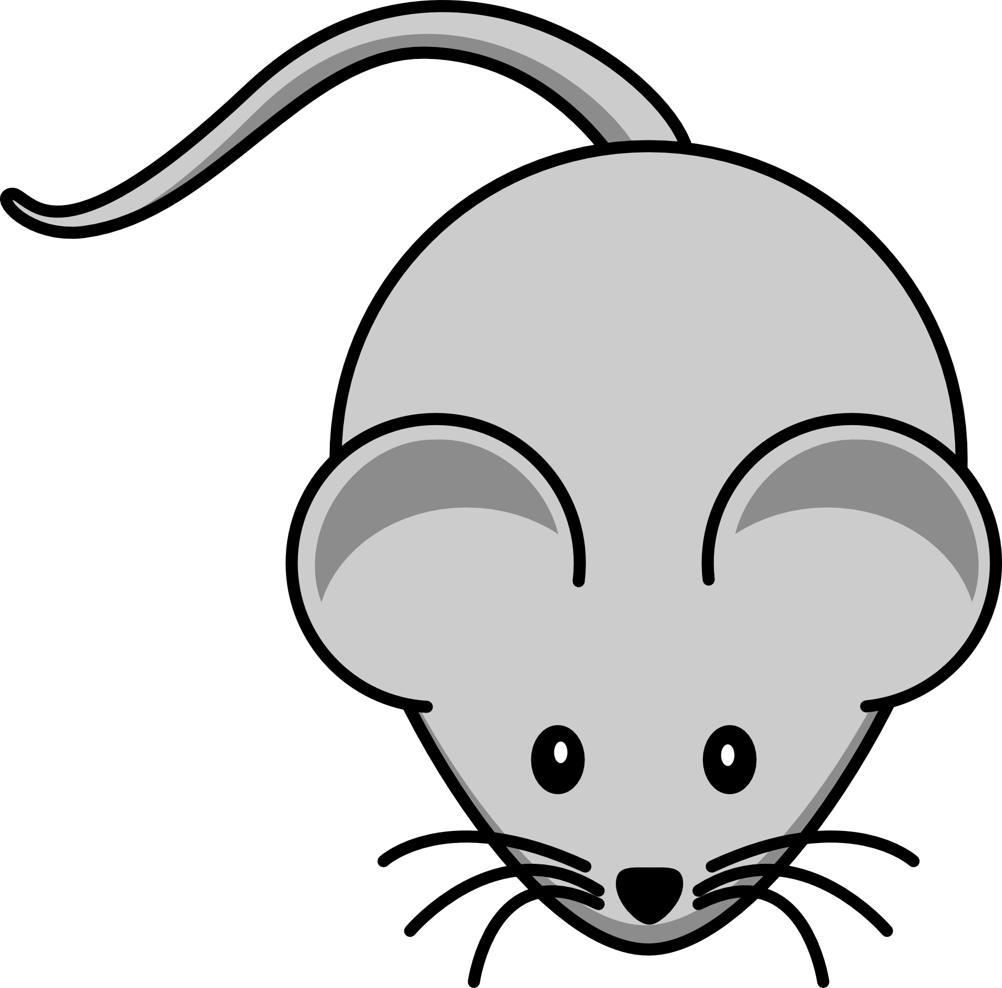


Challenge:
Follow the story!
Read the story and help Alice get through the map in the right order!

Slide 8
Challenge:
Follow the story!
Read the story and help Alice get through the map in the right order!

Slide 9
Challenge:
Follow the story!
Read the story and help Alice get through the map in the right order!

Slide 10
Solution
Challenge:
Follow the story!
Read the story and help Alice get through the map in the right order!

Slide 11
Challenge:
Follow the story!
Read the story and help Alice get through the map in the right order!
9
8
7
3
2
6
1
4
5

Slide 12


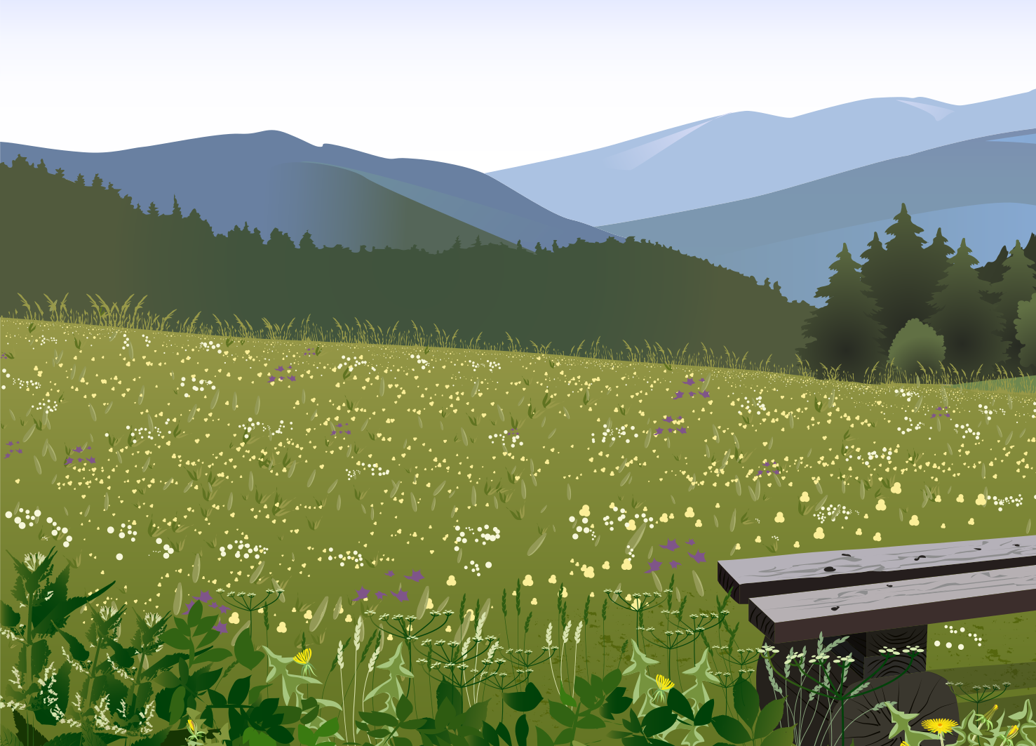
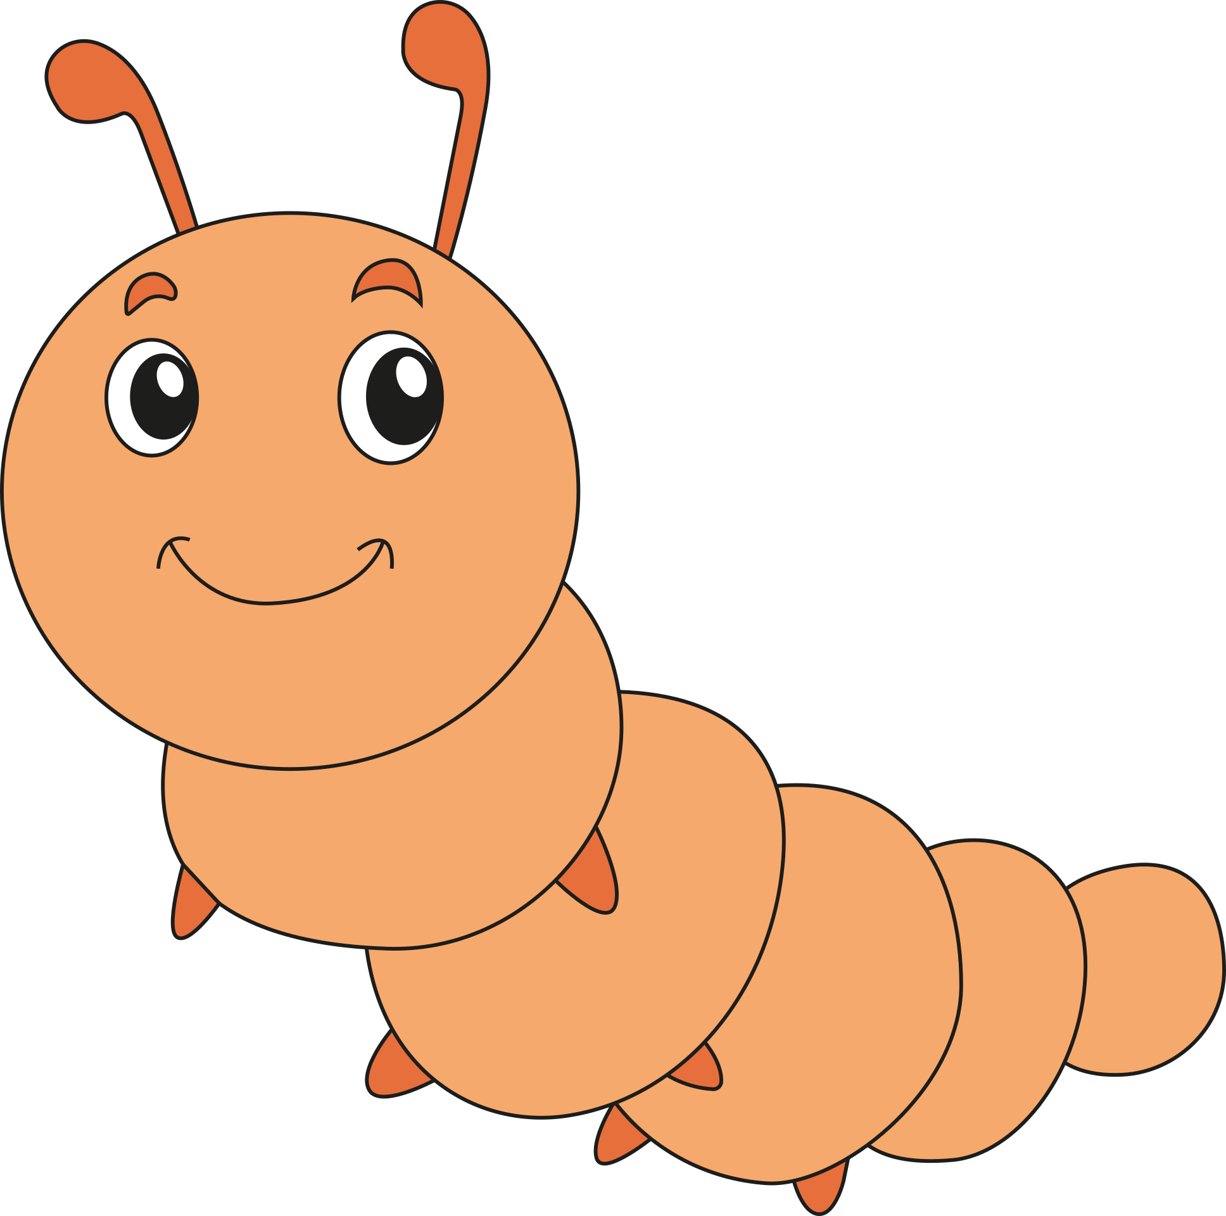
Challenge:
Follow the story!
Read the story and help Alice get through the map in the right order!

Slide 13
Challenge:
Follow the story!
Read the story and help Alice get through the map in the right order!

Slide 14
Challenge:
Follow the story!
Read the story and help Alice get through the map in the right order!

Slide 15
Challenge:
Follow the story!
Read the story and help Alice get through the map in the right order!
Solution

Slide 16
9
8
5
4
10
7
6
3
11
2
1
Challenge:
Follow the story!
Read the story and help Alice get through the map in the right order!

Slide 17

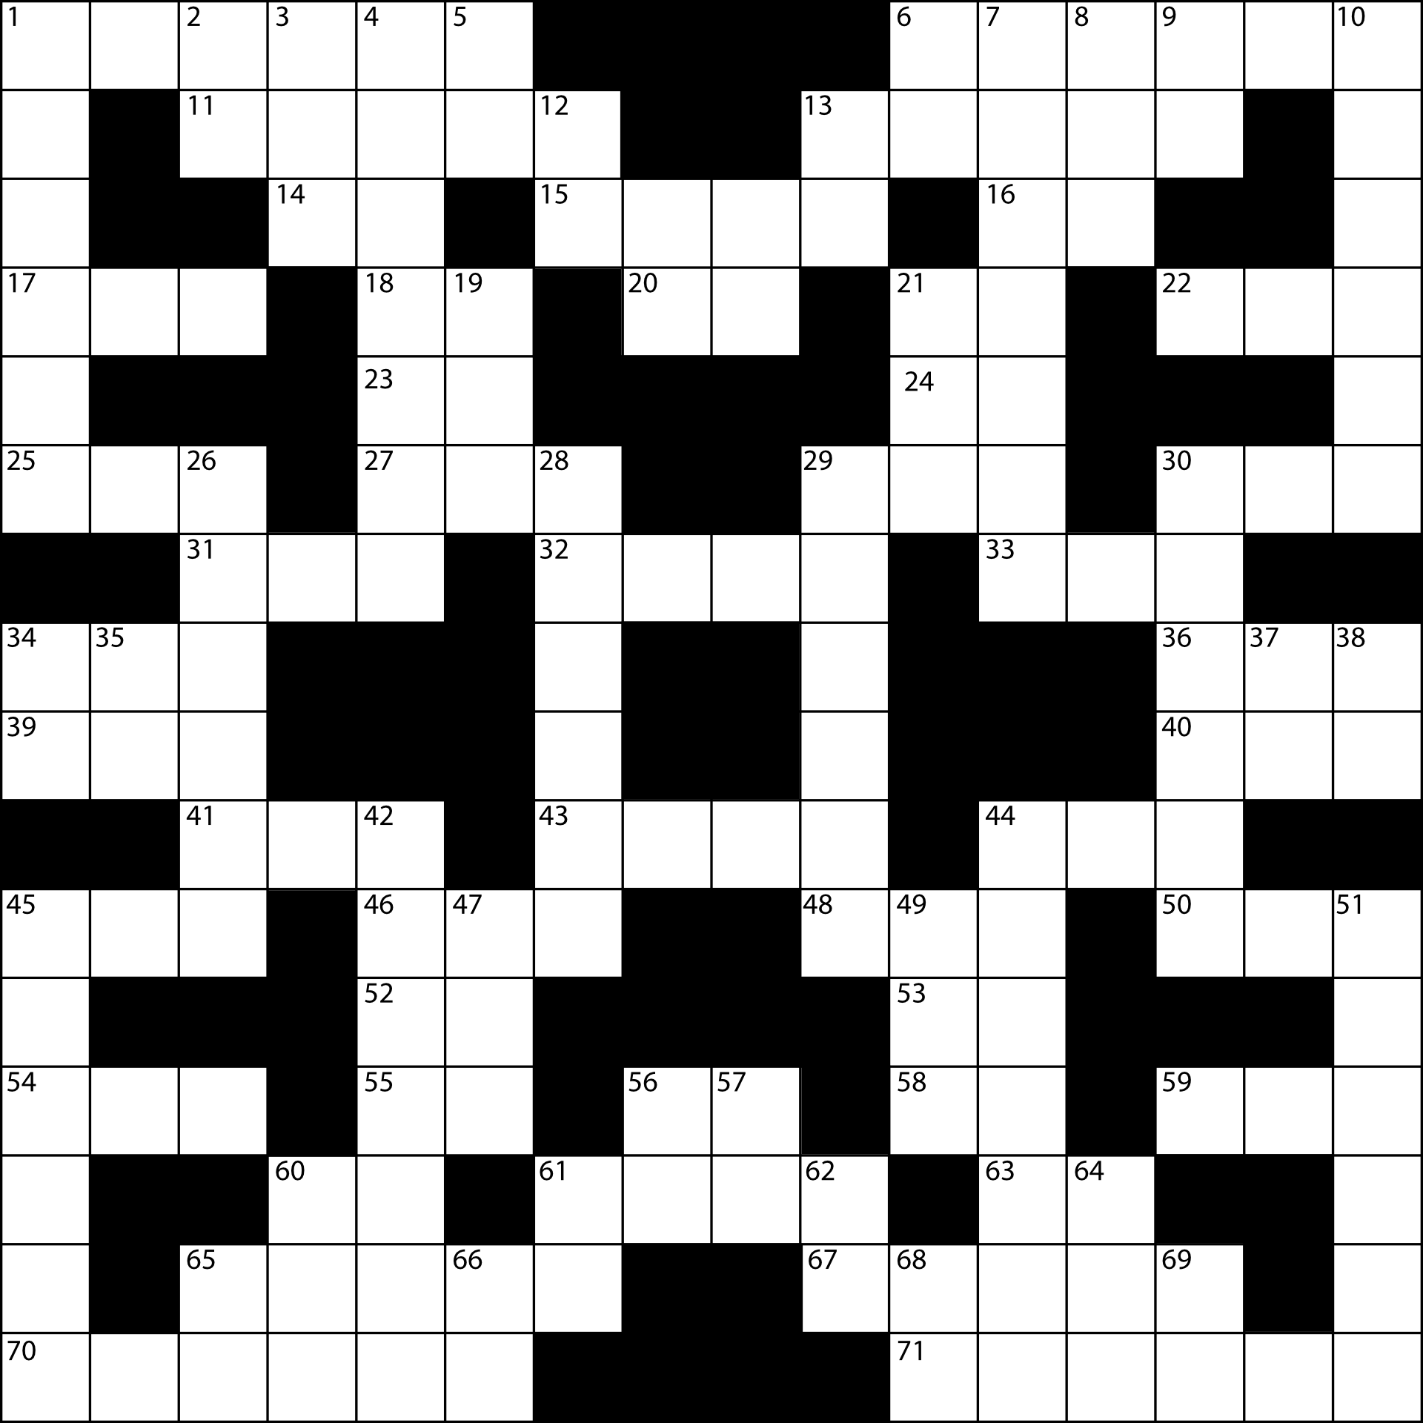
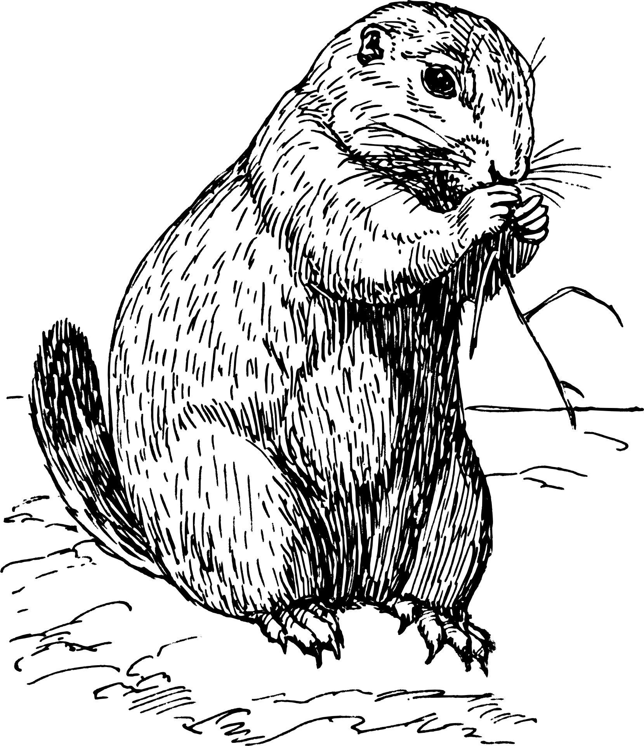

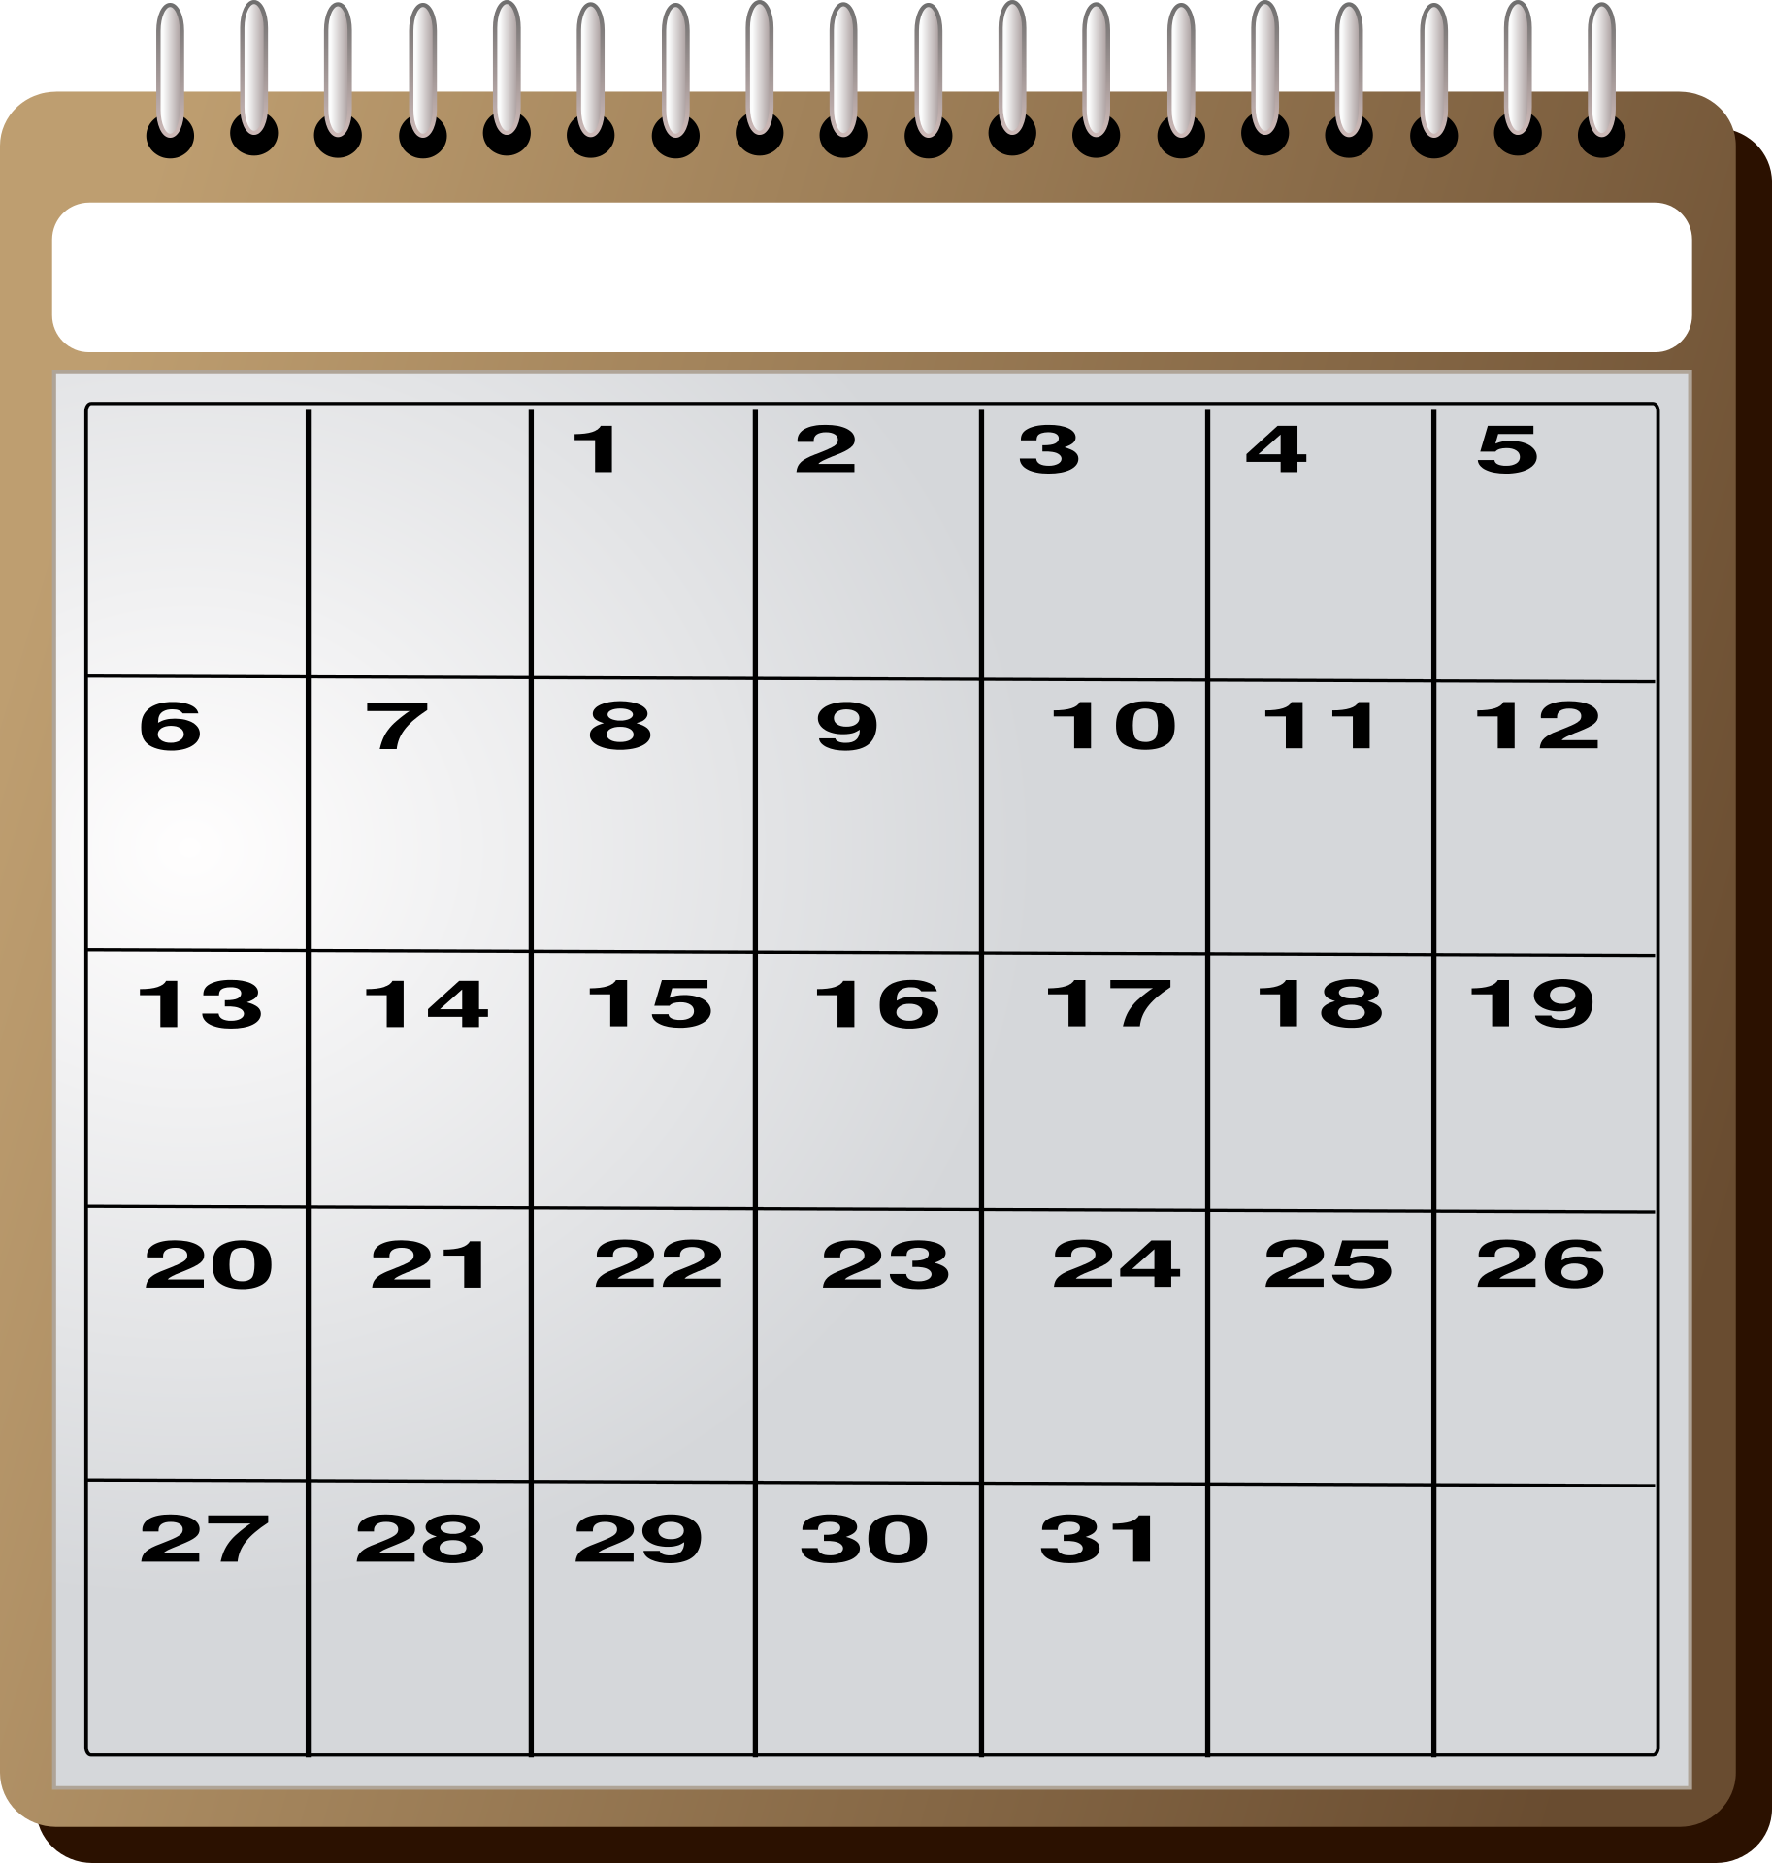



Challenge:
Follow the story!
Read the story and help Alice get through the map in the right order!

Slide 18
Challenge:
Follow the story!
Read the story and help Alice get through the map in the right order!

Slide 19
Challenge:
Follow the story!
Read the story and help Alice get through the map in the right order!

Slide 20
Solution
Challenge:
Follow the story!
Read the story and help Alice get through the map in the right order!

Slide 21
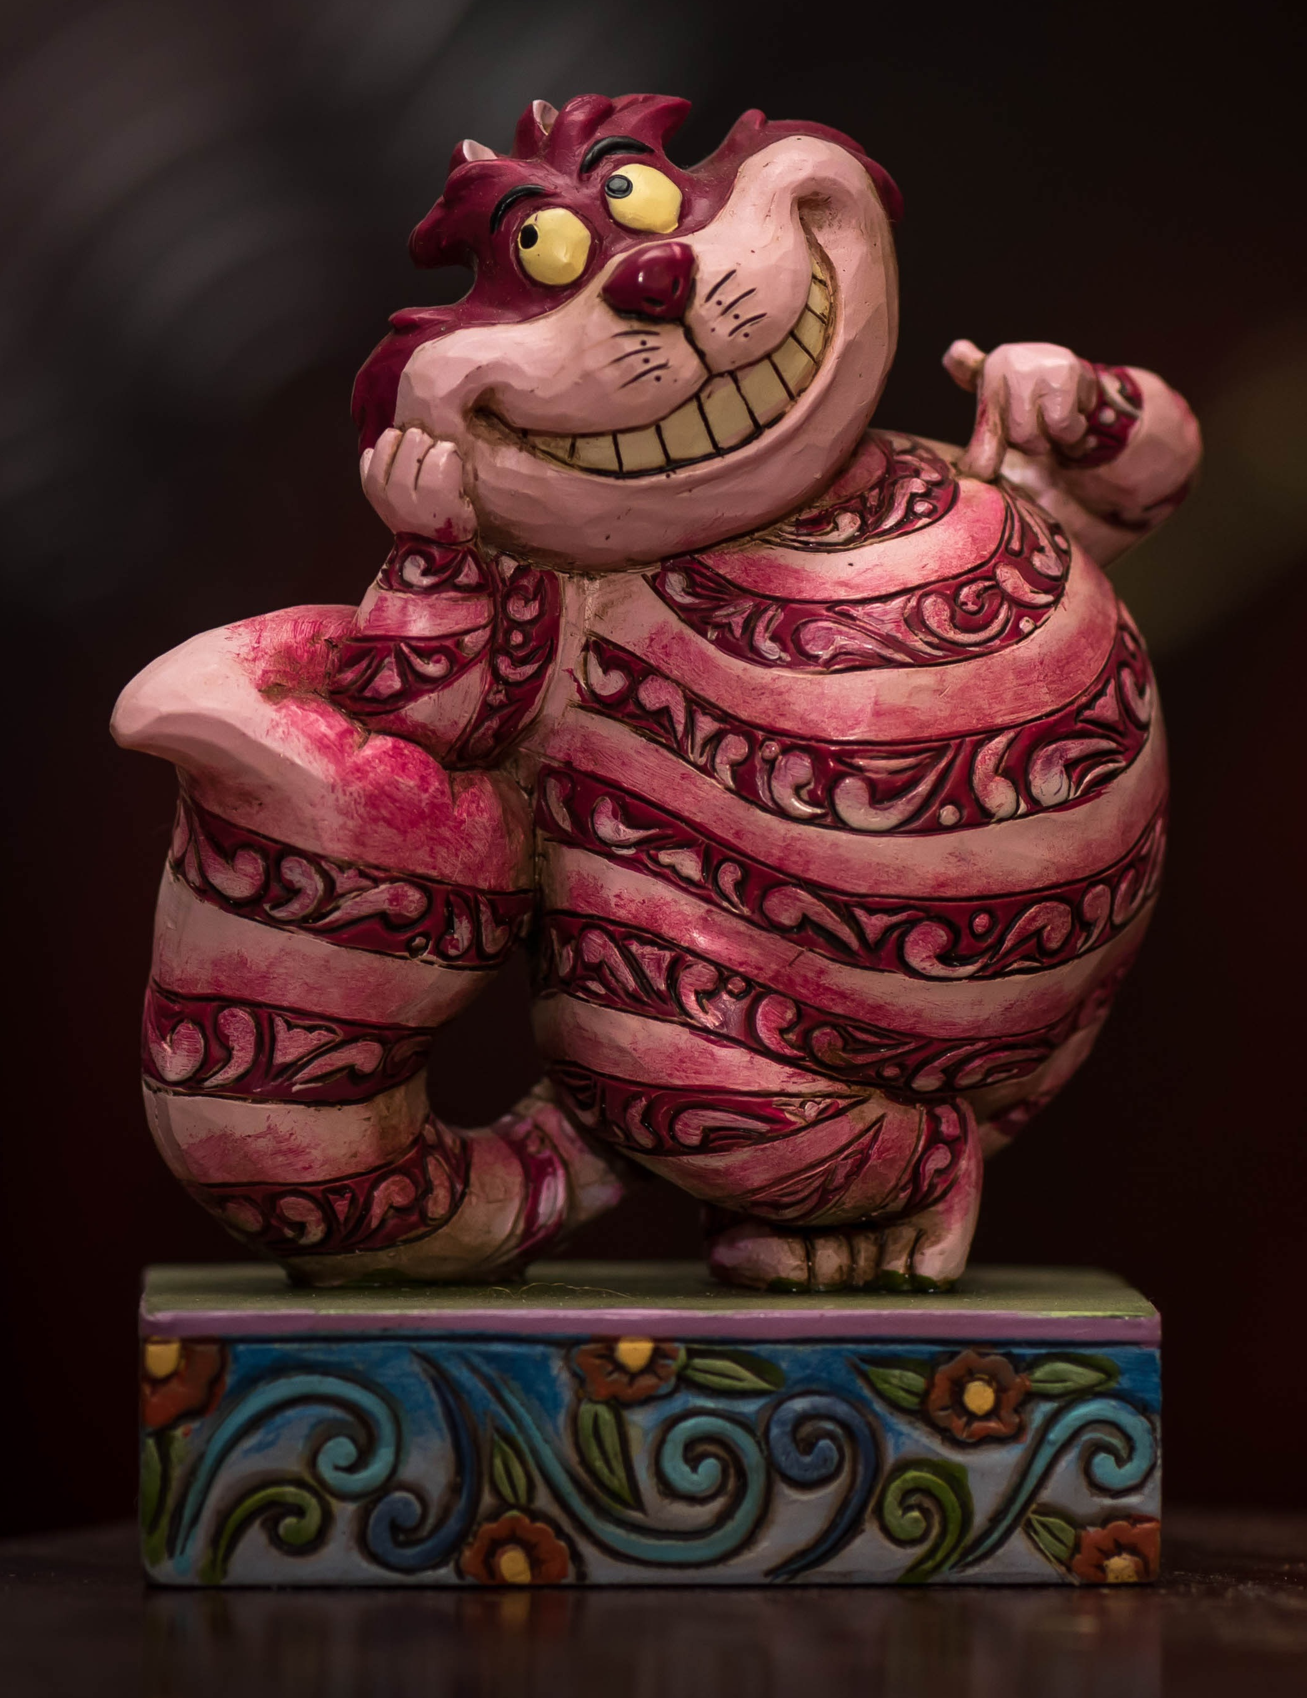
2
3
1
4
5
6
Challenge:
Follow the story!
Read the story and help Alice get through the map in the right order!
7

Slide 22
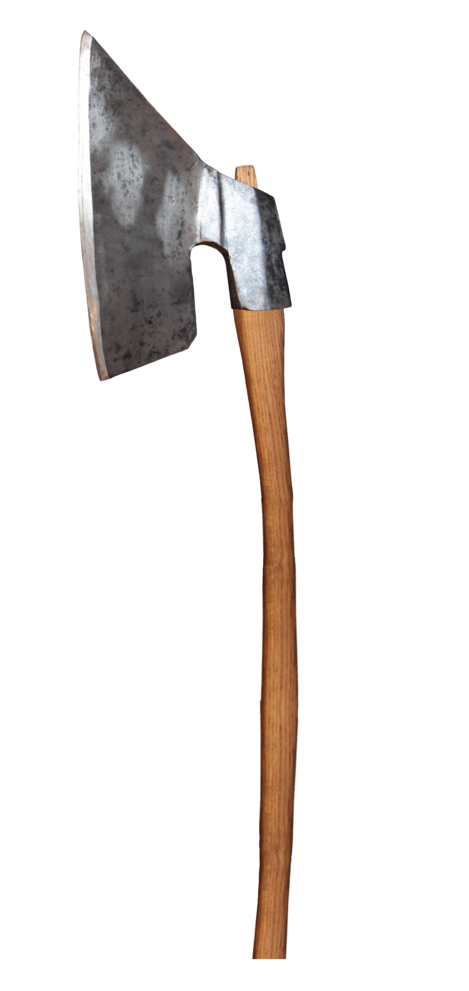


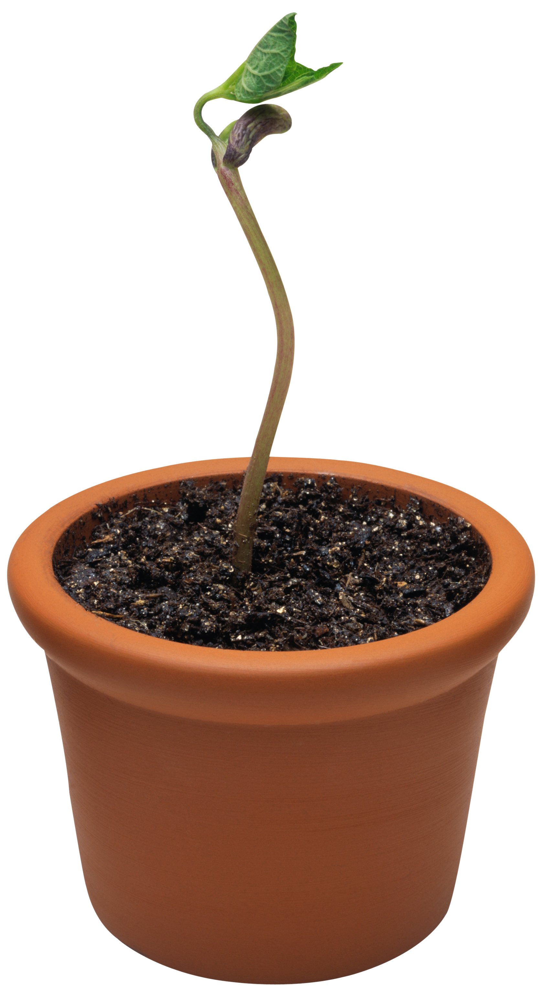

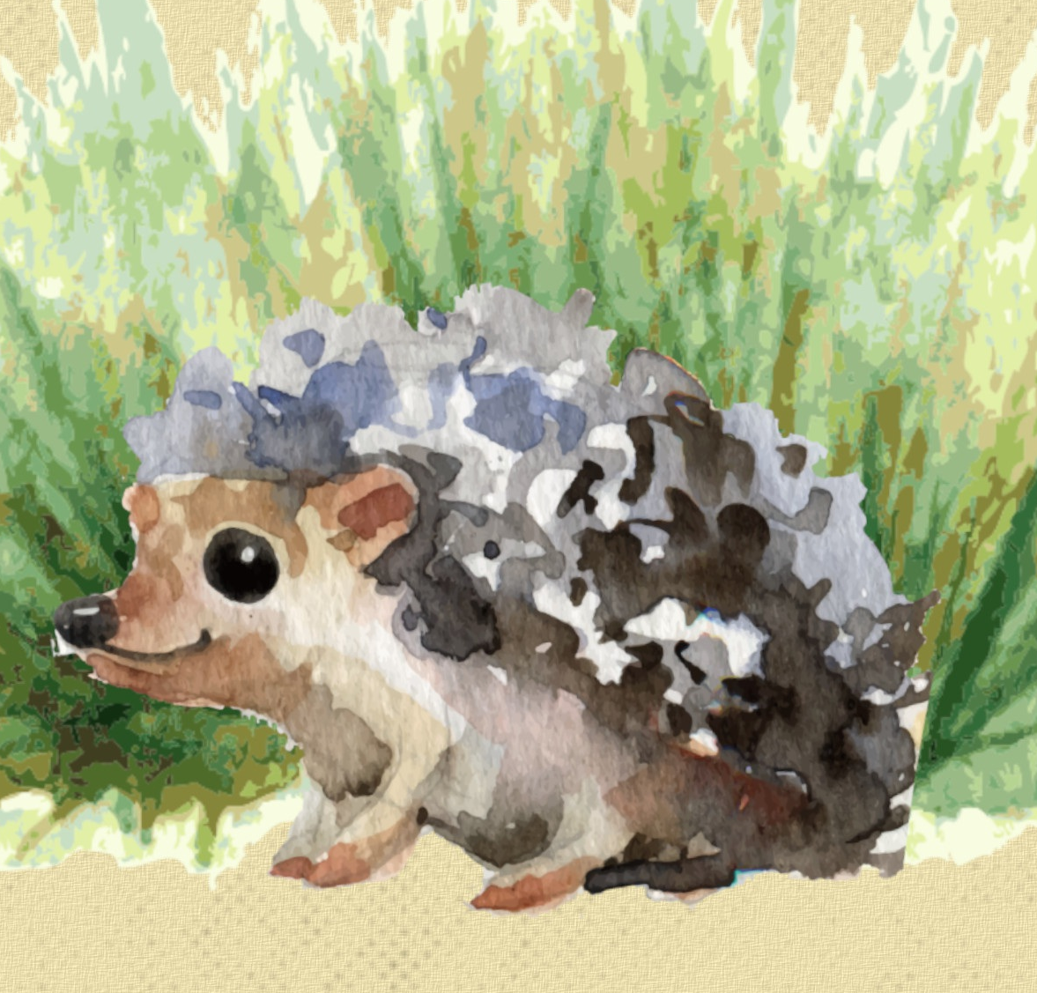
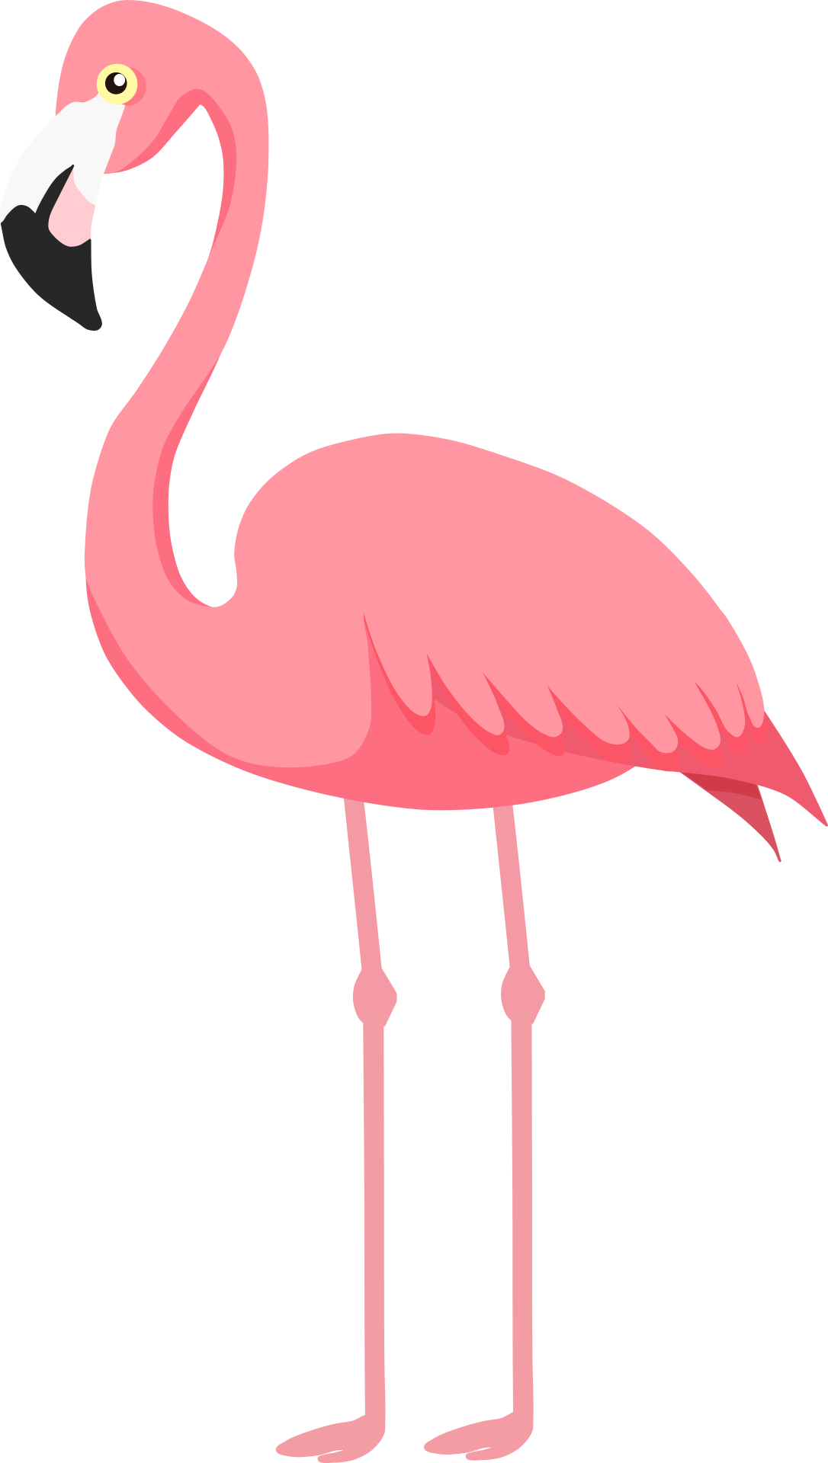
Challenge:
Follow the story!
Read the story and help Alice get through the map in the right order!

Slide 23
Challenge:
Follow the story!
Read the story and help Alice get through the map in the right order!

Slide 24
Challenge:
Follow the story!
Read the story and help Alice get through the map in the right order!

Slide 25
Solution
Challenge:
Follow the story!
Read the story and help Alice get through the map in the right order!

Slide 26
1
4
2
3
5
6
7
8
Challenge:
Follow the story!
Read the story and help Alice get through the map in the right order!
9

Slide 27
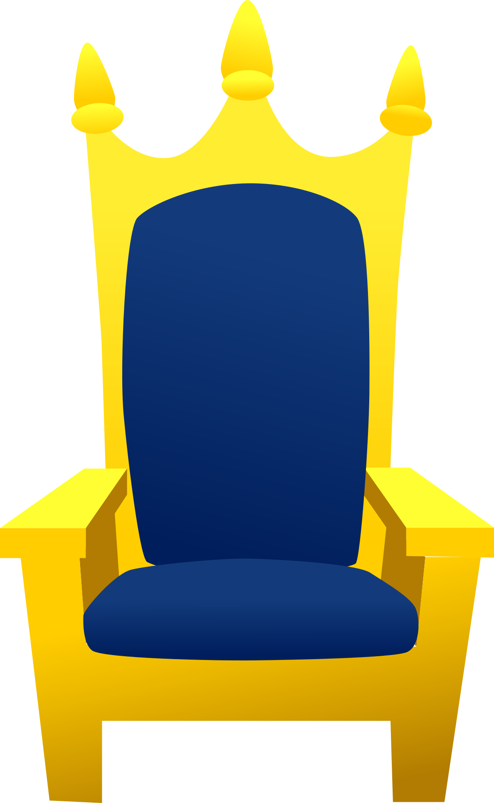


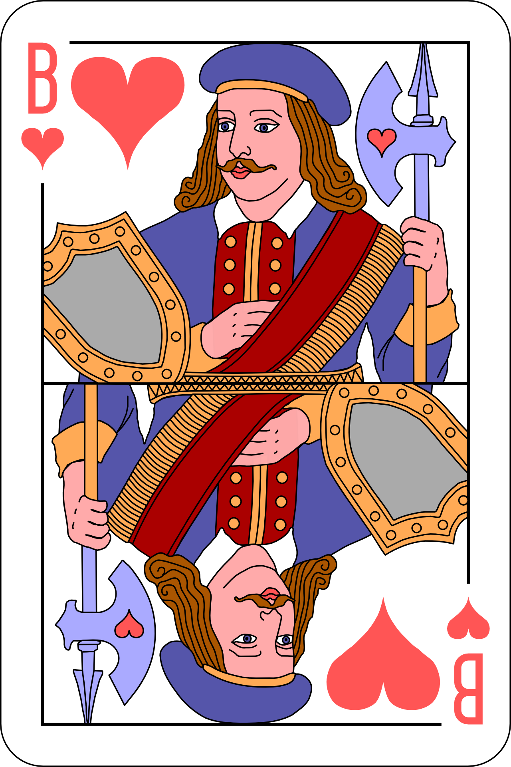
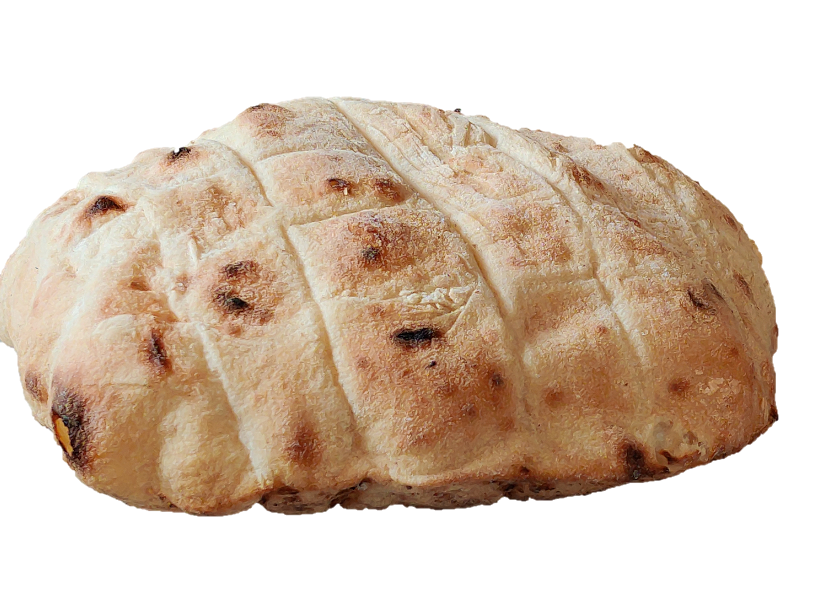



Challenge:
Follow the story!
Read the story and help Alice get through the map in the right order!

Slide 28
Challenge:
Follow the story!
Read the story and help Alice get through the map in the right order!

Slide 29
Challenge:
Follow the story!
Read the story and help Alice get through the map in the right order!

Slide 30
Challenge:
Follow the story!
Read the story and help Alice get through the map in the right order!
Solution

