Slide 1
How to arouse and maintain students' curiosity? A basic didactic approach to teaching technology Welcome
Sacha Tippel
Sacha.tippel@hu.nl
0623765077
Hans van de Wetering
hans.vandewetering@voveghel.nl

Slide 2
https://www.youtube.com/watch?v=1zDHRvoq9vE
https://www.youtube.com/watch?v=TnBqfoPm8Xk

Slide 3
Make Assignment
‘Make assignment’ for making a balloon driven cardboard car
Take your ‘Air balloon Car Kit’, and start building

Slide 4
What were you curious about?
Why am i doing this?
Do I have the skills to do the assignment?
How much time do we have?
Can we work together?
Can i ‘beat’ the others by finishing the assignment early?
Why can’t I do the other assignment?
Do I like doing these kind of assignments?
What do I get out of this assignment? (Is it fun? Do I learn anything?)
Can I use this assignment for my students, or maybe in a different way?

Slide 5
Theoretical framework
Rotherham and Willingham
(Kirschner 2022)
Double loop Learning
(Argyris, 2002).

Slide 6
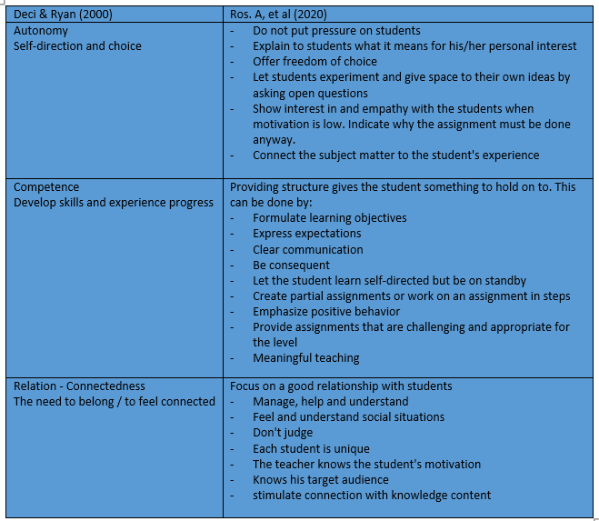
Theoretical framework
Competence, Autonomy, Relation Deci & Ryan 2000

Slide 7
Toshiro Kanamori
Theoretical framework
CHILDREN FULL OF LIFE
‘The interests the children show and the questions they ask should be valued and not rejected by stubborn adults’ ()
Listen to your children, encourage learning everyday things. What kind of adults will our children become? Do they become the builders of a peaceful state and free society? Will they become adults with a broad outlook on life who think carefully, do not put pressure themselves or others and make an effort to make both themselves and others happy and that they always keep a learn attitude and to think creatively.

Slide 8
Theoretical framework
EXEMPLARY EDUCATION
Those who stand in front of the class know better then to let policy makers have their say in the classroom...(Weigand-Timmer, 2007)
Why do we (they) need to learn? What should we (they) learn? How should we (they) learn? How should we evaluate education? How should we organize education?
Exemplary education includes parents who dare to transfer the education of their child to the school
Parents and schools who, from the perspective of 'doing justice to all dimensions of being human', constructively work together to tackle the complex task of educating and raising children

Slide 9
Theoretical framework
THE ART AND SCIENCE OF TEACHING - Student engagement
Marzano states that there are 5 areas that can provide useful insights into how teachers might increase student engagement (Marzano, 2007).
1. High energy
Boost energy by physical activity (blood flow, increased oxygen transport to brain)
Pacing of instruction; keep the activity moving and avoid interruptions, avoid slow transitions between activities
Teacher enthusiasm and intensity (animated behavior arouses the attending behavior of pupils)
2. Missing Information
Tap into the sense of curiosity and anticipation. ‘curiosity and anticipation are known as appetitive states because they stimulate the mental appetite’. (Jensen, 2005)
3. The Self System
…
4. Mild Pressure
…
5. Controversy and Competition

Slide 10
Theoretical framework
VISIBLE LEARNING FOR TEACHERS
Getting kids to engage in learning activities in a formal educational setting is not something that happens naturally.
If all educational psychology were reduced to one rule, this would be; the most important thing for learning is the student's already acquired knowledge. Search for this knowledge and connect with it. So claims David Ausubel (Ausubel, as shown in ‘Leren zichtbaar maken,’ Hattie, 2014). Shayer (Shayer, 2003, in ‘Leren zichtbaar maken,’ Hattie, 2014) states that If you want to generate viable engagement from all students, it is important to clearly visualize the mental levels of students and the cognitive demands of your lesson

Slide 11
Theoretical framework
GAMIFICATION
Lessons that benefit most from using games are those that don't go as well
Within traditional education, teachers and their instruction are focused on explicit knowledge transfer. In this formal setting, students must absorb facts and concepts and reproduce them at a later time, in the hope that they have also assimilated this knowledge. This approach has some success, within certain subjects, and is not always fun for students. That shouldn't be a problem. They will also be confronted with less pleasant things in later (professional) life. Students also have to deal with this aspect of life

Slide 12
Theoretical framework
EFFECTIVE LEARNING
The focus is within the comprehensive concept of 'effective learning' in this discussion on motivation and metacognitive skills. Attention to curiosity and motivation, according to the 6 key concepts of Ebbens and Ettekoven (Ebbens & Ettekoven, 2015) lies in giving meaning to the subject matter
Students must be able to give meaning to the subject matter for themselves

Slide 13
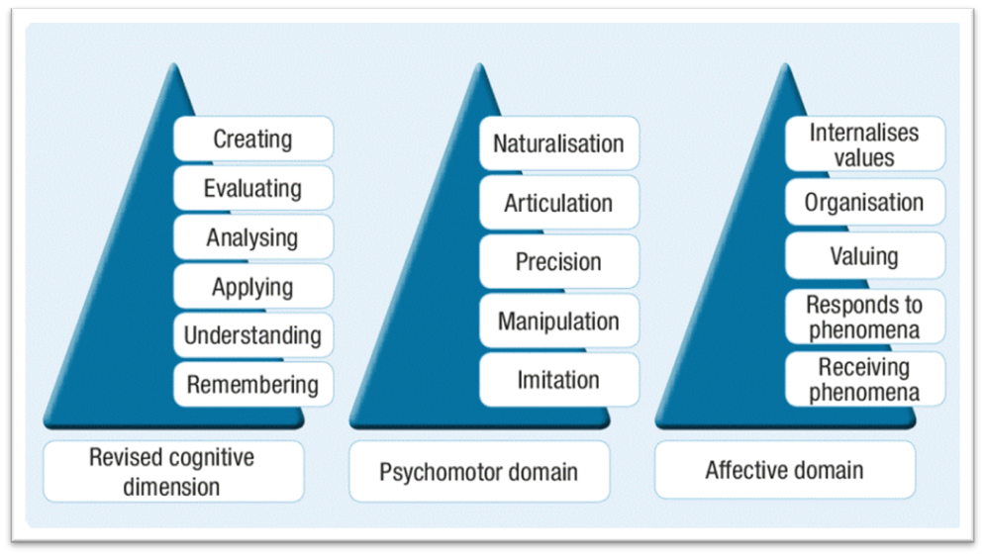
TAXONOMIES
Minds On
Hands On
Affective
Dave, 1974
Krathwohl, Bloom, Masia, 1964

Slide 14
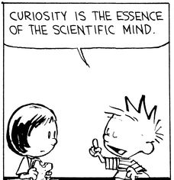
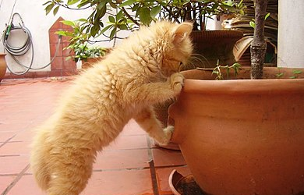
Curiosity - Kíváncsiság
Curiosity is a natural investigative behavior found in humans and many other animal species and is the emotional aspect of living things that leads to exploration, investigation, and learning. The term curiosity can refer to both the behavior and the underlying emotion.
A kíváncsiság az emberekben és sok más állatfajban megtalálható természetes nyomozói viselkedés, és az élőlények érzelmi aspektusa, amely felfedezéshez, nyomozáshoz és tanuláshoz vezet. A kíváncsiság kifejezés egyaránt utalhat a viselkedésre és a mögöttes érzelmekre

Slide 15
Theoretical framework

Slide 16
Theoretical framework

Slide 17
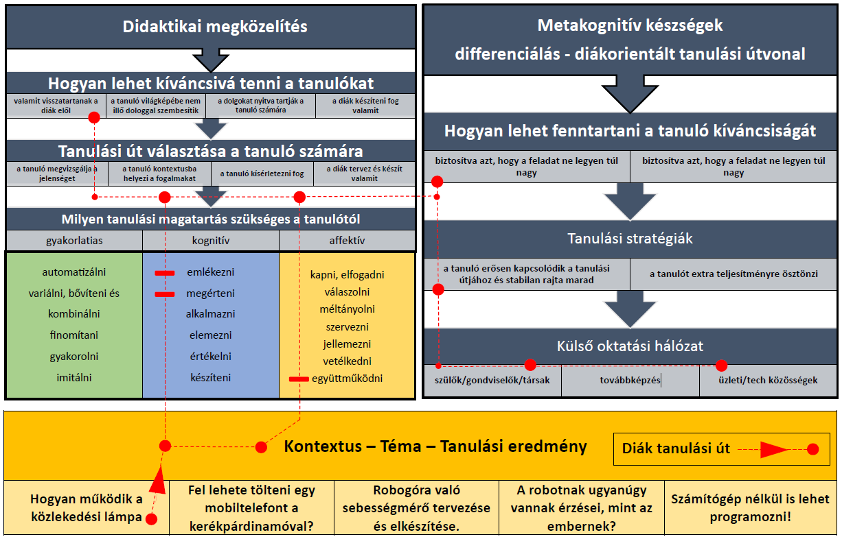

Slide 19
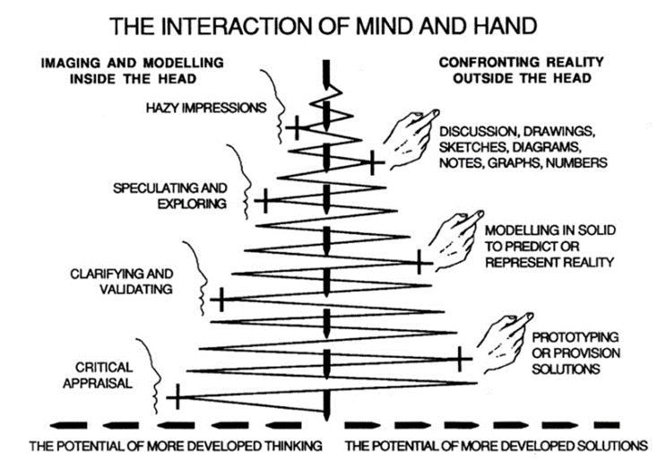
Minds On versus Hands On
Design process for pupils/students

Slide 20
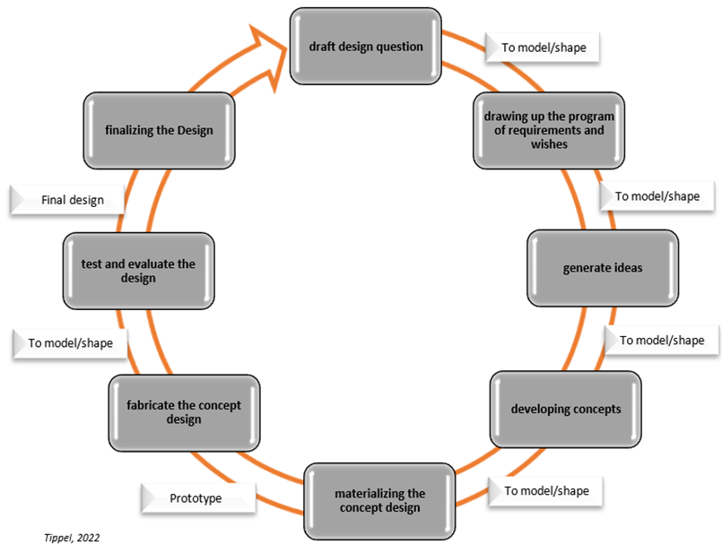
Modelling to Maintain Curiousity
Design circle for pupils/students

Slide 21
Didactical approach - Products
Didactical framework
Fill in instruction for teachers
Didaktikai keret
Teljes utasítások a tanároknak

Slide 22
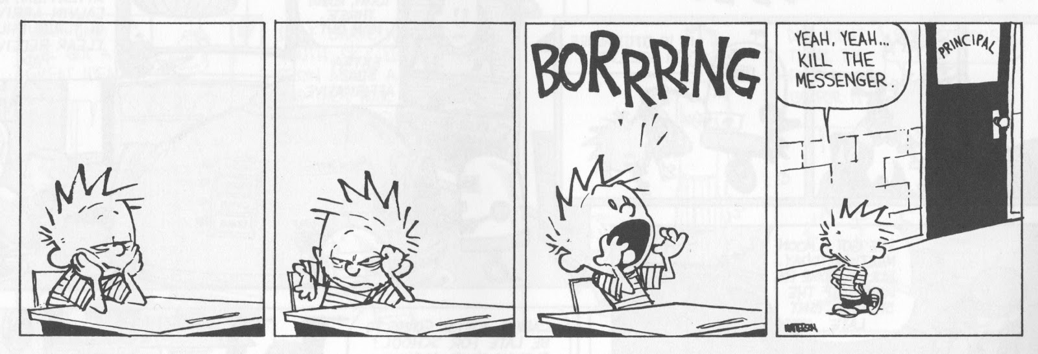
Looking back when walking forward sometimes gives a headache Nézz vissza, de ne felejts el előre tekinteni. Ennek szellemében várjuk a visszajelzéseket.

Slide 23
Resources
Argyris, C. (2002). Double-loop learning, teaching, and research . Academy of Management Learning & Education, 1(2), pp. 206-2018.
Berben, M., & van Teesling, M. (2018). Differentieren is te leren. Amersfoort: CPS.
Deci, E. L., & Ryan, R. M. (2000, januari). Self-Determination Theory and the Facilitation of Intrinsic Motivation, Social Development, and Well-Being. American Psychologist, pp. 68-78.
Dijkstra, P., Bunnik, P., & Krikke, A. (2022). Zelfregulerend leren, effectiever leren met leerstrategieen. Amsterdam: Boom.
Hattie, J. (2014). Leren zichtbaar maken (Visible Learning for Teachers). Rotterdam: Bazalt.
Ingeborg Hansen. (2012). Levenslessen van meester Kanamori. Driebergen: Het Kind.
Kimbell, R., & Stables, K. (2008). Kimbell, R. & Stables, K. (2008). Researching design learning. Londen: Springer. Londen: Springer.
Kirschner, P. (2022, september 23). https://onderzoekonderwijs.net/2015/10/22/21st-century-skills-are-so-20th-century/. Retrieved from https://onderzoekonderwijs.net: https://onderzoekonderwijs.net/2015/10/22/21st-century-skills-are-so-20th-century/
Kirschner, P., & Meelen, M. (2022, september 23). https://3starlearningexperiences.wordpress.com/2016/11/01/21st-century-skills-dont-exist-so-why-do-we-need-them/. Retrieved from https://3starlearningexperiences.wordpress.com: https://3starlearningexperiences.wordpress.com/2016/11/01/21st-century-skills-dont-exist-so-why-do-we-need-them/
Koops, M. (2017). Game Didactiek. Den Haag: Didactica.
Losche, F. (2018). Investigating the Moment when Solutions emerge in Problem Solving. Plymouth: https://pearl.plymouth.ac.uk.
Marzano, R. J. (2007). The Art and Science of Teaching. Alexandria VA: ASCD.
Paul van Tongeren, Karin Pasman-de Roo (red.). (2007). Voorbeeldig Onderwijs. Venlo: Thijmgenootschap.
Ros, A., & Castelijns, J. (2020). Gemotiveerd leren en lesgeven: De kracht van intrinsieke motivatie. Bussum: Coutinho.
Tippel, S. (2014). Hoe ga je dat Ontwerpen? Den Haag: Hogeschool Inholland.
Vorst, R. v. (2007). Nieuwsgierigheid hoe we elke dag worden verleid. Amsterdam: Nieuw Amsterdam.
Winkels, J., & Hoogeveen, P. (2018). het didactische werkvormenboek. Assen: Koninklijke Van Gorcum BV.

